Slide 1
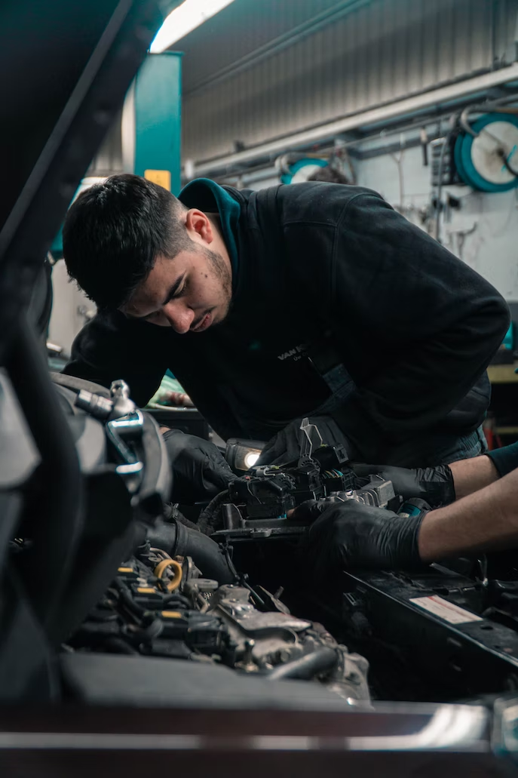
December 14th, 2022
The smartest,
fastest way to hire
Built for scaling an hourly workforce

Slide 2
About us
2017
28,000+
4,000+
Founded
At Workstream, we believe strong communities are built by local businesses and the hourly employees who power them. That’s why we continually invest our time and resources to create technologies that help both thrive, especially in the midst of challenging economic conditions. We’re here to help you hire faster and smarter, so you can focus on supporting your team and serving your customers.
Locations served
Customers
T R U S T E D B Y B U S I N E S S E S Y O U K N O W A N D L O V E
Overview

Slide 3
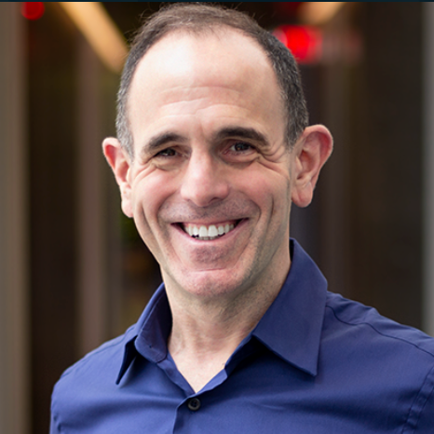
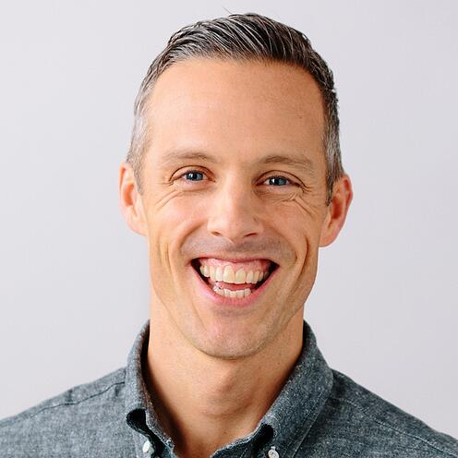
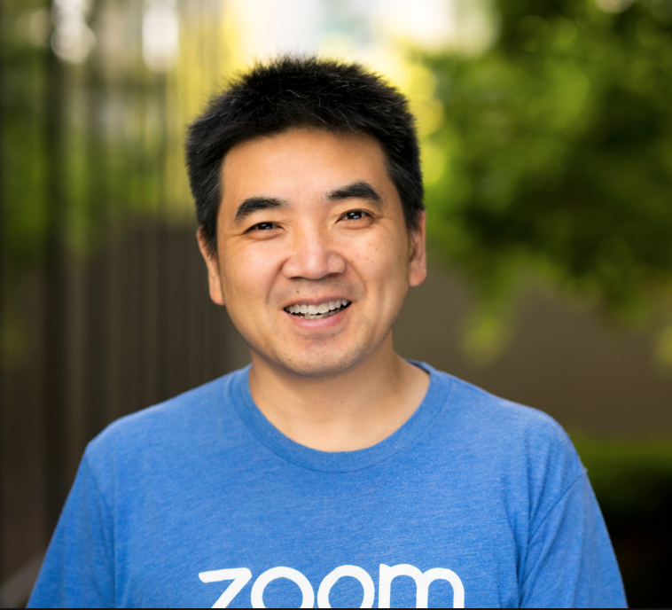
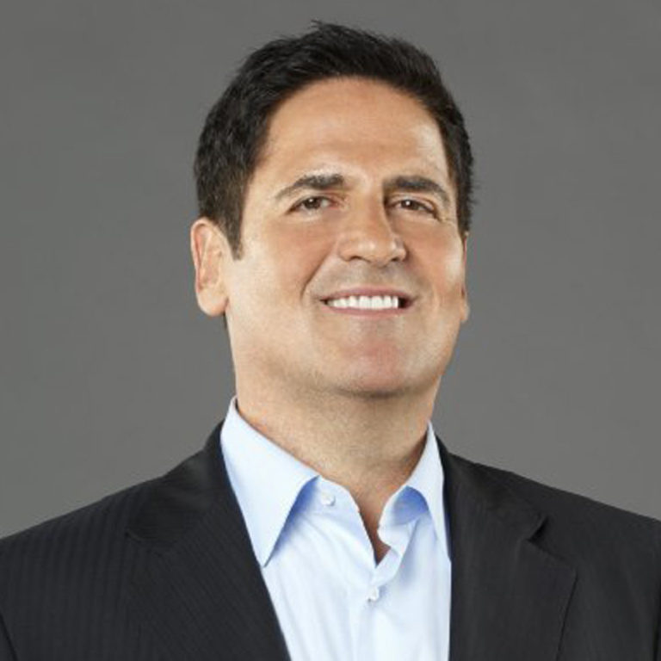
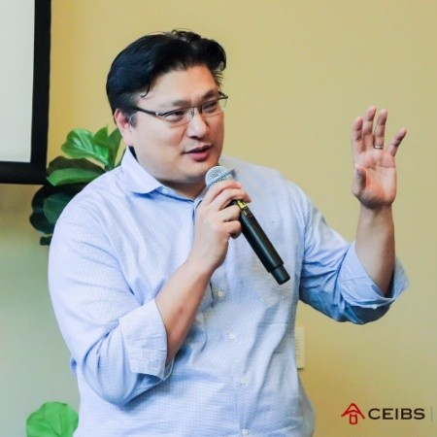
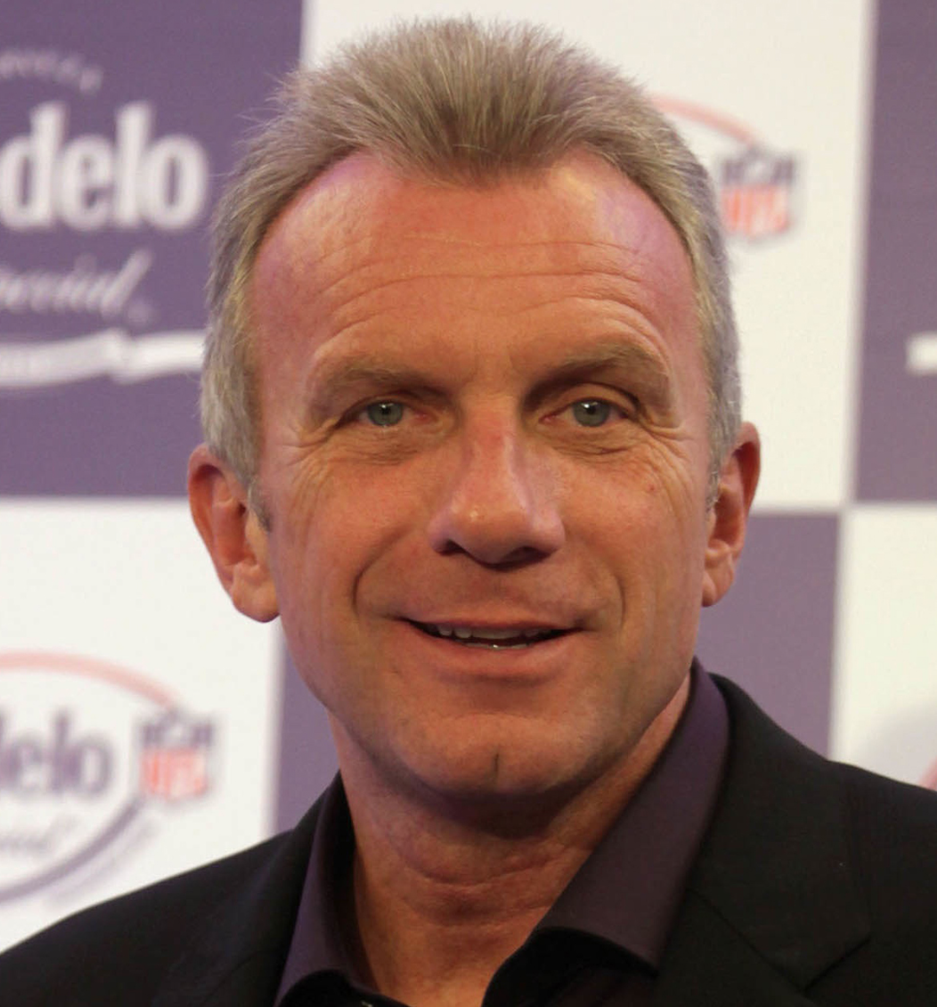
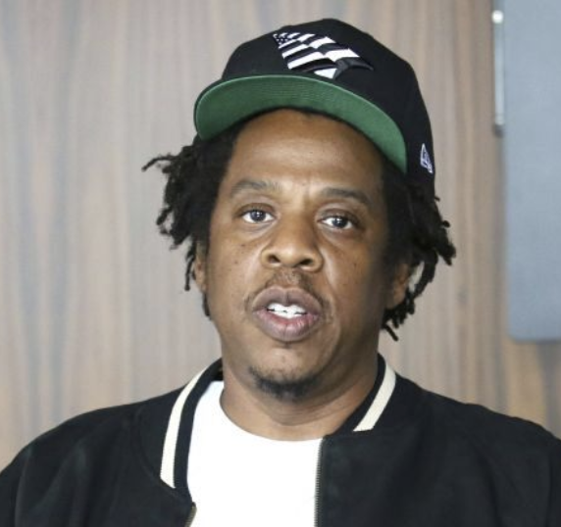
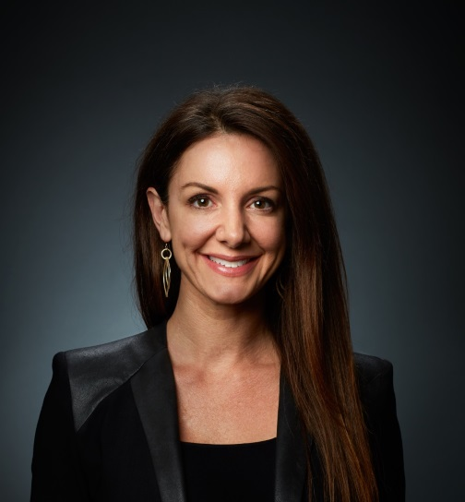
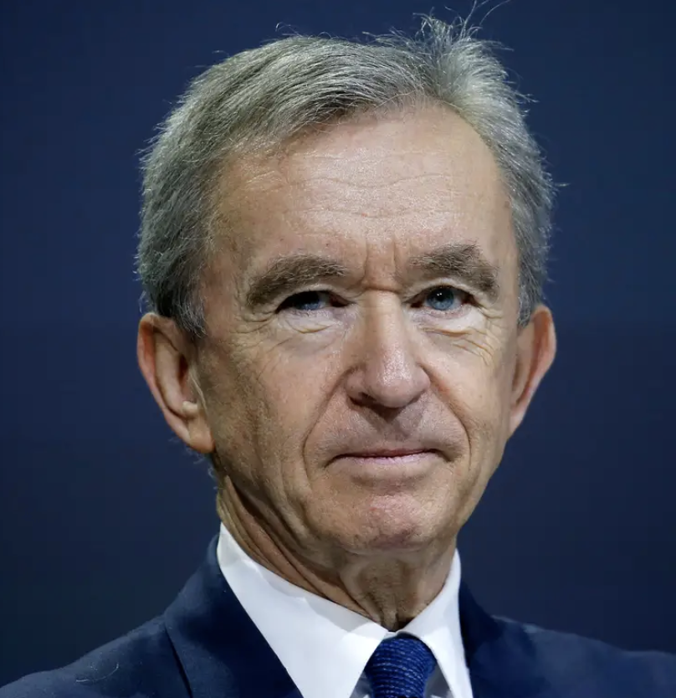
Backed by repeat operators and investors
Keith Rabois
Founders Fund, Former COO, Square
Jay Simons
Former President of Atlassian
Eric Yuan
CEO, Zoom
Tony Xu
CEO, DoorDash
Mark Cuban
Owner, Dallas Mavericks
Hans Tung
Managing Partner
GGV Capital
Joe Montana
Former 49ers QB, GP Liquid 2 VC
Max Levchin
CEO, Affirm, Former CTO, PayPal
Jay Z
Producer, Entrepreneur and Music Executive
Mary Meeker
GP, BOND Capital
Kat Cole
Former COO, Focus Brands
Bernard Arnault
Chairman, LVMH

Slide 4
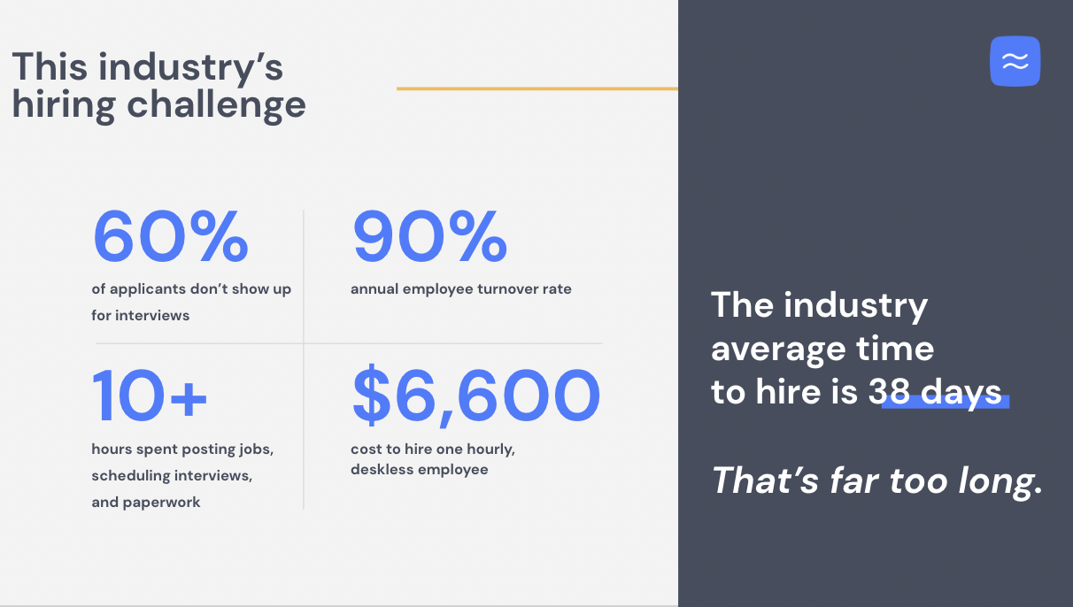

Slide 5
Where Workstream wins

Slide 7
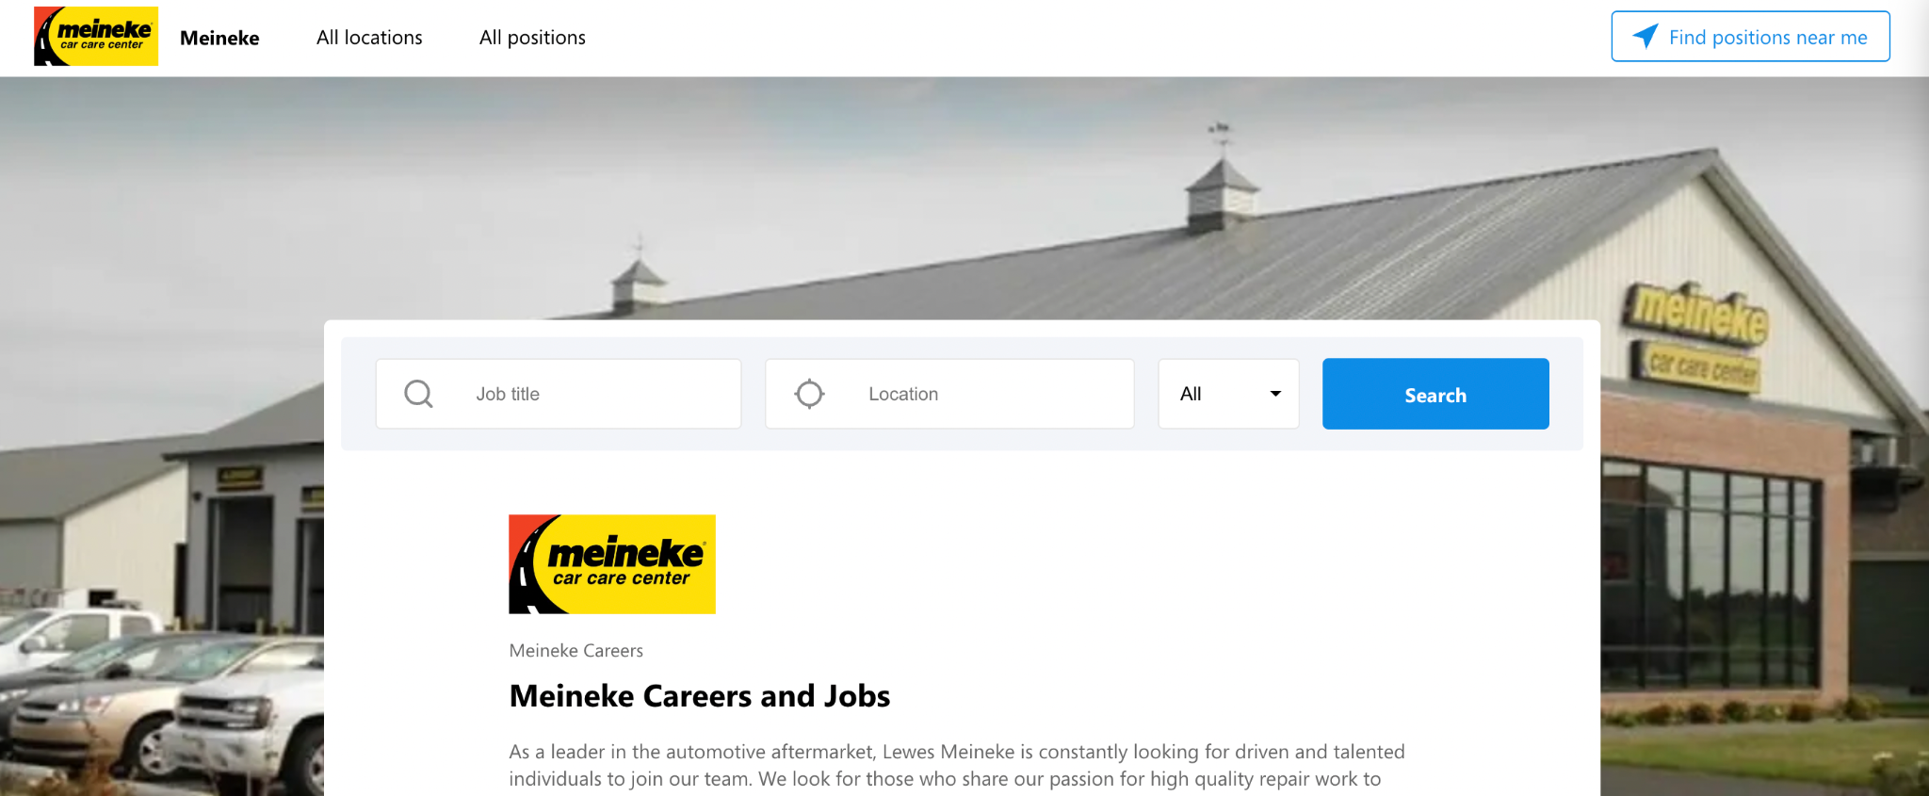
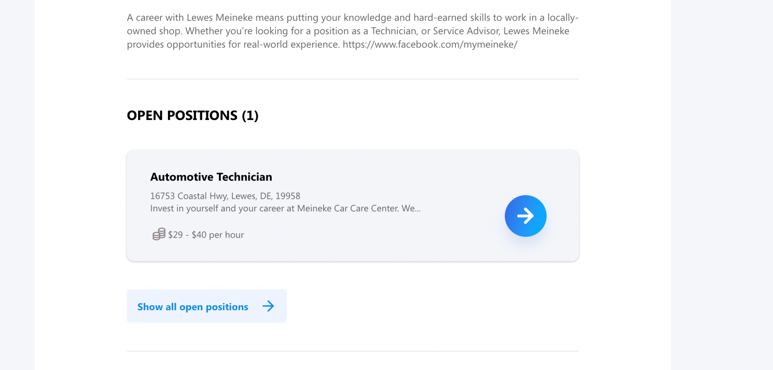

Slide 8
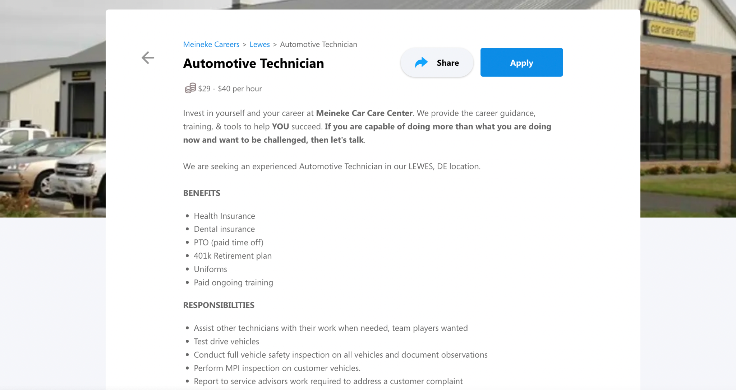

Slide 9
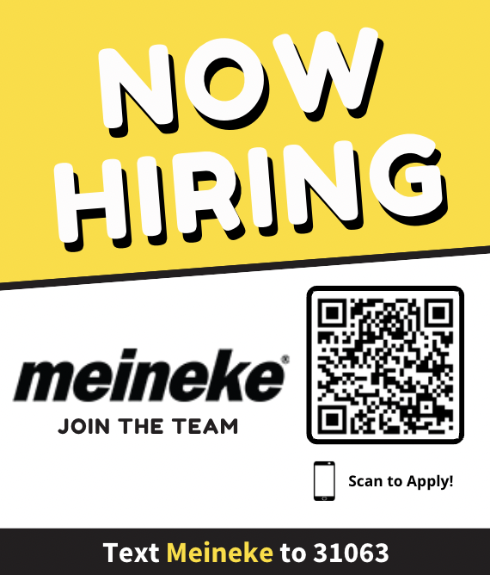
Create custom text-to-apply posters to promote job openings in your stores
E X P E R I E N C E T H E H I R I N G P R O C E S S

Slide 10
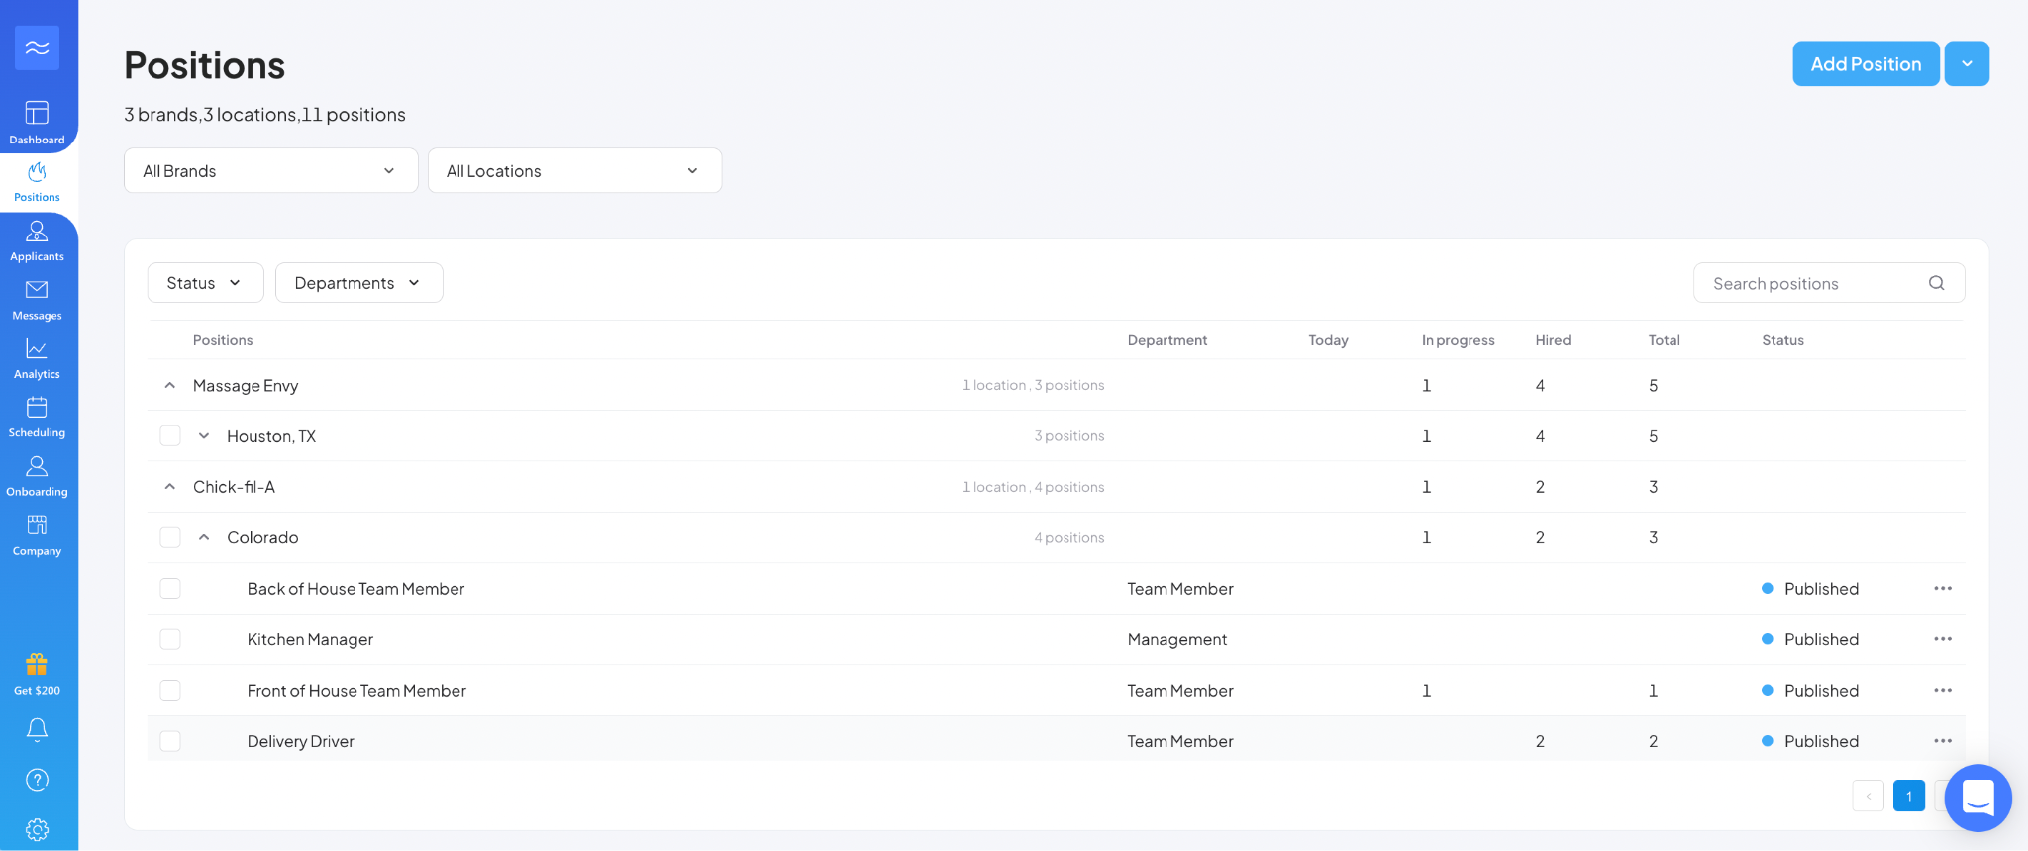
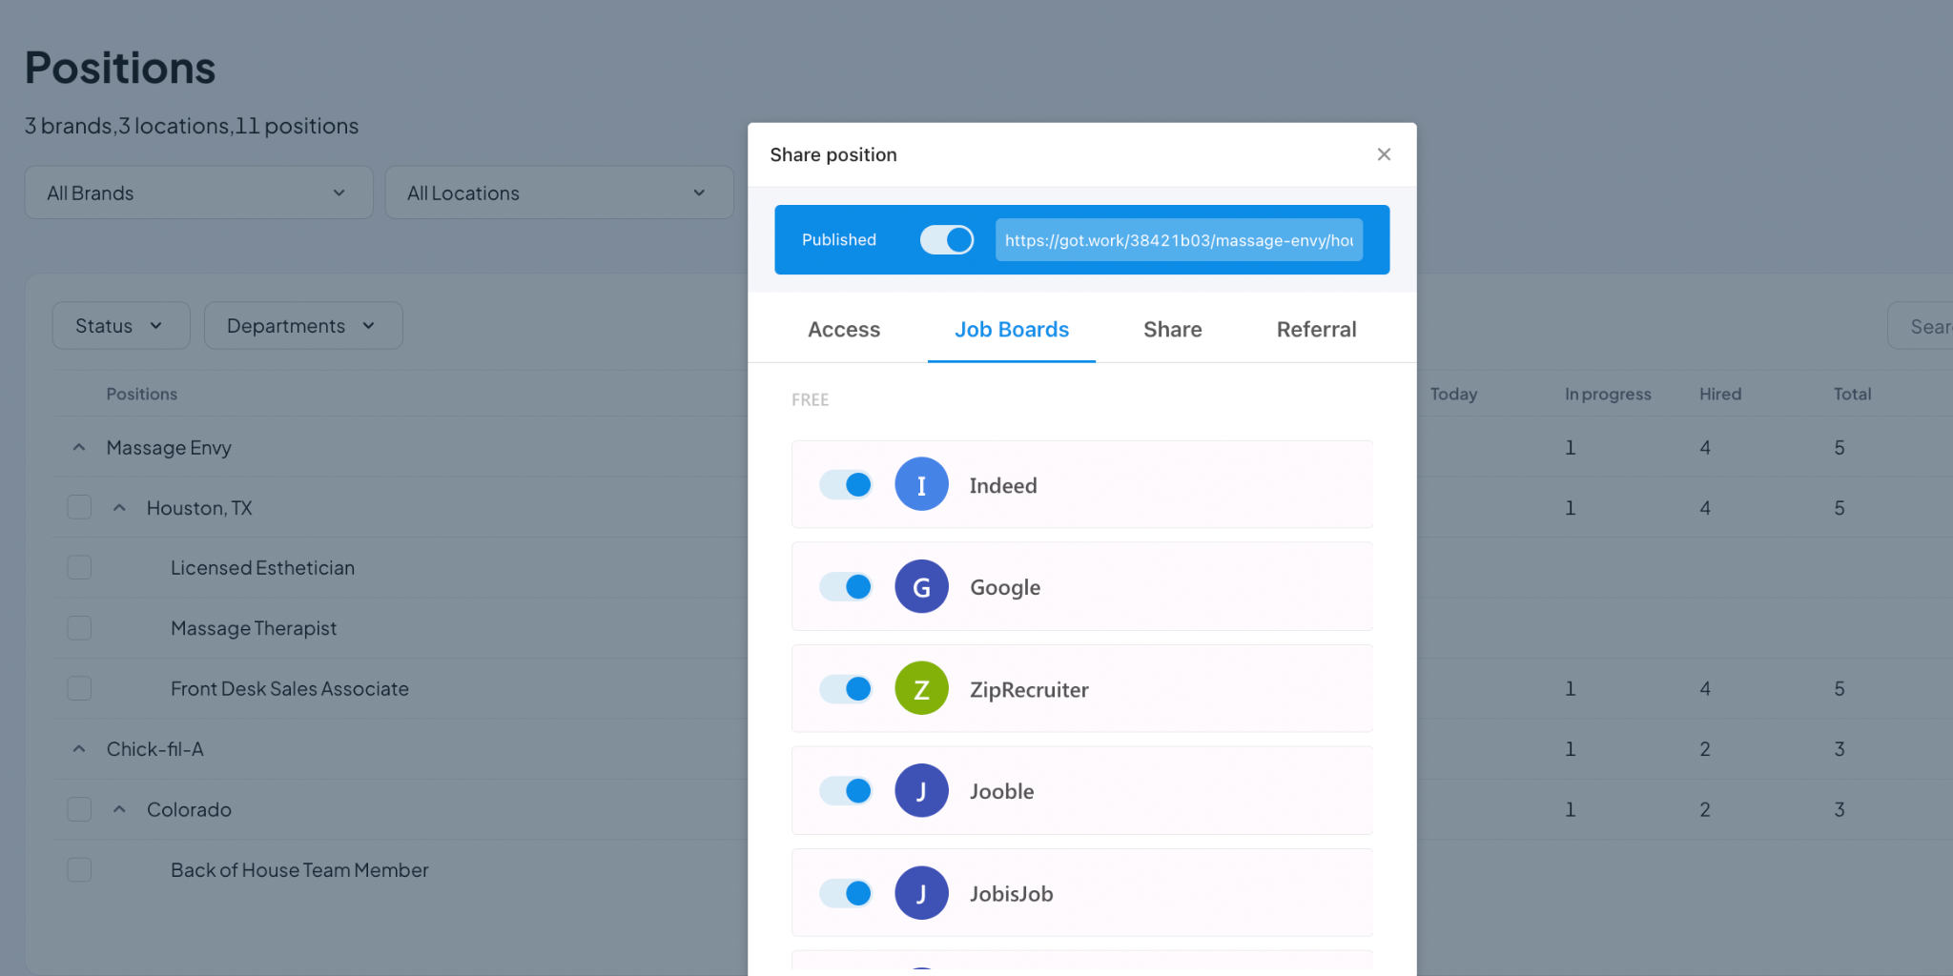
Post to all of the top job boards
with a click of a button

Slide 11
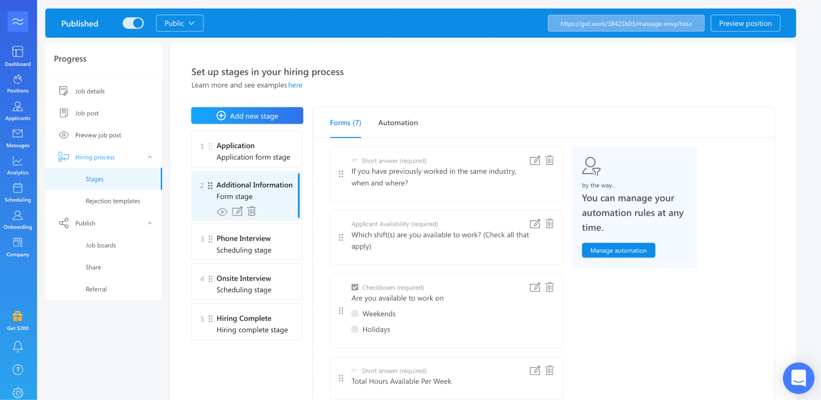
Customizable screening questions..

Slide 12
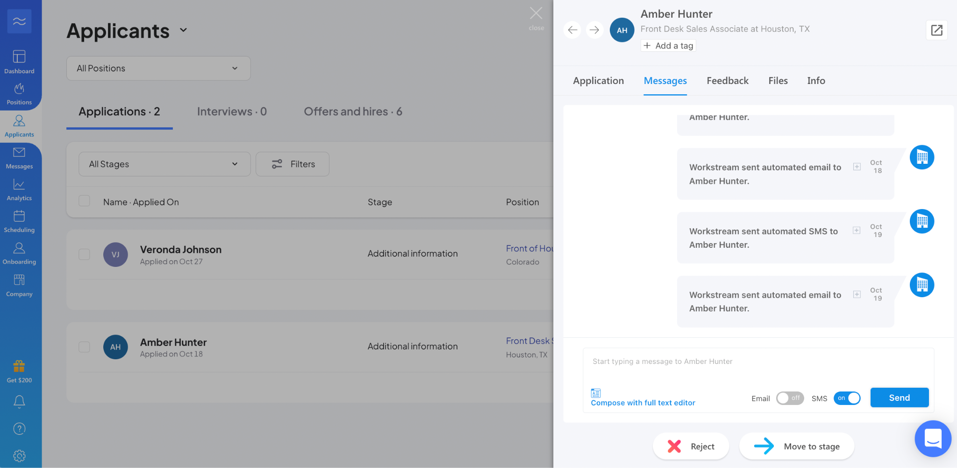
Text the applicant.. Without exposing your personal number

Slide 13
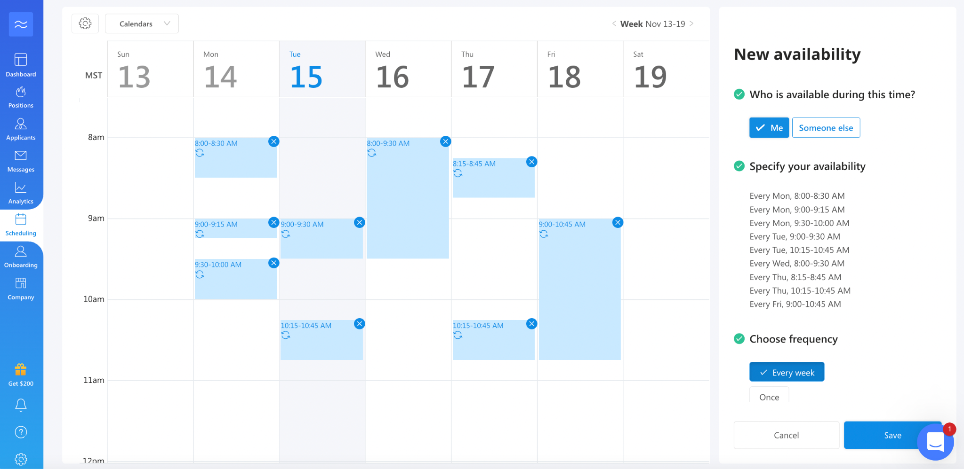
Plug in your calendar availability for applicants to pick from..

Slide 14
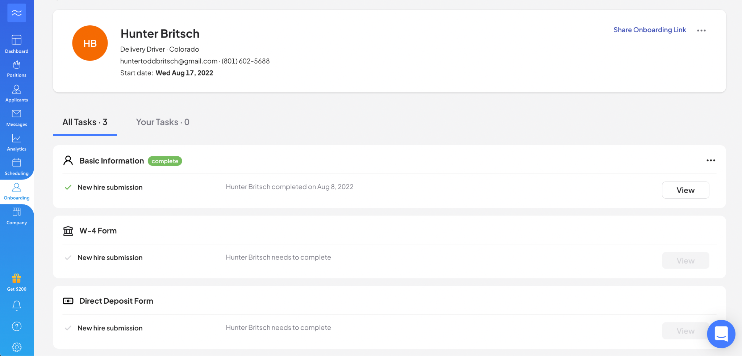
Onboarding made easy

Slide 15
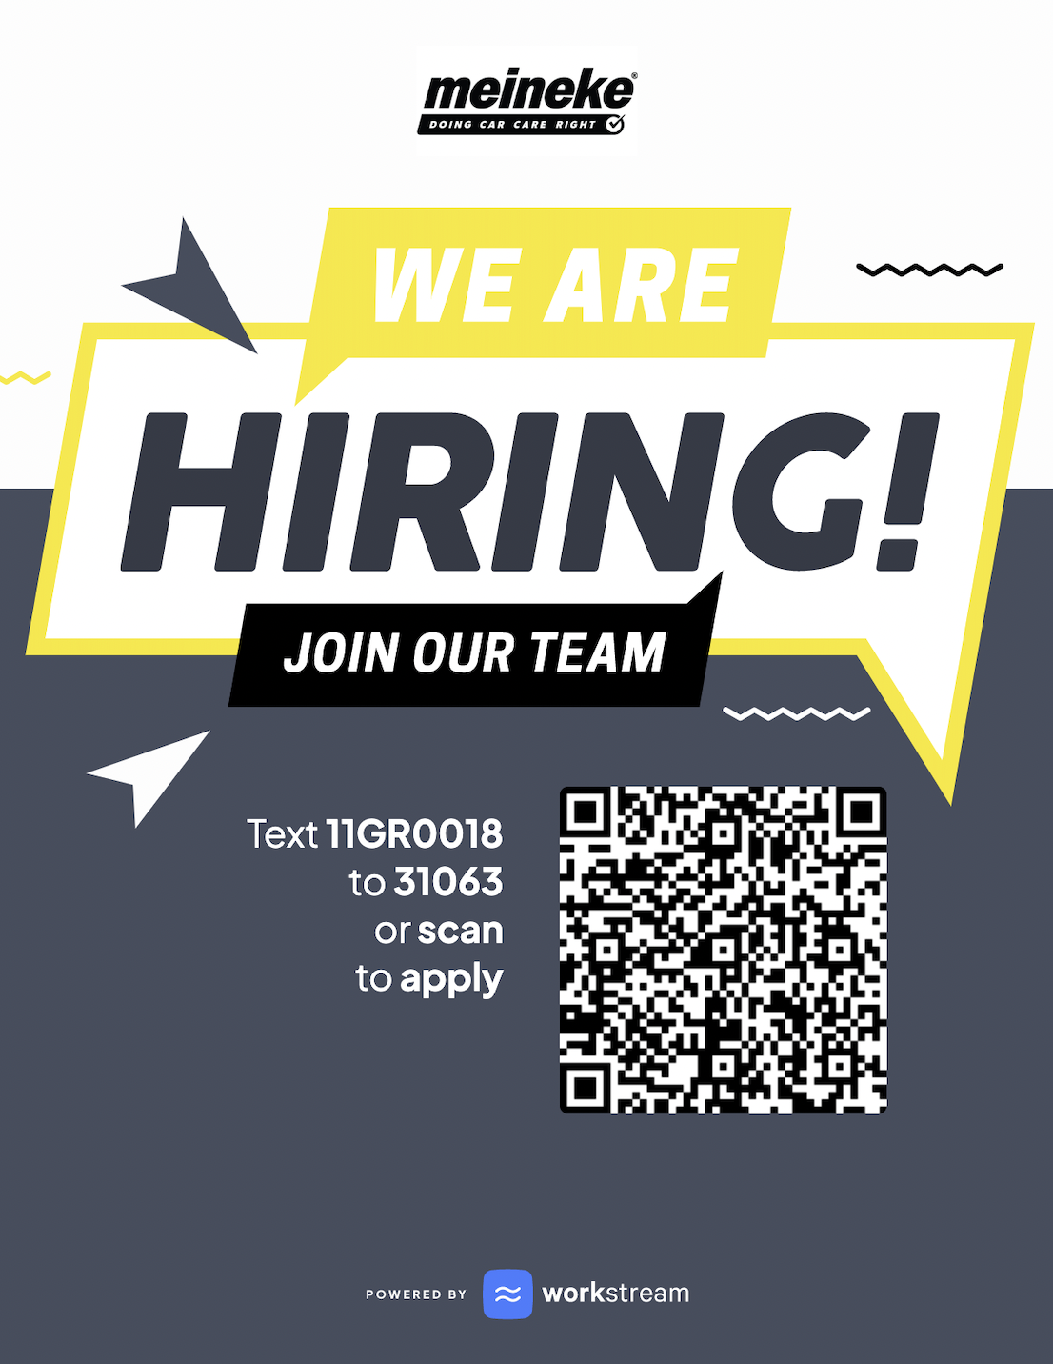
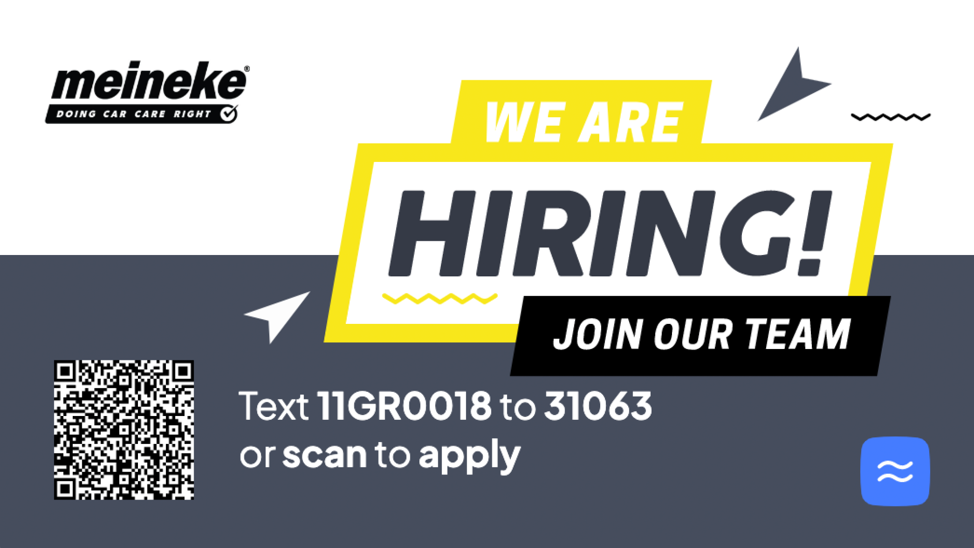
QR Code:
Business cards:
Hiring Posters:

Slide 16
Meineke
at a glance
The Challenge
A shortage of Automotive Technicians in the industry requires Meineke to adapt in order to serve clients more effectively
Manual interview scheduling and paperwork, as well as not having 2 way texts means applicants aren’t being responded to in a timely manner
Managers are spending 6-12 hours away from the floor to reach out to applicants
The Goal
Increasing net of applicants by utilizing creative ways to “fish in the pond”
Finding qualified candidates while creating a highly engaged workforce and company
Streamlining processes and giving operators time back in their day
Working with a true HR partner that is dedicated to helping their business grow
The industry average time to hire is 38 days
That’s far too long

Slide 17
Thank you
Hunter Britsch
Hunter@workstream.is
801-602-5688

