Slide 1
Source4 News
Acquired a large Wide-Format Production Company
  Signage/Banners/Packaging
  Strong Existing Client Portfolio
Multi-Million Dollar expansion finished at our Lynchburg, VA fulfillment center
  Added 43,000 sq ft + 30 new jobs
  Total Lynchburg space now 161,000 sq ft

Slide 2
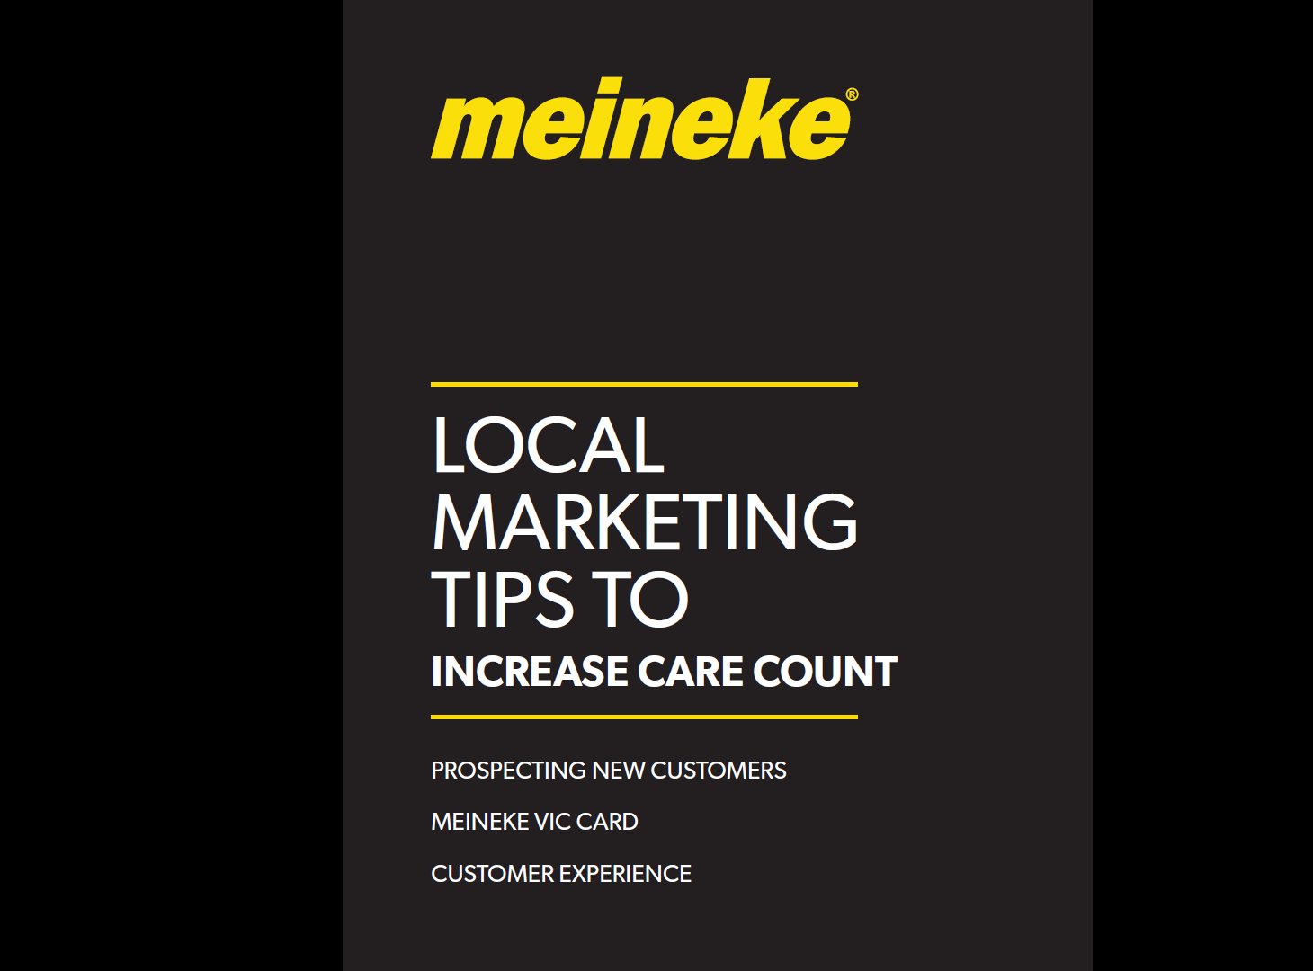

Slide 3
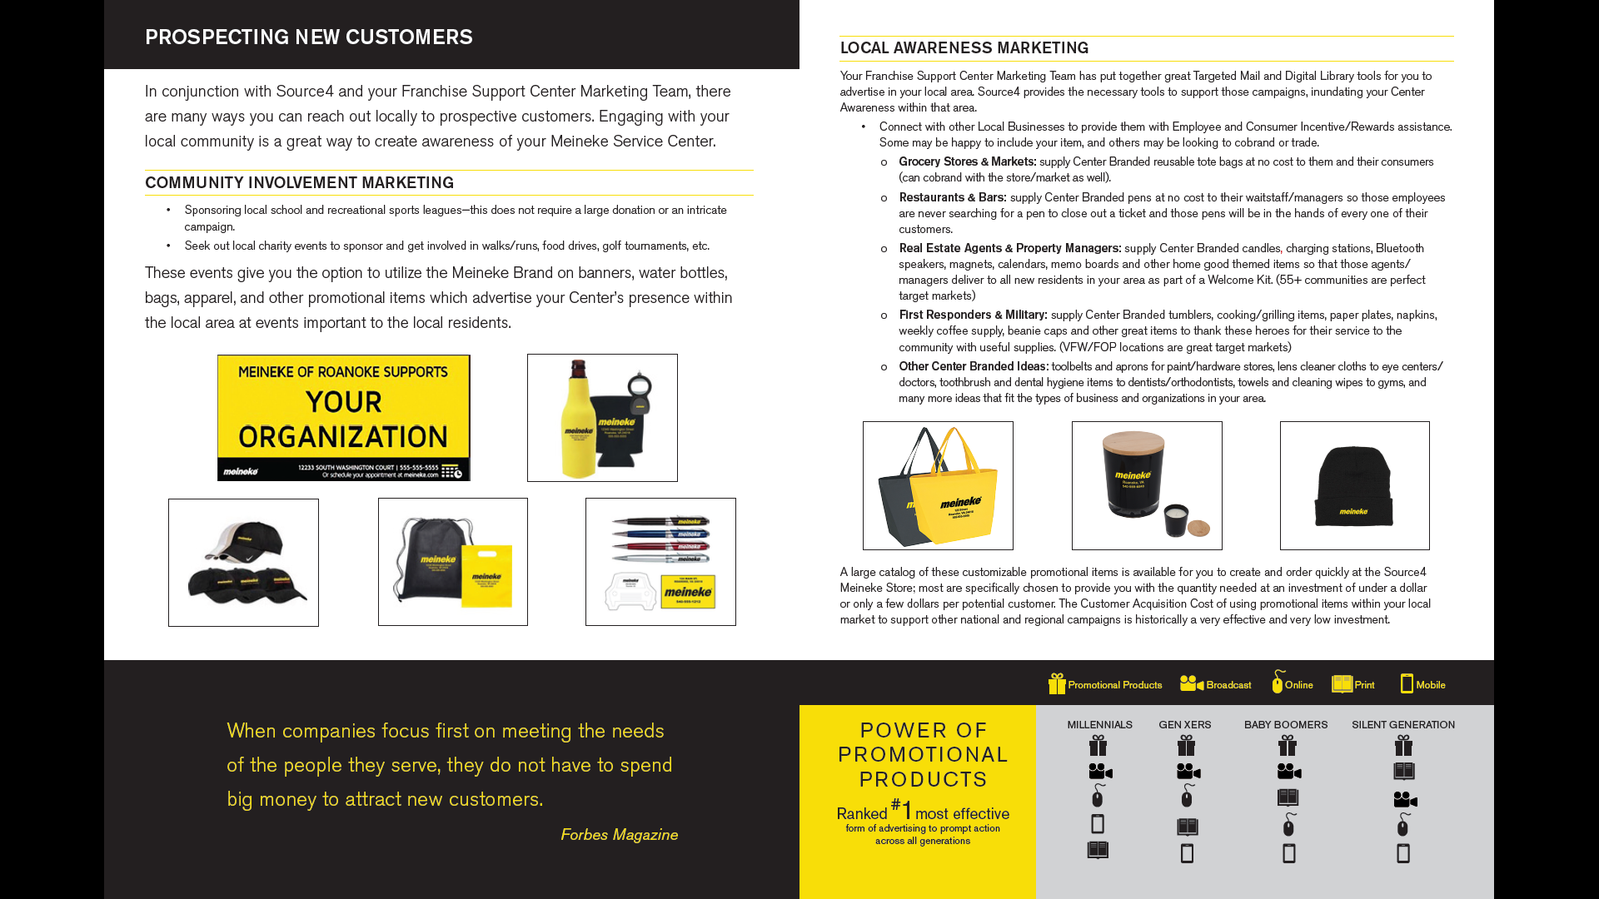

Slide 4
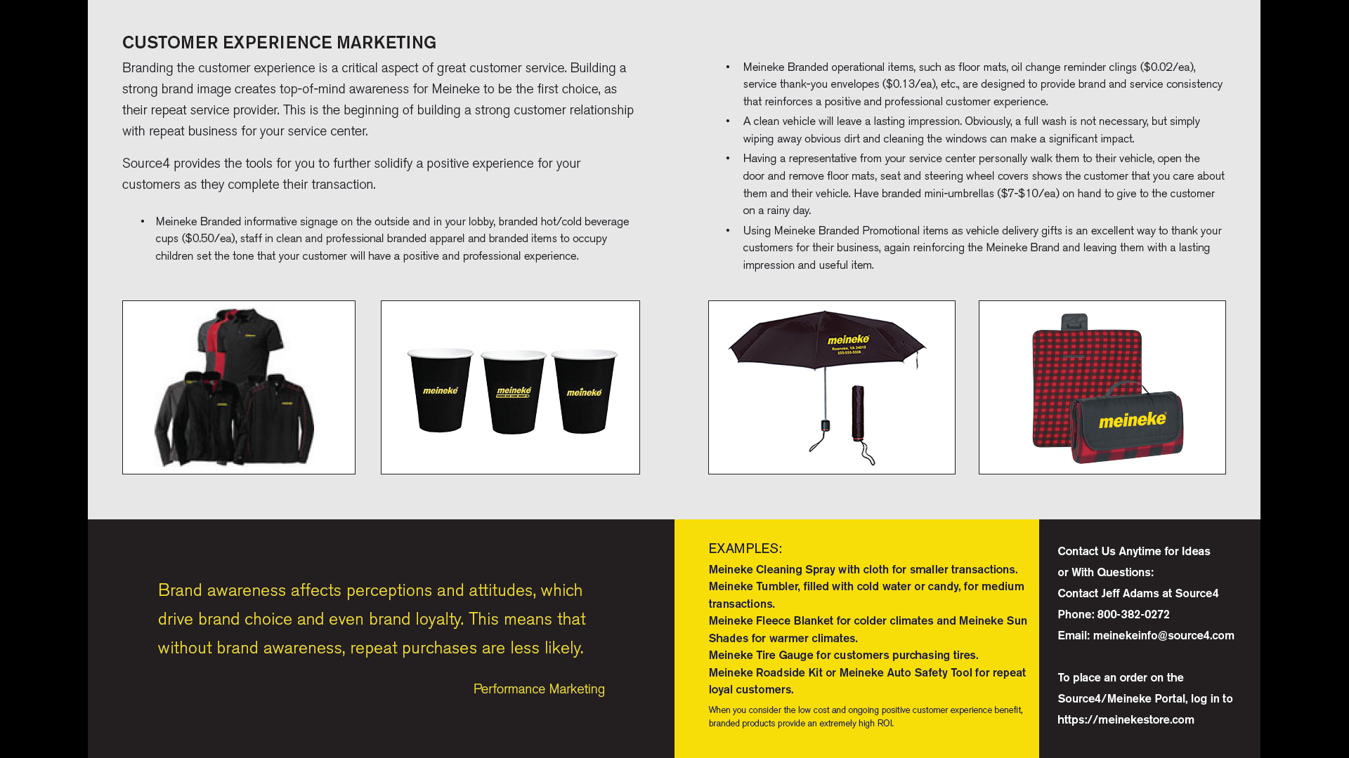

Slide 5
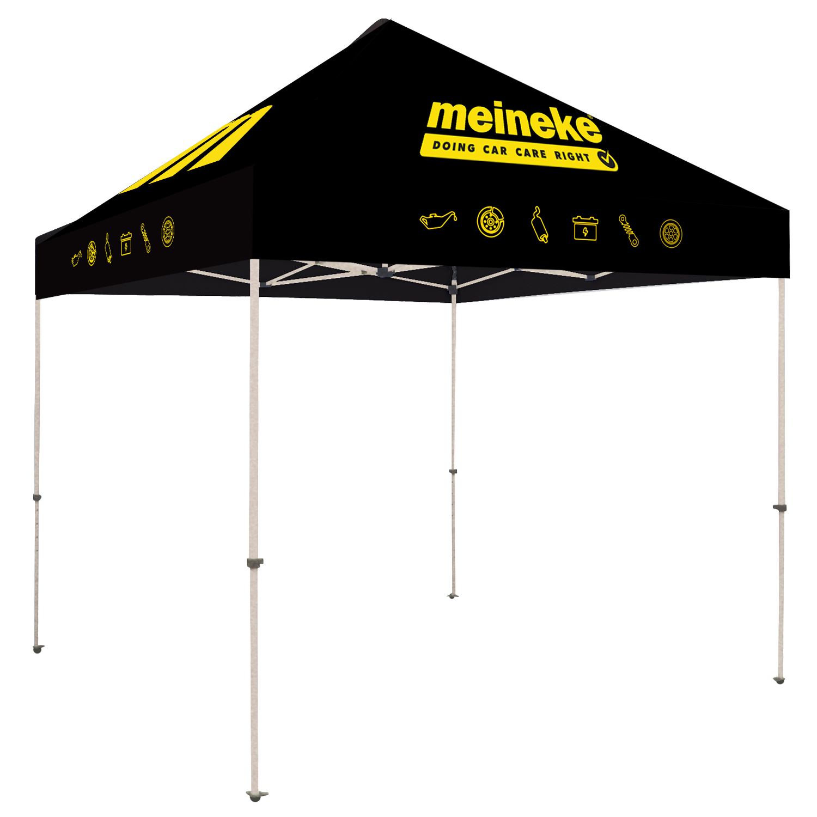
Meineke EzUp Tent Kit
Worked with Corp and Dealers to Design and Produce 10’x10’ Meineke EzUp Tents
  Great for Community Events and Center Functions
  Corp committed to an inventory to reduce cost for the Dealer
  Imprinted on all 4 Peaks and all 4 valances
  Kit includes soft carry case with wheels + stake kit
Jim Sloan Tulsa, OK case study to detail the benefits of Event Involvement and the right Marketing Tools to maximize engagement
Tents are now available on the site
  $1,275.00/ea (INCLUDES SHIPPING)
    $1,461 MSRP

Slide 6
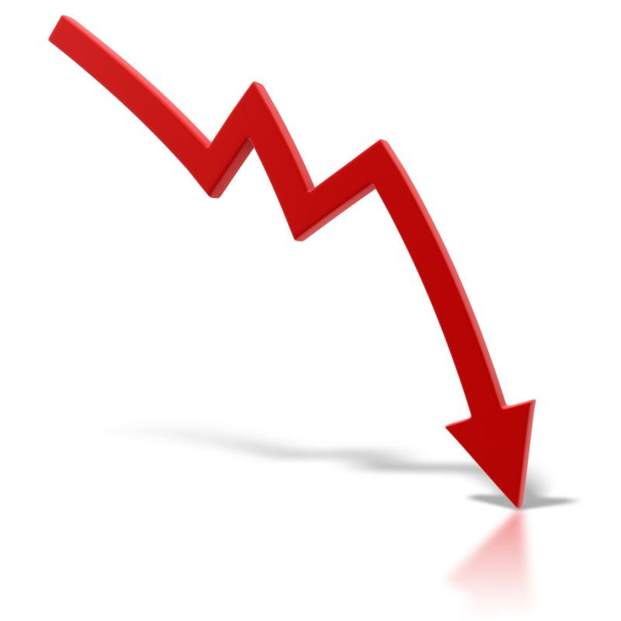
Meineke Revenue Decline
2017: $331,628
2018: $279,014
2019: $264,693
2020: $240.632
2021: $208,468
2022: $168,428 (est)
2009: $553,321 (Invoices: $246,718)

