Slide 1
Driving Retention and Profitability
V03162021
RelaDyne reserves the right to change, amend, modify, suspend, continue or terminate all or any part of the programs outlined in this proposal at any time.
Notes:
Intros

Slide 2
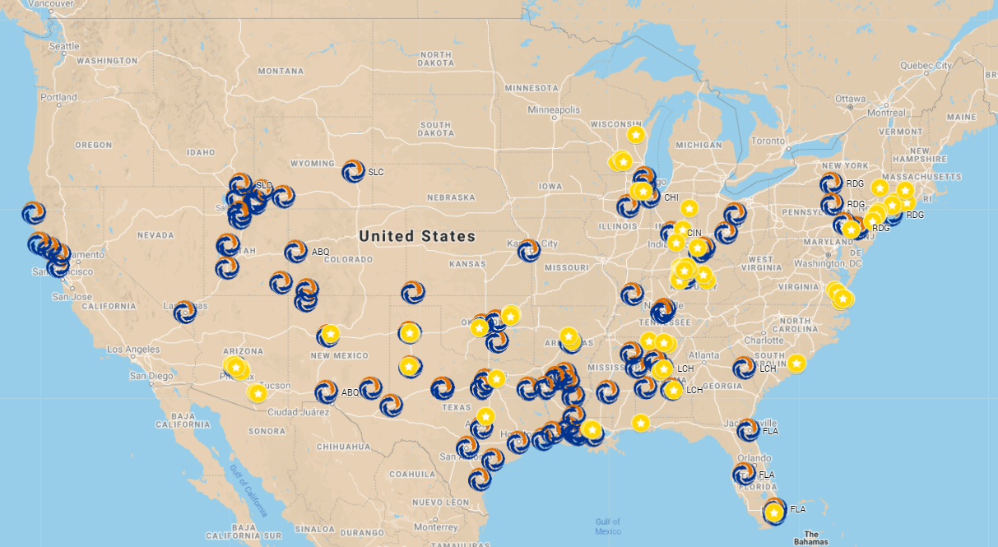
Program Participation & Growth
135 Locations

Slide 3
Testimonials
“I’m very happy with the quality of the DuraMAX brand and the service provided by Circle Lubricants.”
“…have seen a significant increase to the bottom line as a result of working with Reladyne. Now I purchase from the same company who delivers the product as opposed to buying from one and having another deliver. DuraMAXx is a great asset in my product mix and would recommend to all centers.”
Lino Rodriquez
Owner Meineke #1320
Newark, NJ
Roger Cross
TX
“…We have found their products to be of excellent quality and the pricing is better than our previous supplier. Based on our experience with RelaDyne, I would highly recommend using this program.”
Ross Hiltz
CT Zuckerman / Hiltz Group
CT / NY / NJ

Slide 4
Why RelaDyne & DuraMAX?
Drive RETENTION and PROFITABILITY
National brand and distribution with size, scale and resources to support the entire Meineke network
Dedicated account manager with team of 170+ sales reps
Own the “last mile” (most markets)
Standardized & indexed pricing (East / West)
Consumer rewards programs that drive customer retention and profitability
Annual volume incentives + Co-Op & Loyalty Trip rebates, point of sale support and equipment program

Slide 5
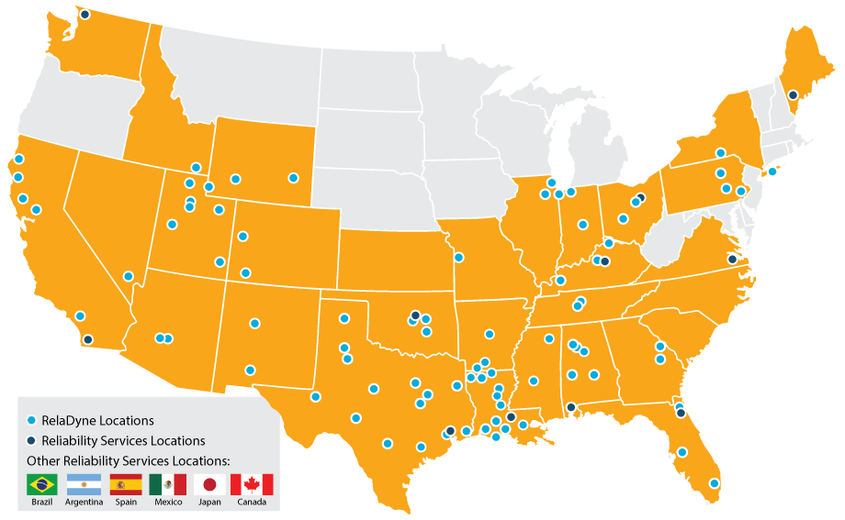
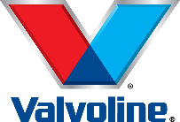
RelaDyne Distribution Centers
70M+
LUBRICANT
GALLONS
Largest U.S. Distributor for the following brands:
Note: Not all brands are available in all RelaDyne locations. Major oil brands are limited to contracted markets.

Slide 6
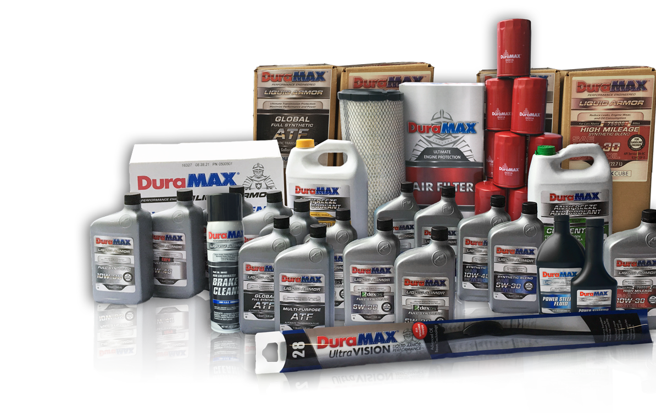
WHY CHOOSE DURAMAX
Drive RETENTION and PROFITABILITY
Complete Line of Automotive Products
High quality full synthetic and synthetic blend motor oils
Fully-licensed GF-6, API SP, SN Plus, and GM dexos1™ Gen 2 products
Antifreeze and coolants
Wiper blades
Air, cabin air, oil, and fuel filters
Automotive ancillary products
Marketing Support to Retain and Grow Your Business
DuraMAX DOLLAR$ Program with Text & Online Redemption
Liquid Armor Engine Warranty
Online Presence with the Installer Locator Map
Enhance retention and profitability for you!

Slide 7
MOTOR OIL
WASHER FLUID
WINDSHIELD
OTHER
Synthetic Blend
High Mileage
Full Synthetic
Full Synthetic dexos1™ Gen 2
-20° Washer Fluid
0° Washer Fluid
32° Washer Fluid
ClearVISION Wiper Blades
UltraVISION+ Wiper Blades
Glass Cleaner
Penetrating Lubricant
Carb Cleaner
FILTERS
Power Steering Fluid
Oil Filter
Air Filter
Cabin Air Filter
Fuel Filter
Fuel Injector Cleaner
ATF FLUIDS
BRAKES
ANTIFREEZE
GEAR OILS
Global ATF
Dexron® VI ATF
D/M ATF
CVT Fluid
Type F ATF
Antifreeze (Green)
AMAM Extended Life Antifreeze
75w90 Syn Gear Oil
80w90 Gear Oil
75w140 Gear Oil
DOT 3 Brake Fluid
DOT 4 Brake Fluid
High VOC Brake Cleaner
Low VOC Brake Cleaner
Some products may not be available in all areas.

Slide 8
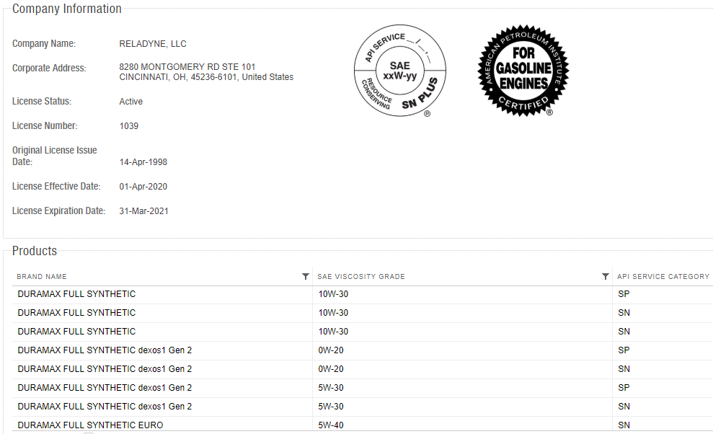
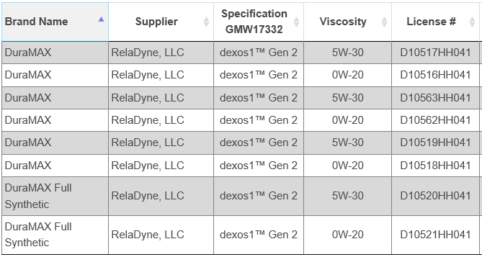
DURAMAX QUALITY OF PRODUCTS
API Licensed
GM dexos1™ Gen 2 Licensed
https://engineoil.api.org/Directory/EolcsSearch
https://www.gmdexos.com/brands/dexos1/index.html

Slide 9
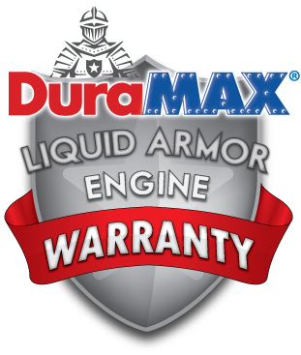
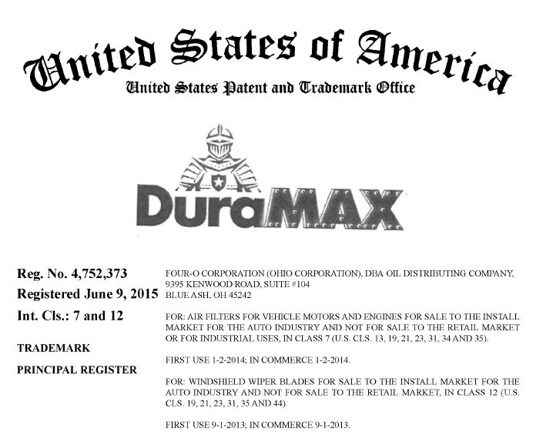
DURAMAX QUALITY OF PRODUCTS
Owned by RelaDyne
Backed by 10-Year, Up to 300k-Mile* Warranty
*The DuraMAX® Liquid Armor Engine Warranty covers 300,000 miles for DuraMAX oils. See www.duramaxwarranty.com for details/terms and conditions.
Part of PQIA in Support of Lubricant Quality and Integrity Assurance

Slide 10
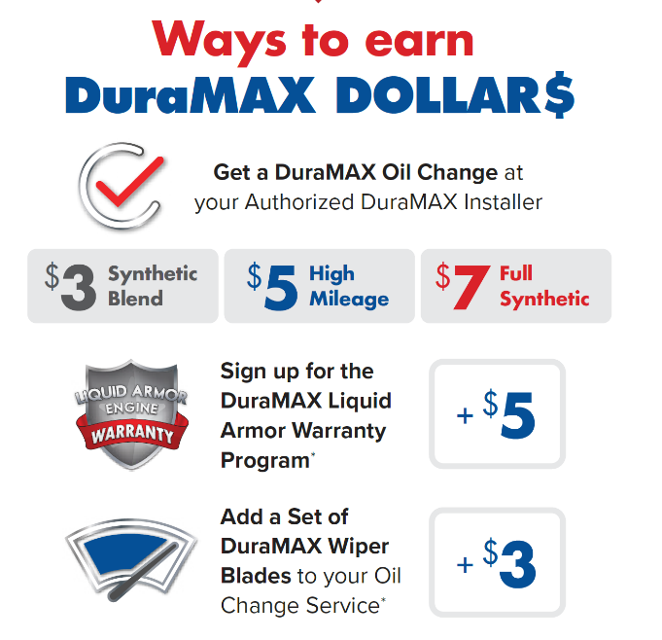
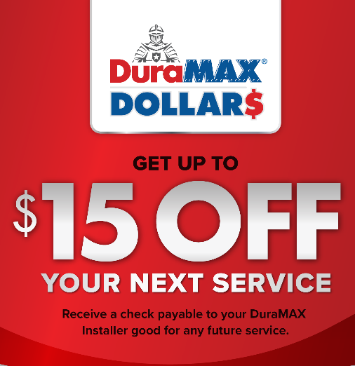
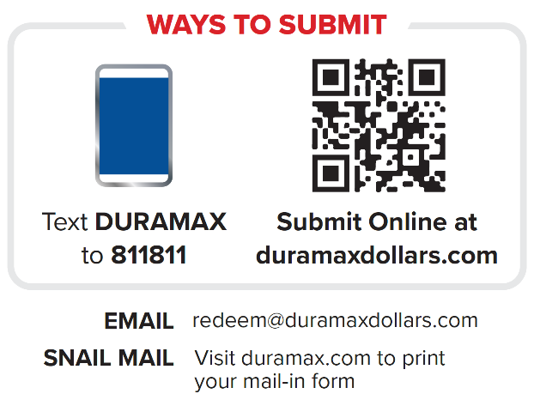
DuraMAX DOLLAR$ PROGRAM
www.DuraMAXDollars.com
Offering your customers up to $15 off their next Vehicle Service, with a DuraMAX DOLLAR$ check, made payable to you, the Authorized DuraMAX Installer
Increase your Retention, Frequency, and Profitability
Utilize ongoing DuraMAX DOLLAR$ Program as a retail profit enhancer
Watch Program Video
Notes:
Mention SNIPP- text submittal option as well as analytics

Slide 11
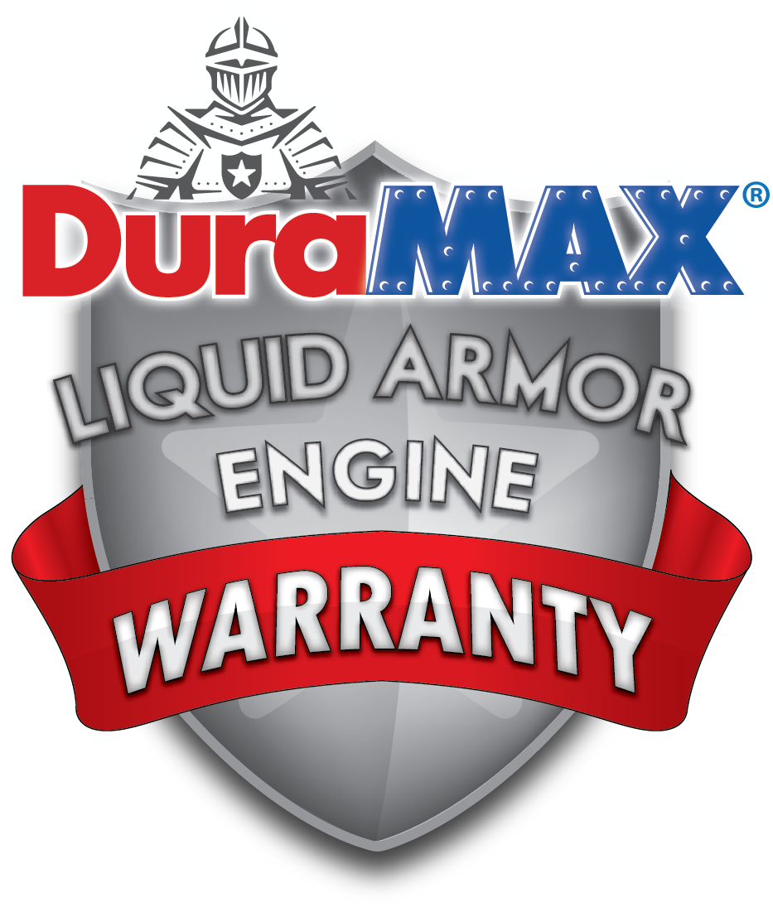
ENGINE WARRANTY PROGRAM
Your customers can receive a $5 DuraMAX DOLLAR$ Check just for enrolling
www.DuraMAXWarranty.com
When your customers use premium DuraMAX Motor Oil and have their oil changed as recommended by the Original Equipment Manufacturer, they will receive a FREE 10-Year/Up to 300,000-Mile* Limited Engine Protection Plan that is completely transferrable.
(*See www.duramaxwarranty.com for details/terms and conditions.)
As a DuraMAX Authorized Warranty Installer, you’ll receive the following benefits:
Increased customer retention and loyalty
Increased profitability
Online features and capabilities:
Consumers will receive a Service Reminder every 120 days (3 times a year) starting on the day the vehicle was enrolled in the Warranty.
You, as the Installer, receive 2 Email Marketing Campaigns per Year to send to Warranty enrollees where you can offer service coupons, special deals, or announcements specific to your business.
Additional email marketing campaigns can be purchased for $50 plus $0.05 per email.
(See next page for Service Reminder and Email Campaign examples)
Notes:
LOCKED

Slide 12
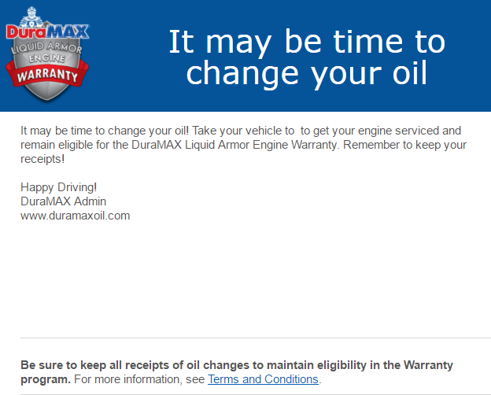
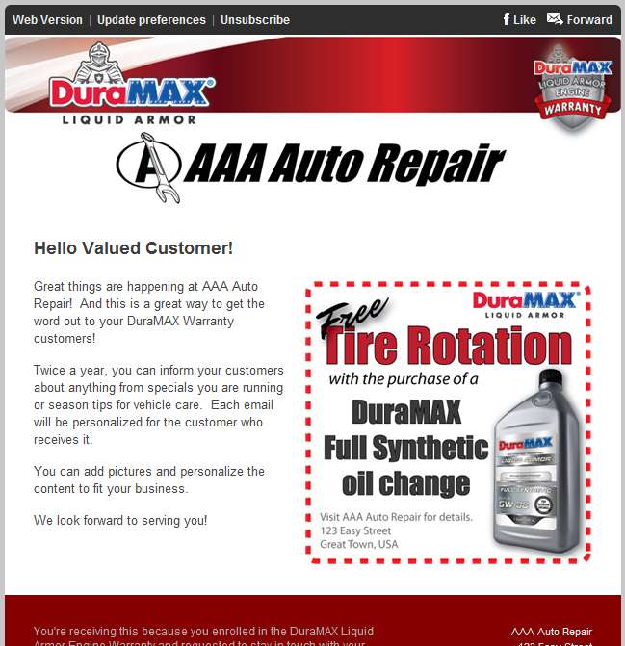
ENGINE WARRANTY PROGRAM
Online Capabilities included in your DuraMAX Authorized Warranty Installer Program
Example 120-Day Service Reminder
Example Email Marketing Campaign
Customized with
your logo and name
Customer Name
goes here
Your Company Name Here!
123 Main St USA
888-123-4567
Include any
promotion you have
Notes:
LOCKED

Slide 13
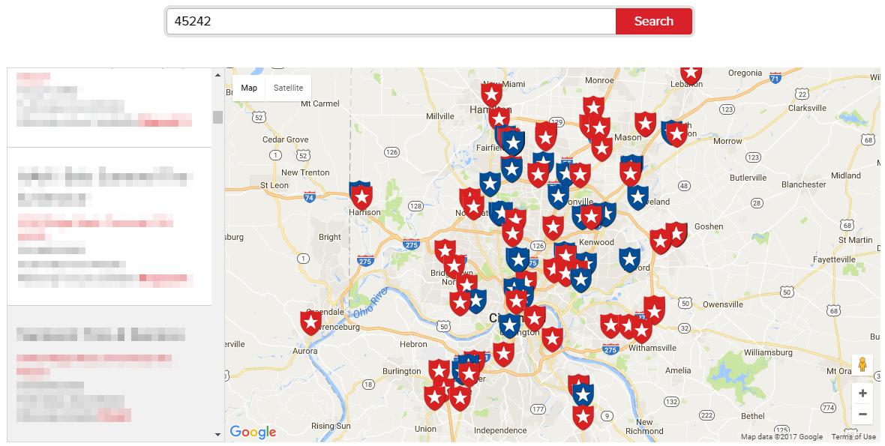
INSTALLER LOCATOR at www.DuraMAX.com
Now, your consumers can learn about DuraMAX products, enroll in the DuraMAX Warranty Program, submit for DuraMAX DOLLAR$, and contact you for service appointments – all from one mobile-friendly location.

Slide 14
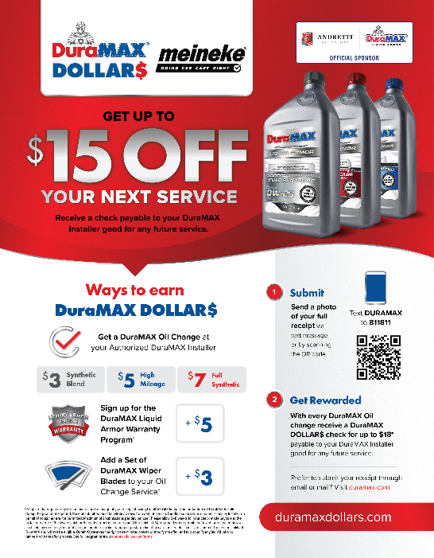
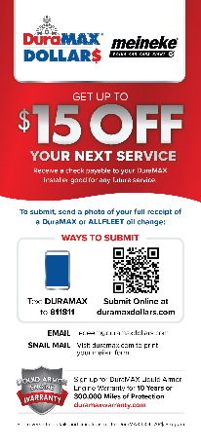
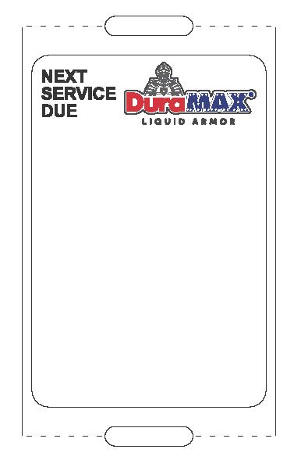
DURAMAX POS ITEMS INCLUDED
Program Flyer
Promo Tear Pads
Floor Mats
Static Cling Stickers
Godex
Zebra

Slide 15
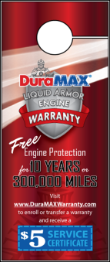
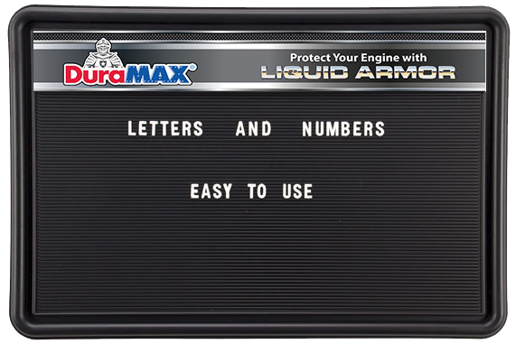
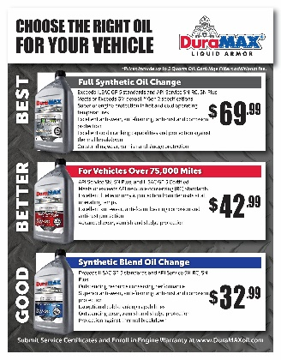
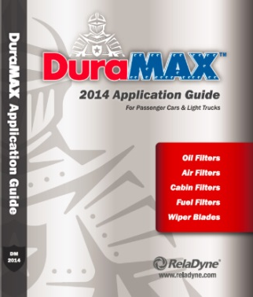
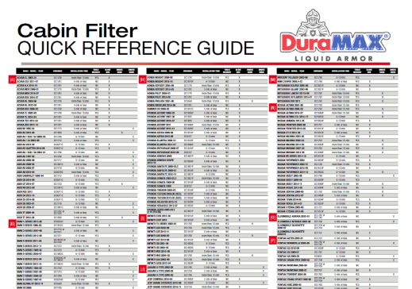
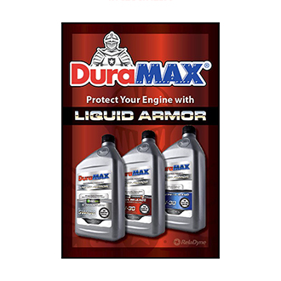
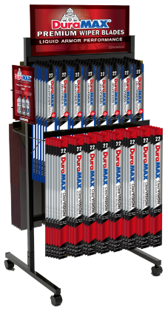
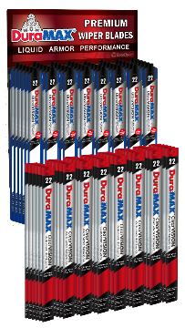
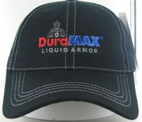
ADDITIONAL POS AVAILABLE
Static Clings Printers
Mirror Dangler
Header Card (Customizable Size)
Customizable Menu Board
Customized Menu Card
Filter & Wiper Blade Application Guide
Customizable Bay Banners
Shop Installation Guide Poster
Poster & Static Clings
2-Sided Floor
Rack
16-Prong Wall Rack
Waiting Room Poster
Counter Mat & Inserts
Apparel

Slide 16
PROGRAM ELEMENTS
2 Price schedules – EAST & WEST ($.45/gal higher)
Pricing is indexed & reviewed quarterly
Pricing is uniform across all locations (subject to note above)
Equipment loan options (4-Year amortization)
$1 per annual gallon (+$.30 / gal.)
$2 per annual gallon (+$.60 / gal.)
Marketing Programs
MDPCI will have access to all DuraMAX programs & POS materials
Static cling decal, floor mats & customized Service Certificates @ N/C
Volume & loyalty rebates to be paid to MDPCI

Slide 17
KEY ITEM PRICE SCHEDULE (eff. 12/12/22)
PRICE SCHEDULE
Packaged Pricing
Drums: add $1.00 gal to bulk
Quarts: add $1.50 gal to bulk
Product | Packaging | Price- East / West
DuraMAX Synthetic Blend 5w20 / 5w30 Motor Oil | Bulk | $8.40 / $8.85
DuraMAX High Mileage 5w20 / 5w30 Motor Oil | Bulk | $9.60/ $10.05
DuraMAX dexos1™ Gen 2 Full Synthetic 0w20 / 5w30 Motor Oil | Bulk | $11.60/ $12.05
DuraMAX Global ATF | Bulk | $12.90 / $13.35
Notes:
Indexed pricing reviewed quarterly
West coast pricing add +$.45/gal
Terms: 30 days via EFT
CONFIDENTIALITY: This quote is offered only for the entity or organization listed above. It contains confidential and/or privileged material. Dissemination or retransmission of this quote is strictly prohibited. Violation or breach of any provision of this agreement will void the offer.

Slide 18
MDPCI REBATES
In addition to the other program components, there are rebates and accruals earned with our program:
2% MDPCI Co-op (paid quarterly)
2% MDPCI Loyalty Trip rebate (paid quarterly)
MDPCI Volume Incentive rebate (paid annually)

Slide 19
MDPCI VOLUME REBATE
ANNUAL VOLUME | 250,000 - 499,999 | 500,000 - 999,999 | 1,000,000 - 1,499,999 | 1,500,000 +
PRODUCT
DuraMAX Synthetic Blend | $0.05 | $0.10 | $0.15 | $0.20
DuraMAX Syn Blend High Mileage | $0.10 | $0.20 | $0.30 | $0.40
DuraMAX Full Synthetic | $0.20 | $0.40 | $0.60 | $0.80
Notes:
Rebate paid to MDPCI and distributed to members- current run rate approaching 200K

Slide 20
ORDERING PROCESS
MDPCI franchisees can order via several methods:
Email: MeinekeOrders@reladyne.com
Web: https://info.reladyne.com/Meineke via Order Form link
Customer Portal: My.RelaDyne.com
Phone: by contacting local RelaDyne branch or Territory Sales Rep

Slide 21
DELIVERY COMMITMENTS
All orders delivered within 3 business days of P.O. receipt
Minimum delivery = 165 gallons aggregate all products
Minimum bulk delivery = 100 gallons PER BULK SKU
Less than minimum volume fee of $75 per delivery
Product portfolio includes all DuraMAX products, including filters, wiper blades & chemicals (where available)
Products not on authorized list can be sold through RelaDyne branch via standard credit procedures

Slide 22
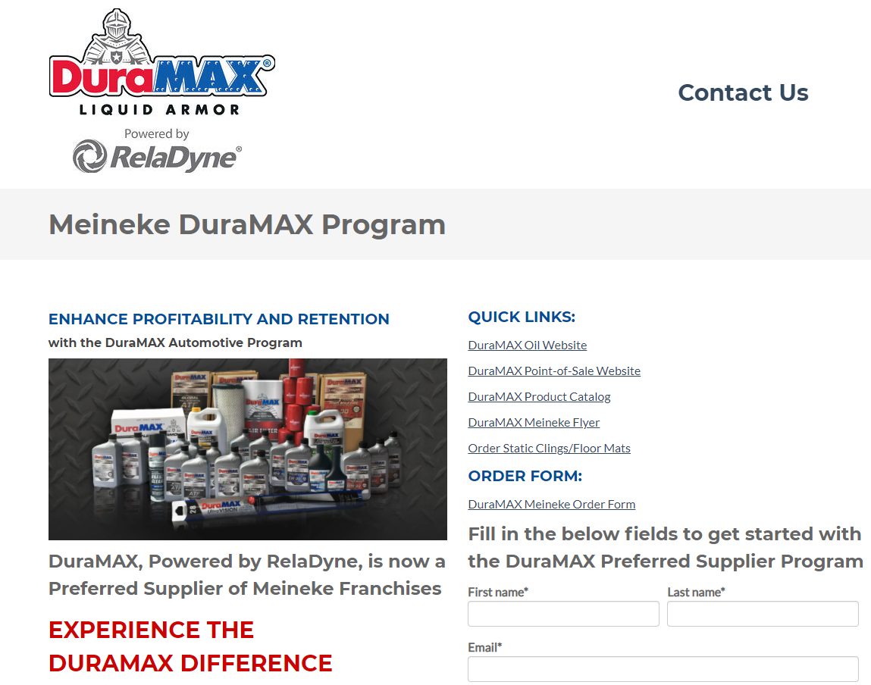
MORE INFORMATION?
info.reladyne.com/meineke

Slide 23
MDPCI ACCOUNT CONTACT
David Barnett, Corporate Account Manager
David.Barnett@reladyne.com
(502) 751-8020 cell

Slide 24
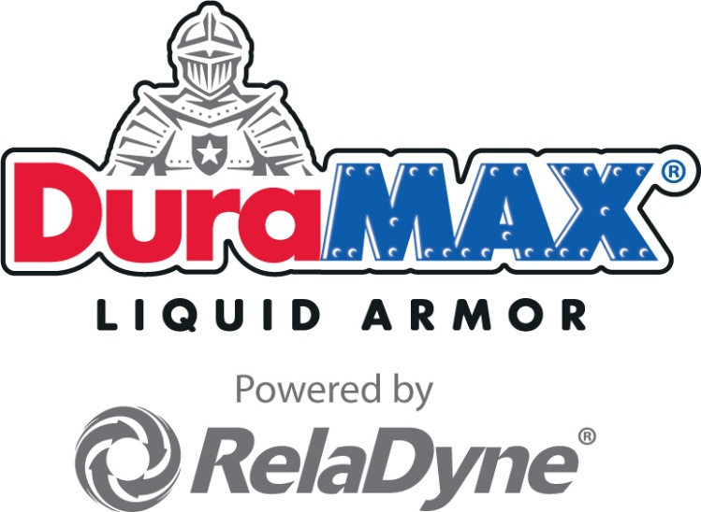
Thank you !

