Slide 1



December 14, 2022 Orlando, FL

Slide 2

NATIONAL ACCOUNT TEAM
MIKE PEACE
The Pronto Network
VP Sales & Business Development
BOB RESCO
Federated Auto Parts
Director National Accounts

Slide 3



DECEMBER 2014
+
=

Slide 4
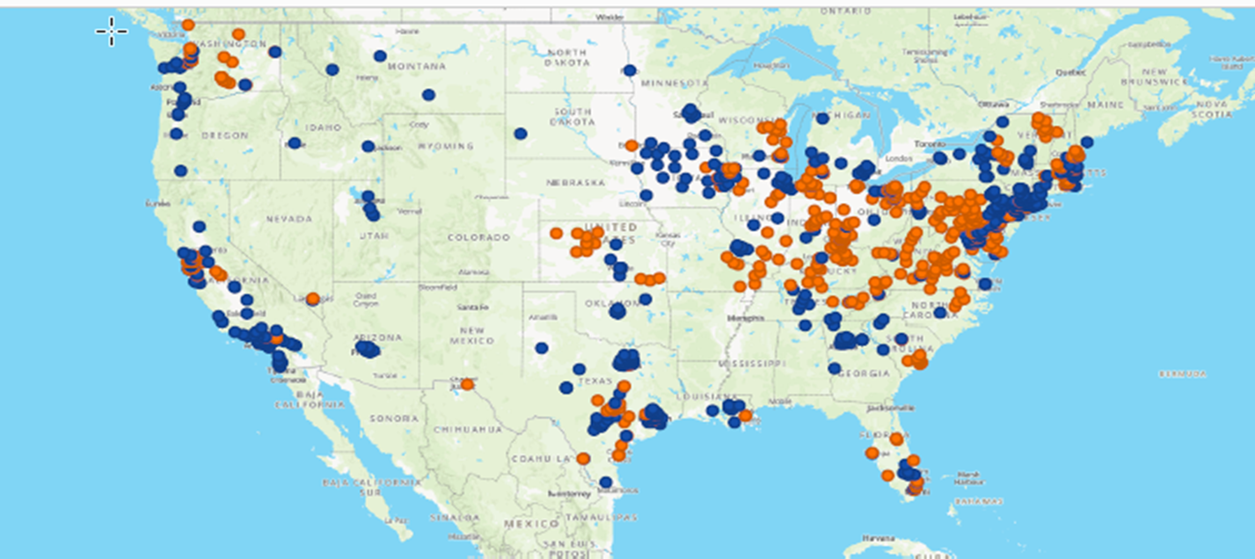
STORE LOCATIONS – DECEMBER 2020

Slide 5

BREAKING NEWS!

Slide 6



Notes:
There were really so many reasons behind this merger. Over the next few slides we will examine of few of the key areas and reasons we did what we did.

Slide 7
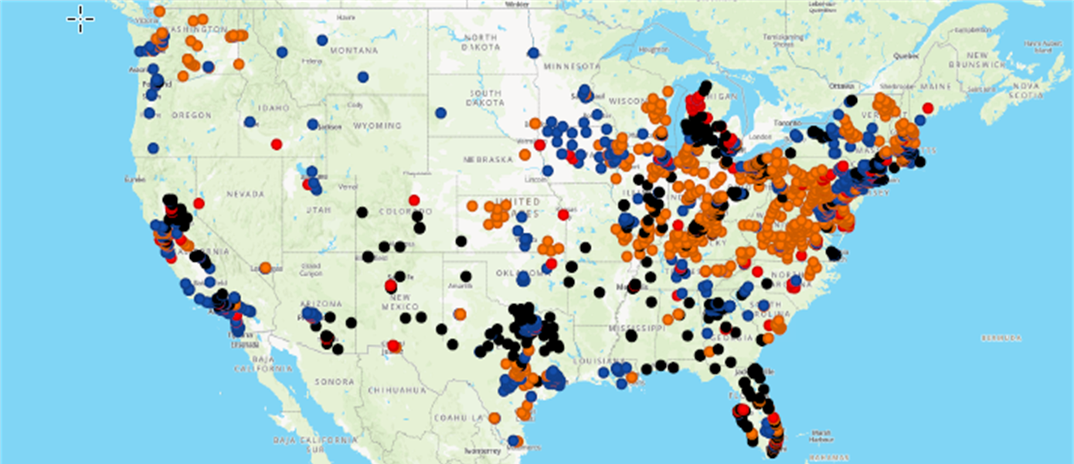
STORE LOCATIONS – JANUARY 2021

Slide 8

BREAKING NEWS!
+

Slide 9




THE GROUP – BRAND NAMES

Slide 10
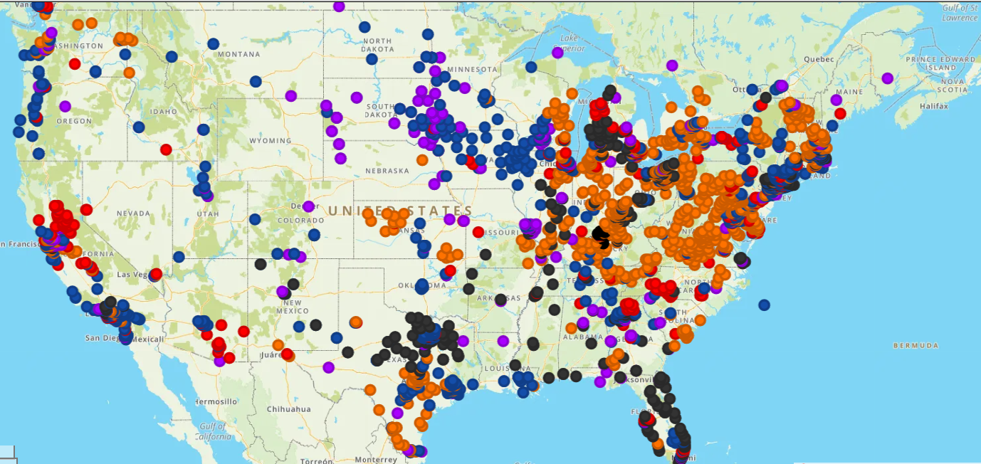
STORE LOCATIONS – JANUARY 2022

Slide 11




















GROUP MEMBERS

Slide 12


Purchasing Power
Technology Initiatives
Business Intelligence/Analytics
Marketing Programs
Service Center Programs
Training
Sales Performance
Notes:
The first one everyone seems to mention is the consolidation of our purchasing power and yes that one is very significant. But as we examined and compared our groups there was so much more.

Slide 13

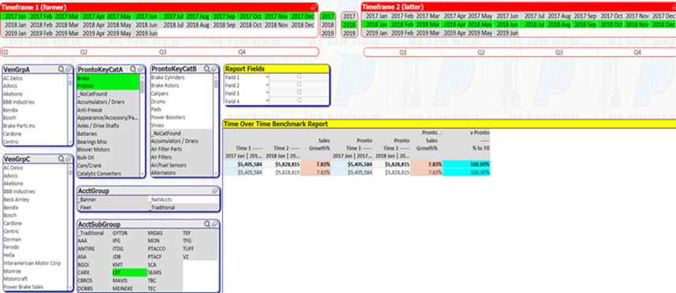

BUSINESS INTELLIGENCE
Brake Category – Year over Year Indexing

Slide 14


INDEPENDENT WHOLESALE DISTRIBUTOR
Independently Owned Auto Parts Distributor
Operate under their own business name
Operate Warehouses and Stores
Business is 90%+ wholesale
Stock Multiple Brands – Market/Customer based
Operate on their own Computer System
Team consists of experienced Parts People
Focused on Service, Quality and Availability

Slide 15













VENDOR PARTNERS

Slide 16









O.E. VENDOR PARTNERS

Slide 17



MARKETING & SERVICE CENTER PROGRAMS
Roadside Assistance
Nationwide Warranty
Road Hazard Warranty
Preferred Partner Programs
Business Management Training
Technician Training
Shop Identity Program
Plus much more…

Slide 18



TRAINING - ONLINE

Slide 19
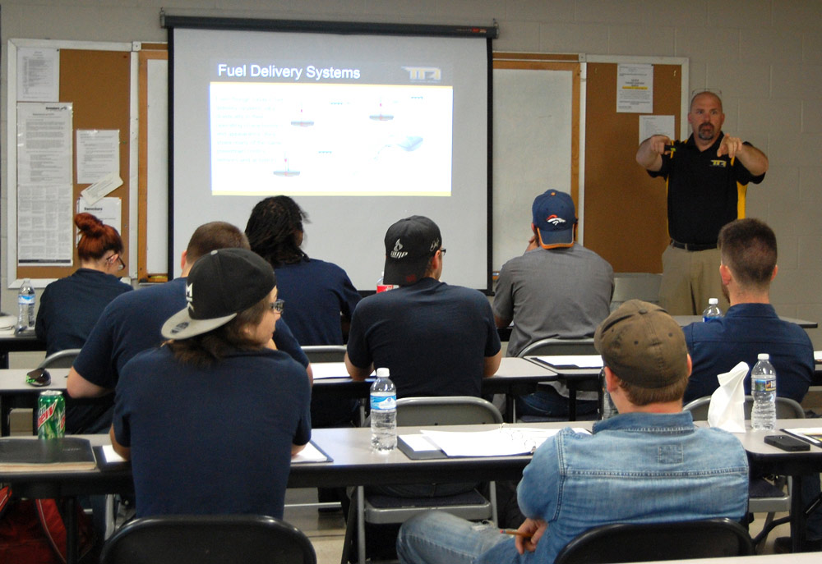

TRAINING - LIVE

Slide 20



PURCHASE REVIEW – 2021 YEAR END
 | 2021 | 2020 | % | # Shops
 | $3,029,014 | $2,696,358 | +12.4% | 132
 | $6,006,311 | $5,690,730 | +5.5% | 223
 | $9,035,325 | $8,387,080 | +7.7% | 355

Slide 21
PURCHASE REVIEW – YEAR TO DATE 2022
 | 2022 | 2021 | % | # Shops
 | $2,497,245 | $2,506,709 | -0.4%
 | $5,567,951 | $5,452,781. | 2.1% | 247
 | $8,065,196 | $7,959,490 | 1.3%

Slide 22

NATIONAL ACCOUNT PROGRAM DETAILS
Platinum Vendor
National Account Pricing – Market Based
Volume Rebates – up to 8.5%
Loyalty Trip Rebate – 1.0%
Other Discounts & Rebates – provided locally

Slide 23


QUESTIONS?

Slide 24

THANK YOU FOR YOUR SUPPORT!

