Slide 1
How To Leverage Public Reviews To Drive Growth
More Reviews = More Revenue

Slide 2
Why are reviews important?

Slide 3
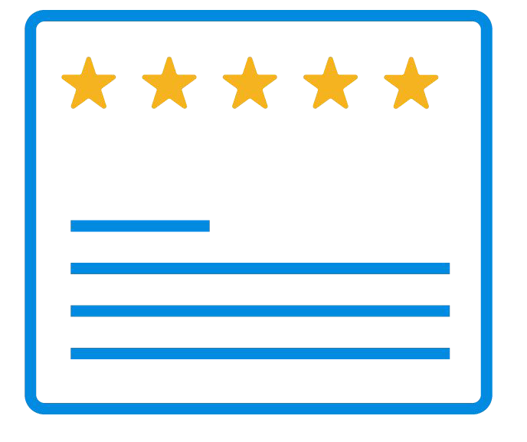
Residential Customers Read Your Reviews
GET FOUND
BE CHOSEN
97%
of consumers read reviews
for local businesses
84%
of consumers trust online reviews as much as recommendations from friends or family

Slide 4
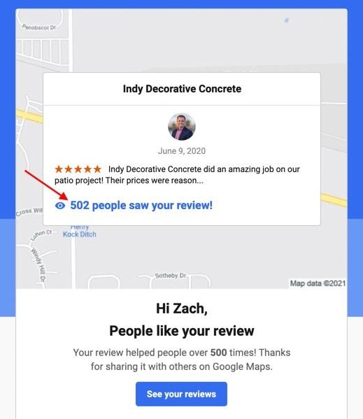
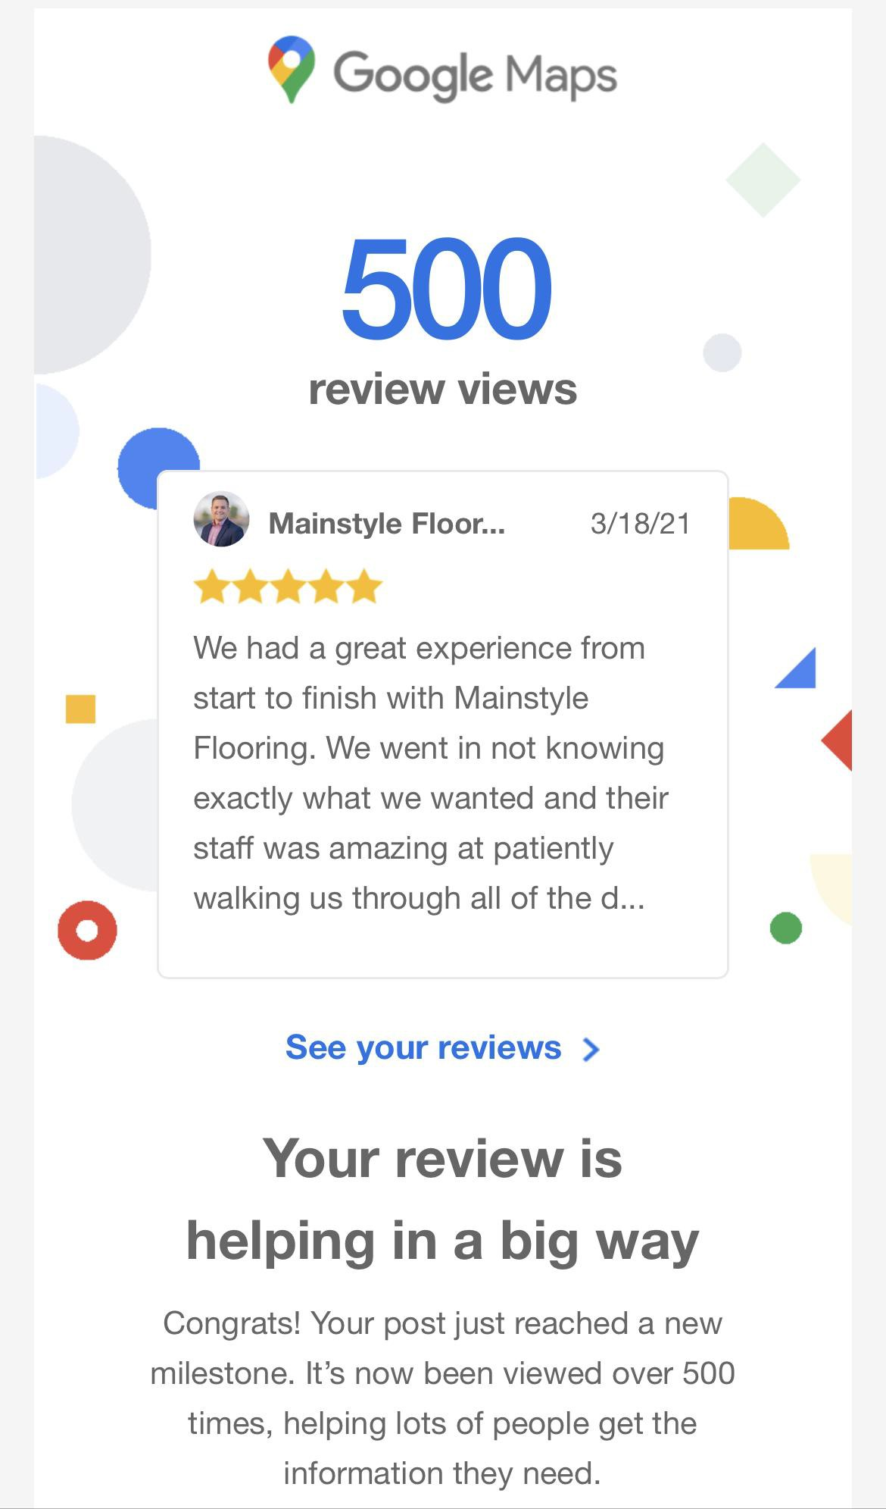
Each Google Review Is Read 500 Times Per Year

Slide 5
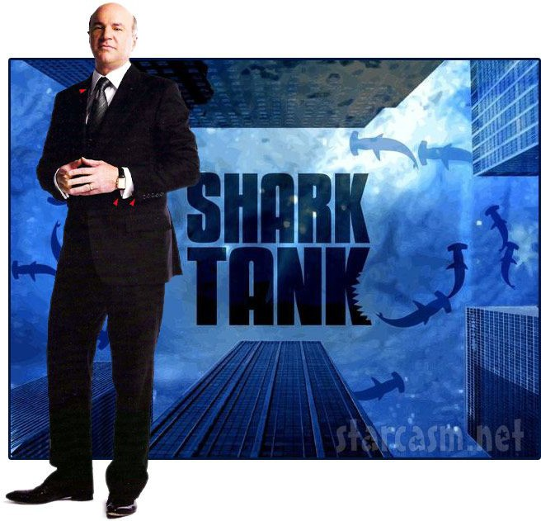
Potential Buyers Care A LOT About Your Reviews
“The database of customers, with these 5 star reviews is actually a very valuable asset. You could sell that to somebody if you wanted to.”
-Kevin O’Leary

Slide 6
Potential Employees Read Your Reviews
1 in 3 people have turned down a job offer because of a company’s bad online reviews
-Forbes

Slide 7
How do they impact search?

Slide 8
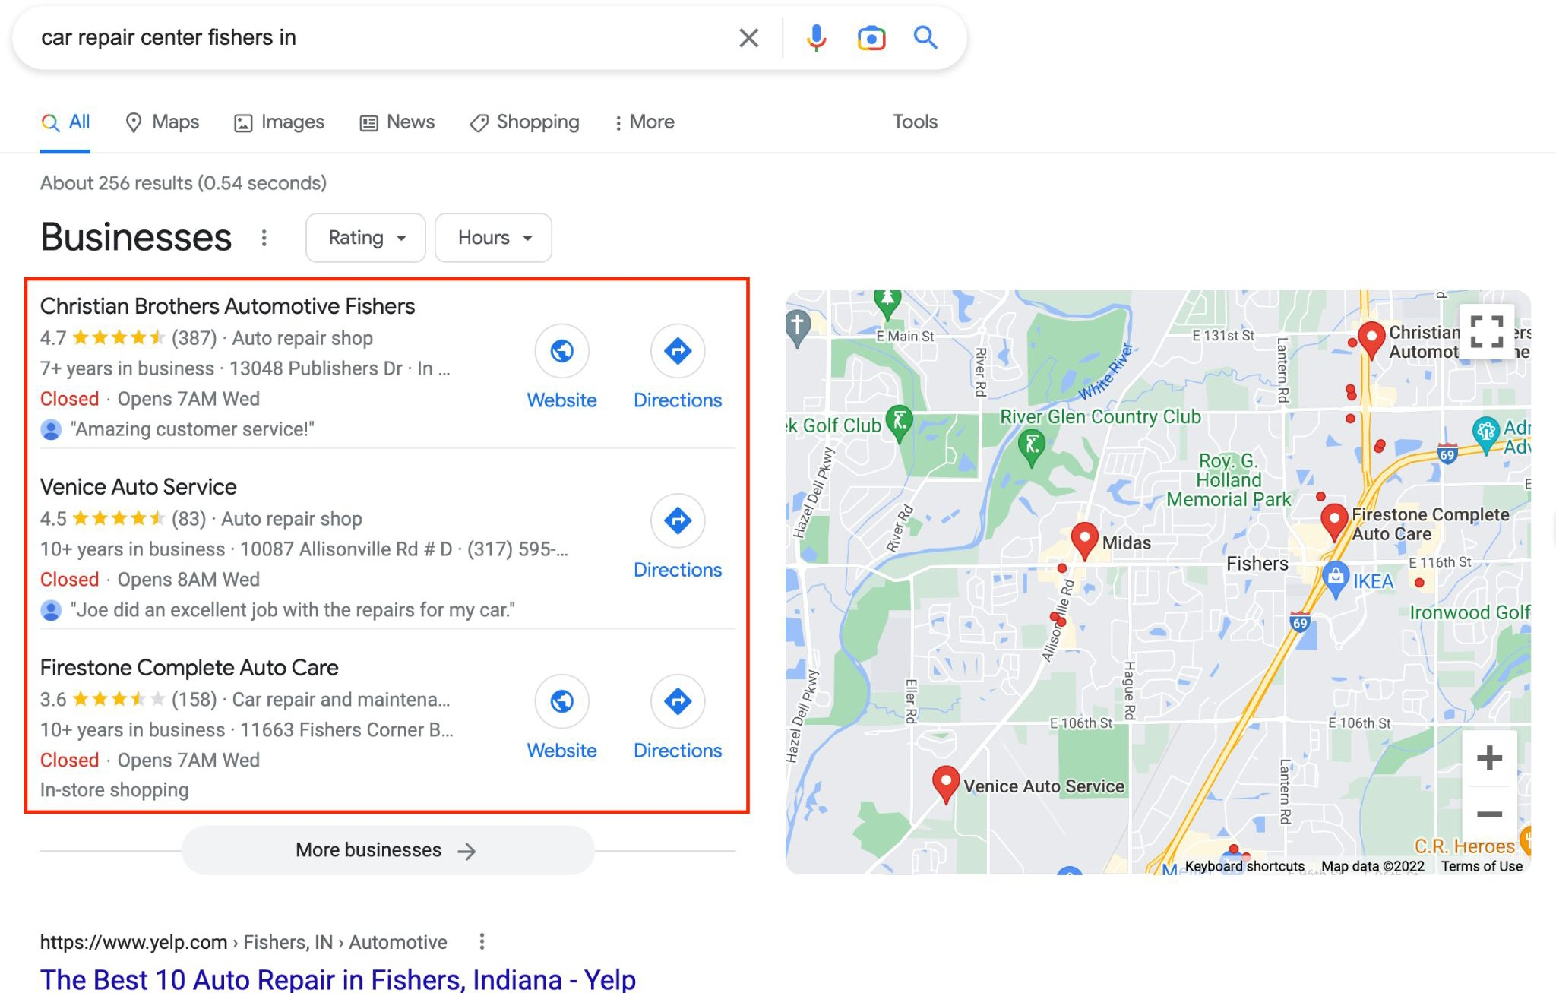
You Must Be In The Google “Power 3 Pack”

Slide 9
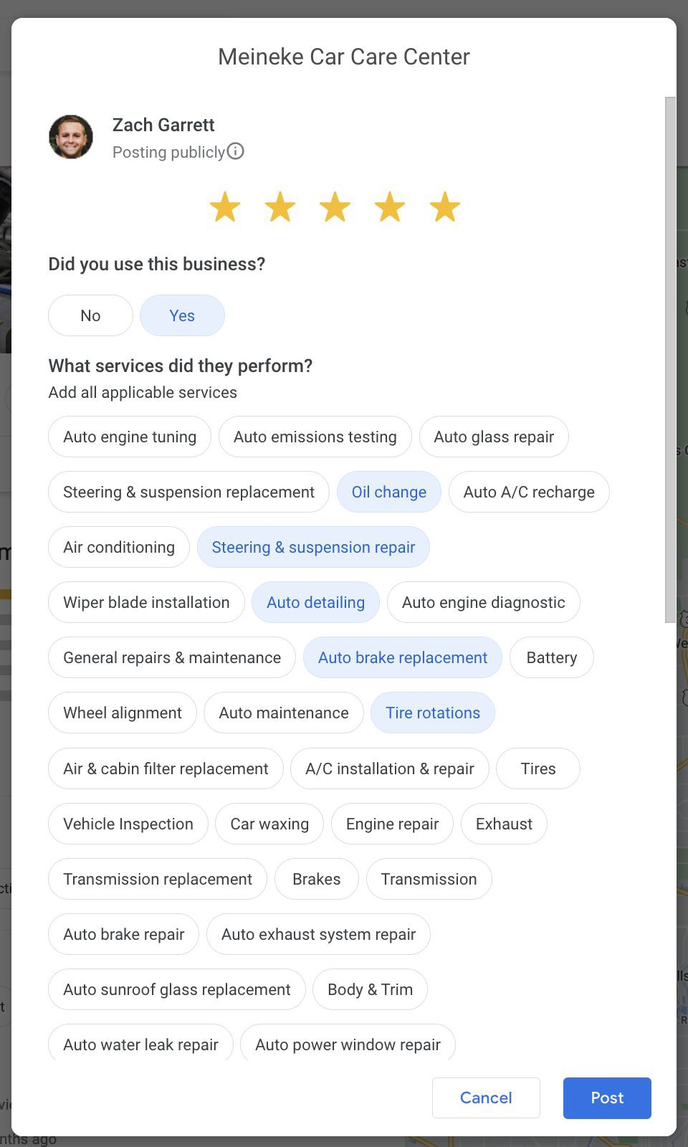
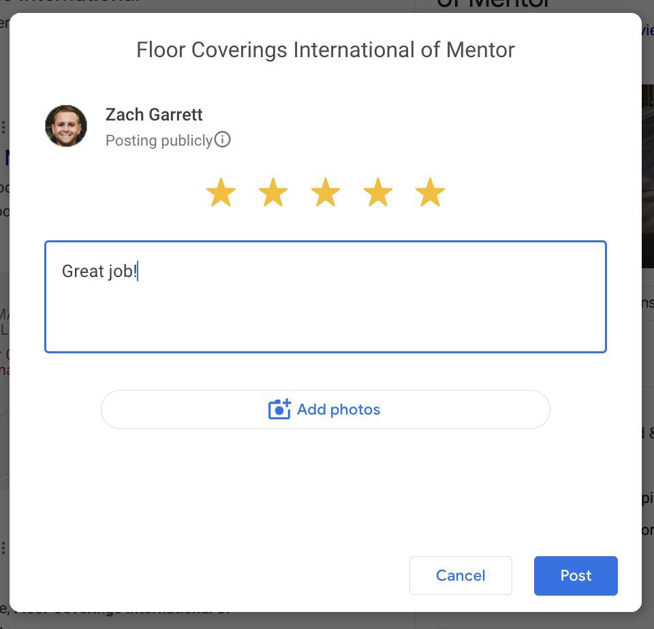
NEW! Services Question Changes The Game

Slide 10
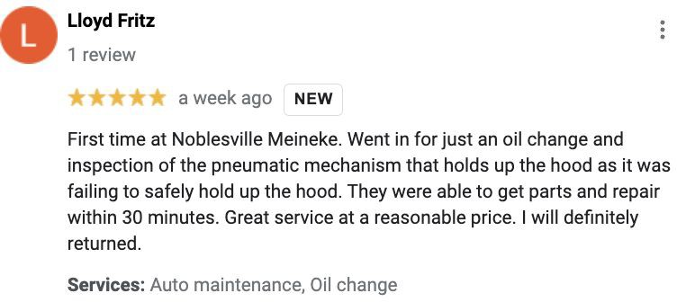
Google Now Tracks Your Rating Per Service

Slide 11
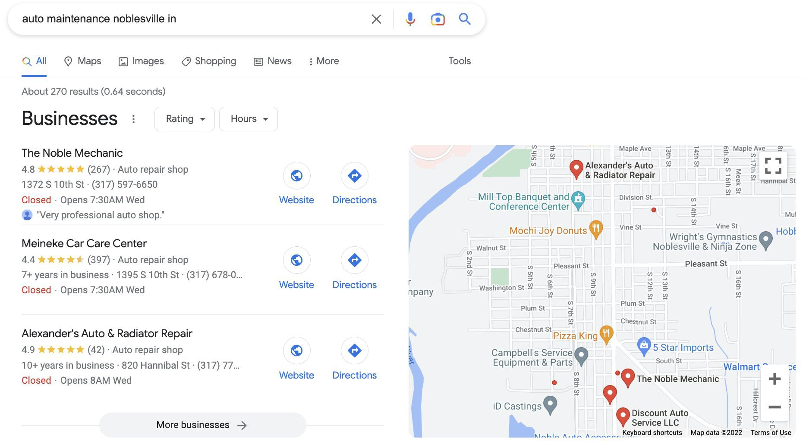
Win The Google “Power 3 Pack” At Service Level

Slide 12
Franchisee Case Studies

Slide 13
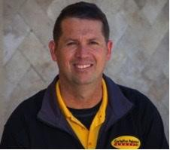
Home Services
Painting
“This company makes things easy for me and my customers, we are extremely pleased with the response rate.”
Steve West
Owner
CertaPro Painters, Lexington KY

Slide 14
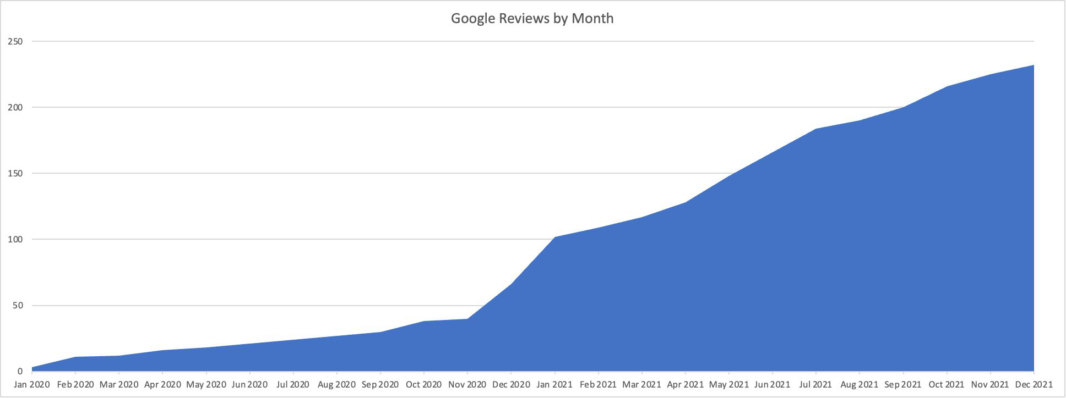
Increased Google Reviews by Almost 200
Started with Liftify

Slide 15
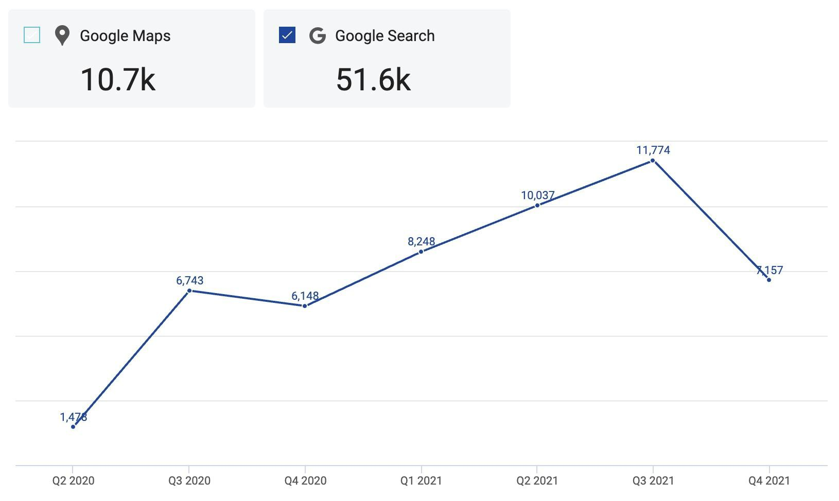
Google Search Traffic Up 159% YoY
Started with Liftify

Slide 16
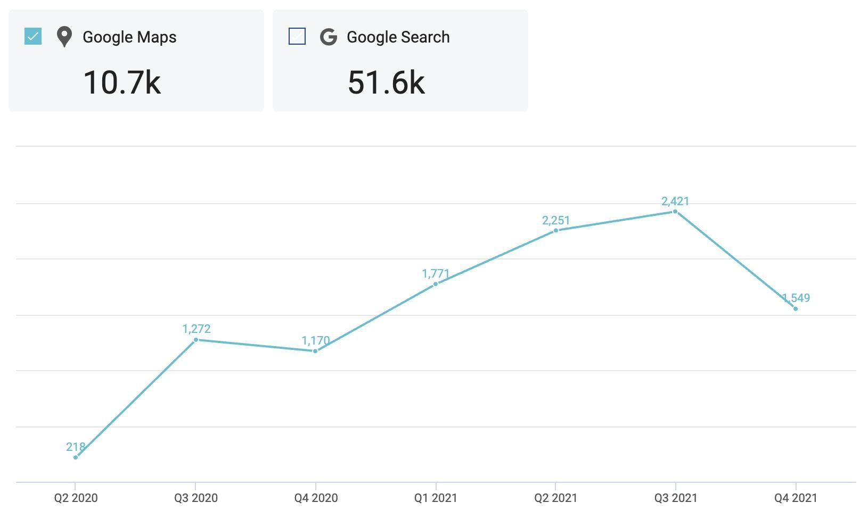
Google Maps Traffic Up 200% YoY
Started with Liftify

Slide 17
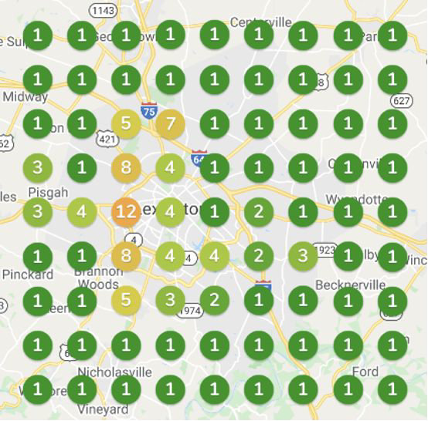
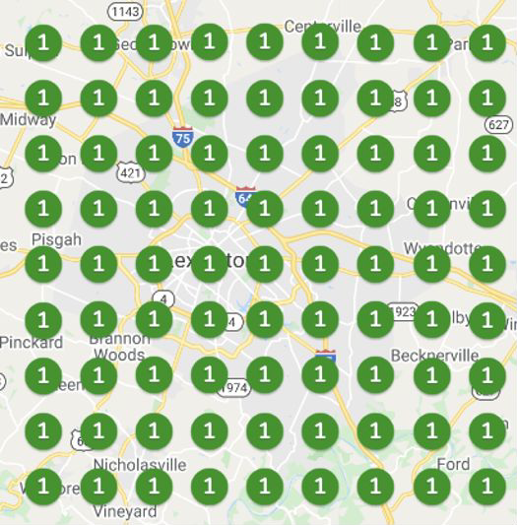
Now #1 For “Painter” Across All of Lexington
January 2021 January 2022

Slide 18
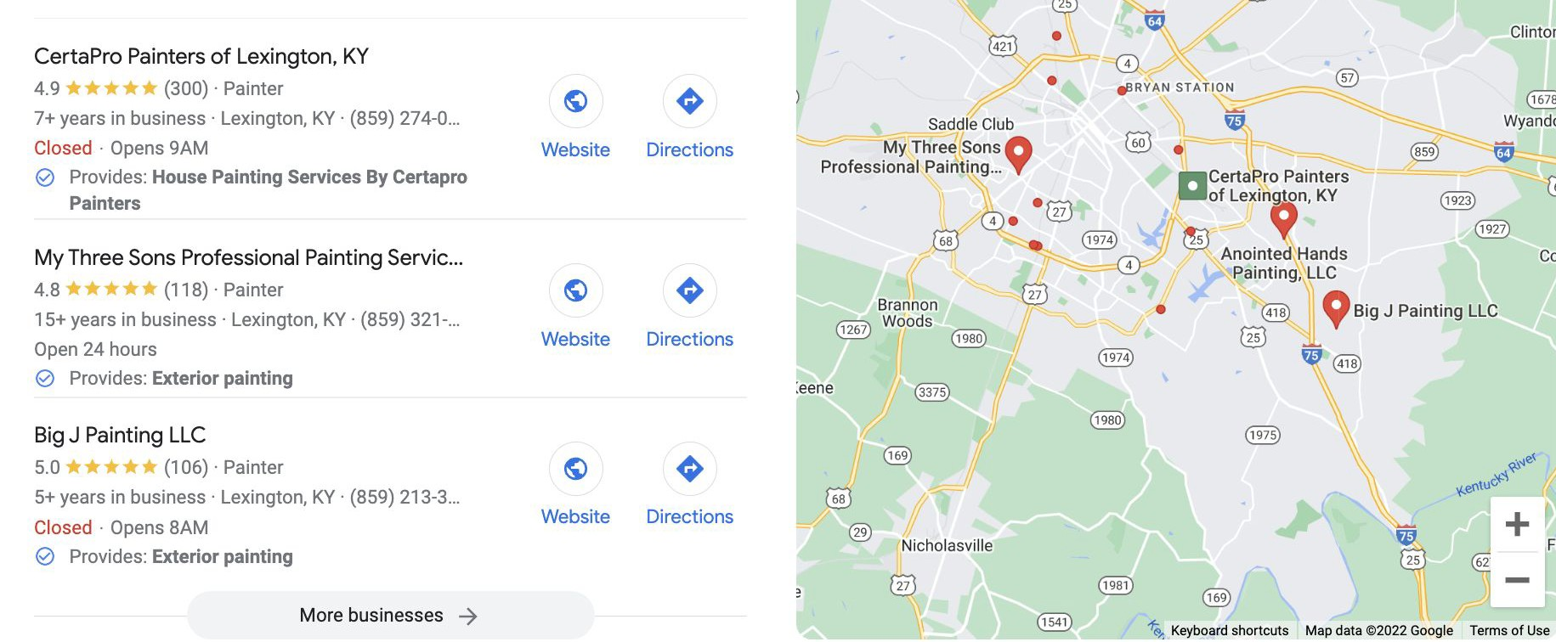
Which Company Would You Call?

Slide 19
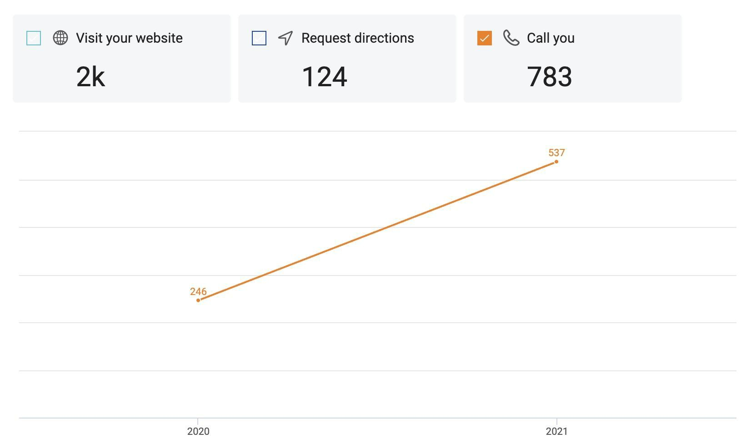
FREE Organic Google Leads Up 118% YoY

Slide 20
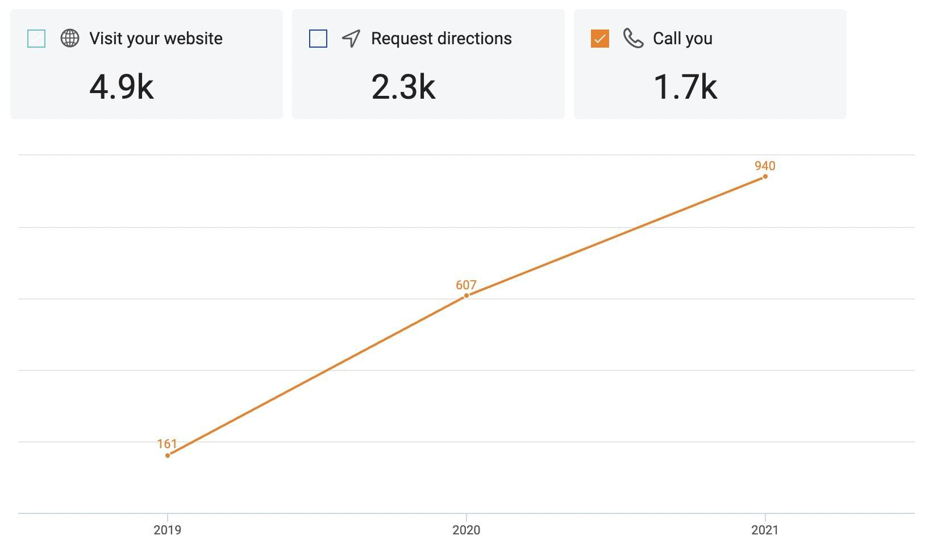
Austin, TX FREE Leads From GmB Up 5x since ‘19

Slide 21
Meet Liftify

Slide 22
Our Formula For Success
SIMPLE + EASY = REVIEWS →
(for company) (for customer)
LEADS → REVENUE → PROFIT →
LOCAL + SHAREHOLDER VALUATION

Slide 23
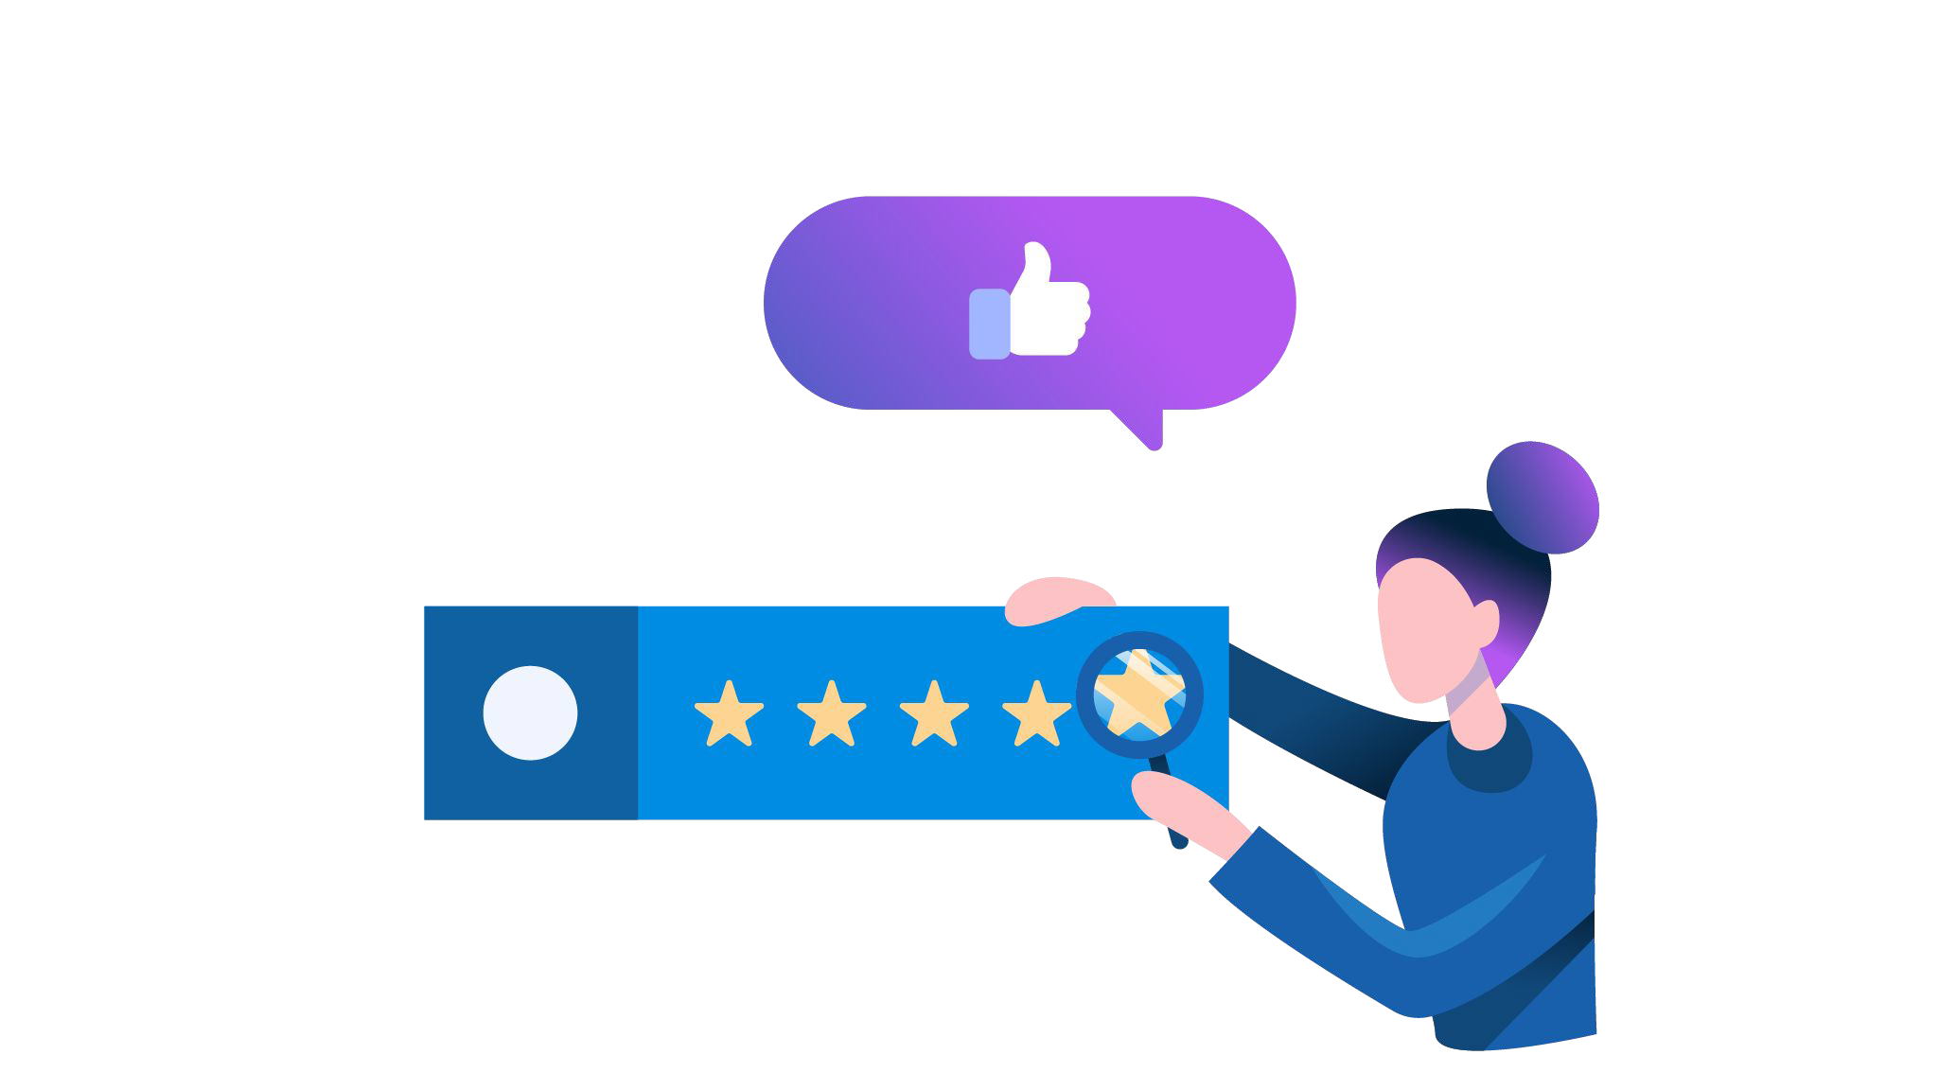
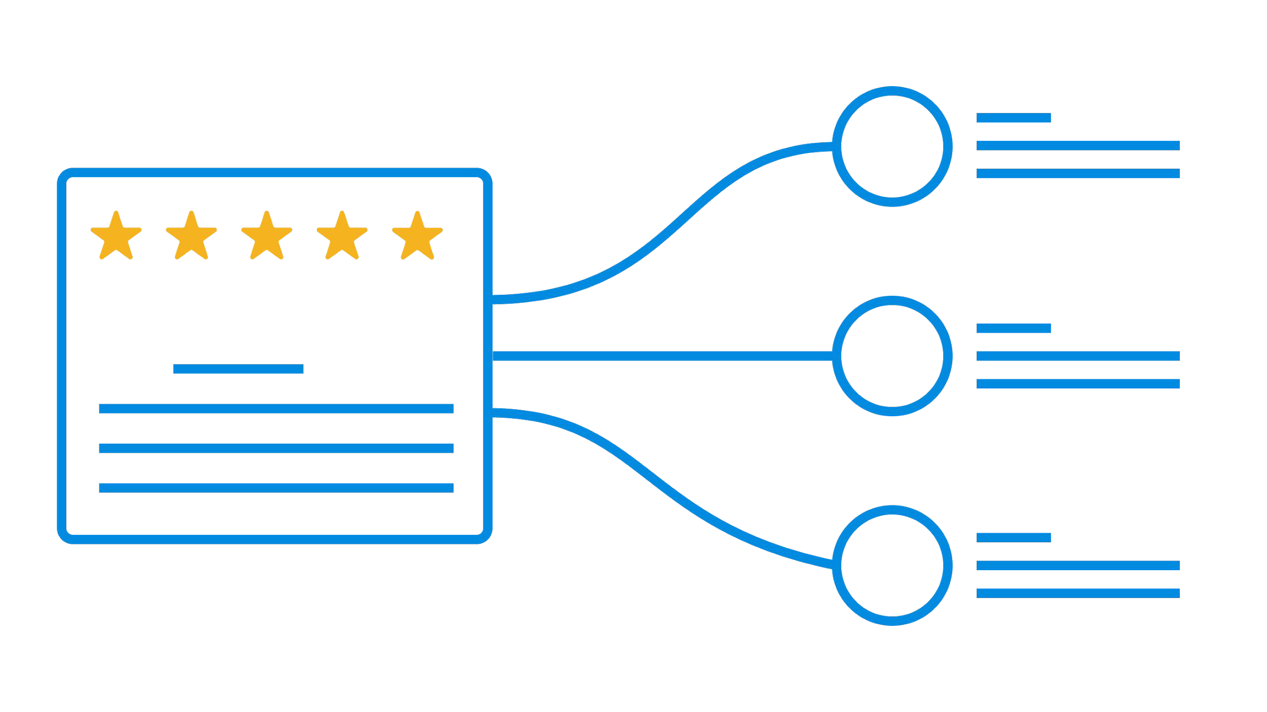
3 Key Elements To Build an Online Reputation
Review Generation
Review Monitoring
Review Marketing
Get great reviews.
Boost your reputation. Attract new customers.
Listen to customers. Show that you care. Win their loyalty.
Showcase your reviews.
Blast on Twitter and Facebook.
Stream to your website.

Slide 24
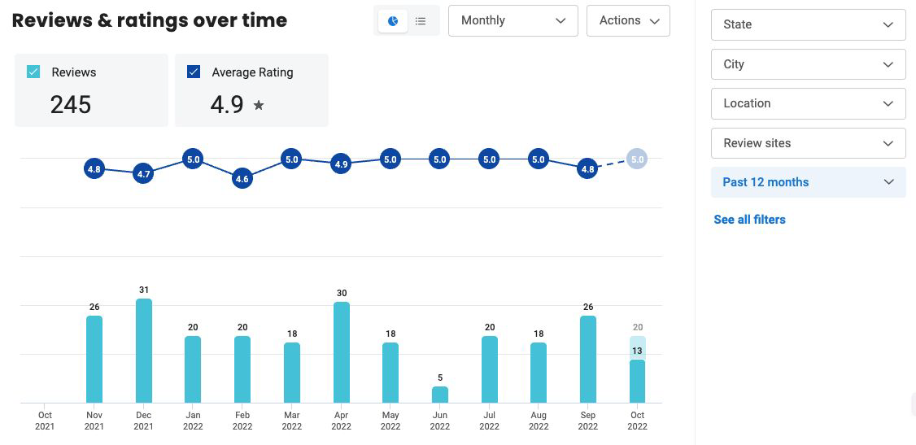
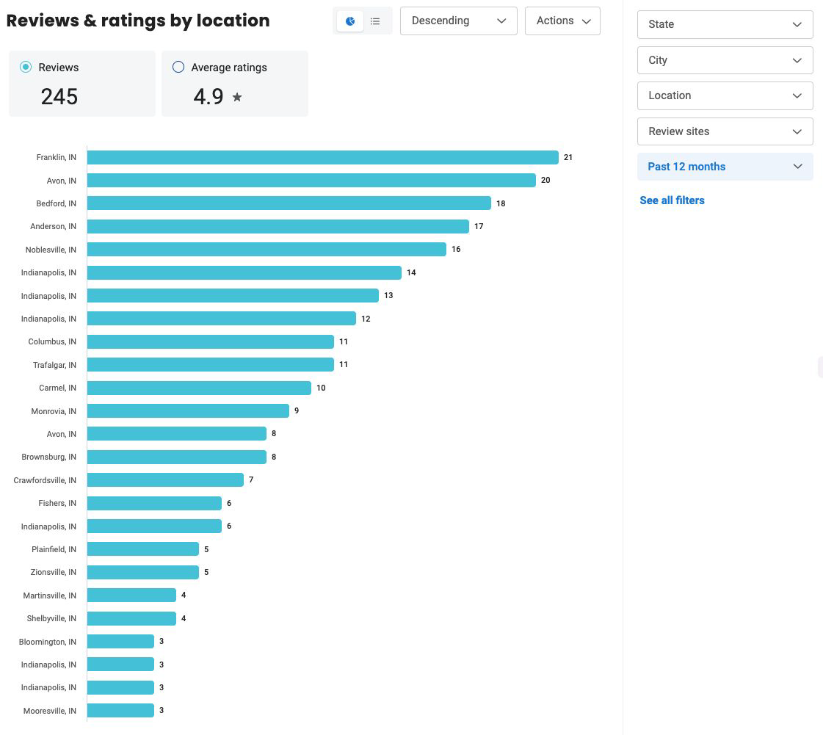
Monitoring
Enterprise Dashboard
See a macro and micro view of your progress in easy to use dashboard experience.
Analyze but time - pre configured and custom segmentation
Break down by location
Add additional filters for regions, teams, etc.

Slide 25
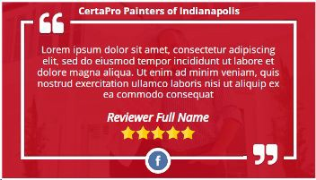
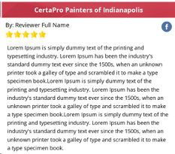
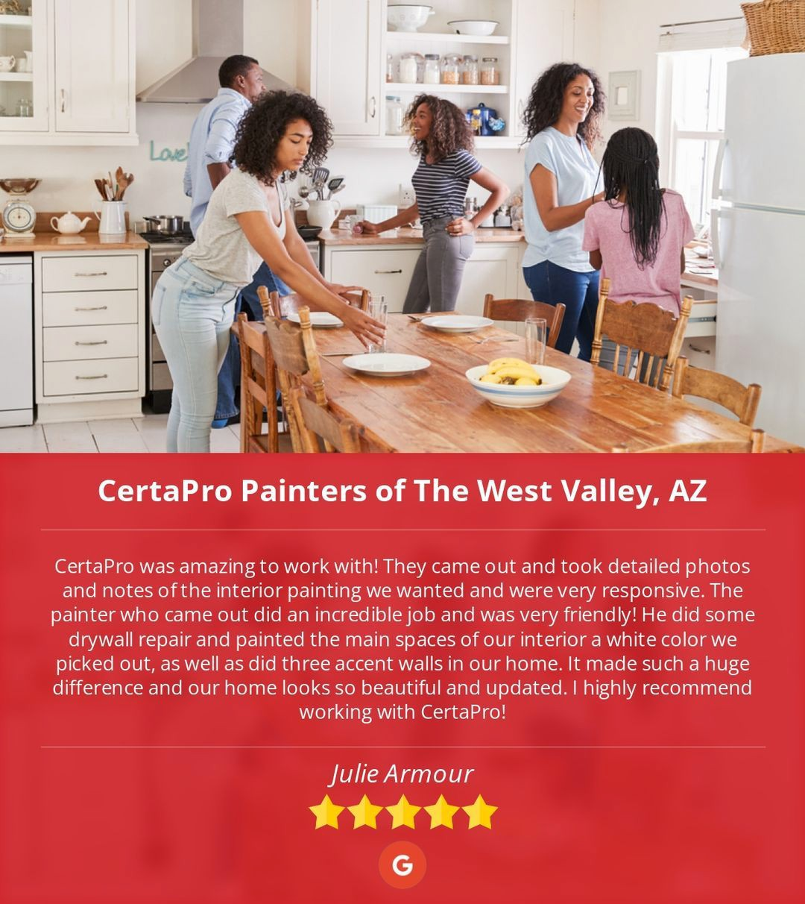
Marketing
Social Sharing+
Automatically share reviews to Facebook, Instagram, Linkedin, Twitter and more with beautiful custom branded imagery.
Auto share 5 star reviews
Provide set of images
We will share across channels
Get more brand exposure
Save time of local team

Slide 26
We transform brands public reputations

Slide 27
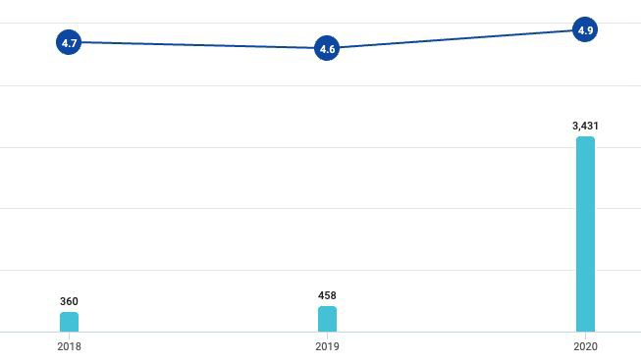
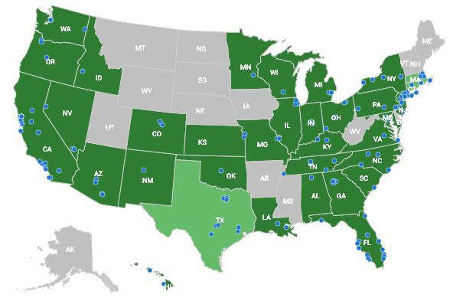
First Service Brands
California Closets was first FSB brand that we worked with
Started in early 2020 with 1 franchisee
Spread through word of mouth
Formally entered agreement with corporate wide rollout end 2020
Current do all of their NPS surveys and public reviews

Slide 28
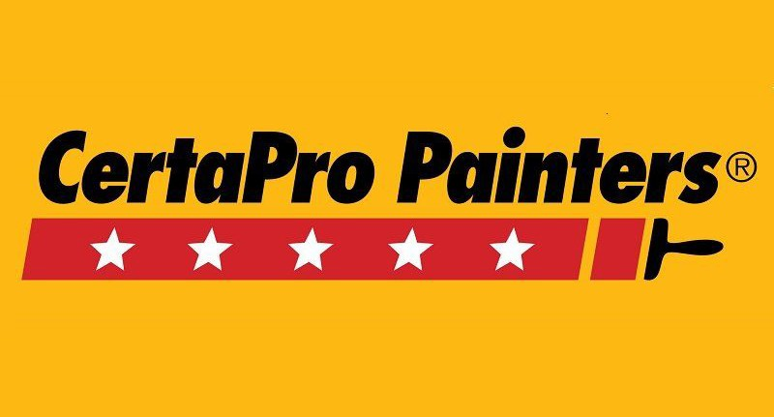
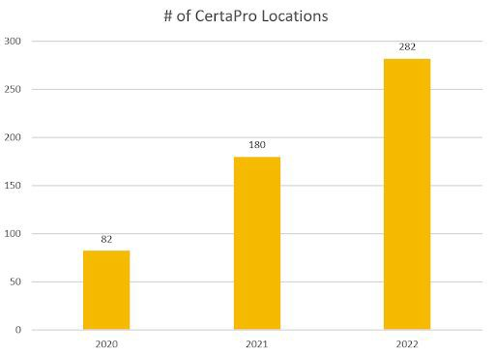
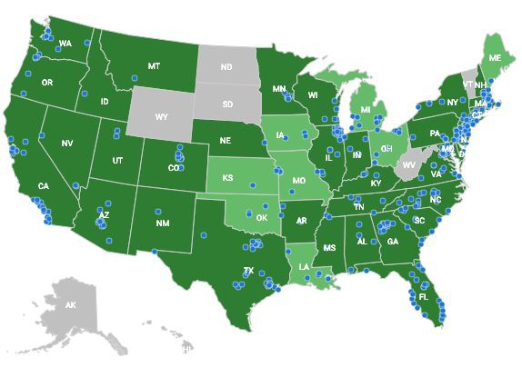
300 CertaPro franchise locations currently work with us
Franchise Level
Started in mid 2020 with 1 franchisee
Spread through word of mouth
Added about 100 new locations to our service each of the last 2 years
Currently utilized by almost everyone on CPFOA, BMAB, Big Shop, etc.
28

Slide 29
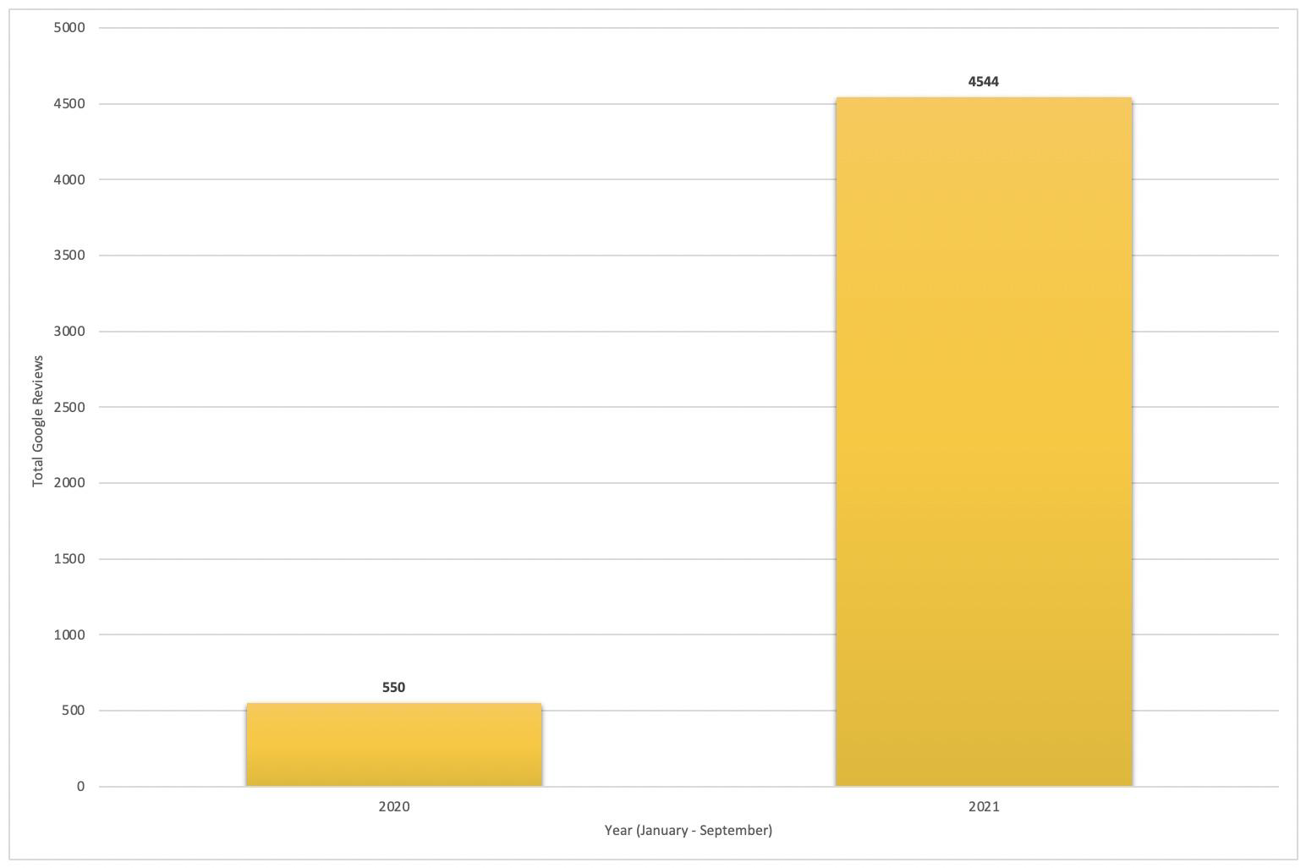
725% YoY increase in Google reviews for CertaPro franchises working with us.

Slide 30
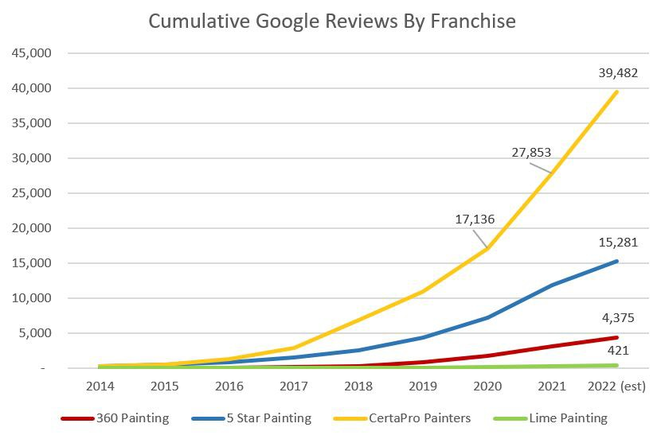
4x increase in brand dominance gap vs. national competitors since 2019.
24k
6k

Slide 31
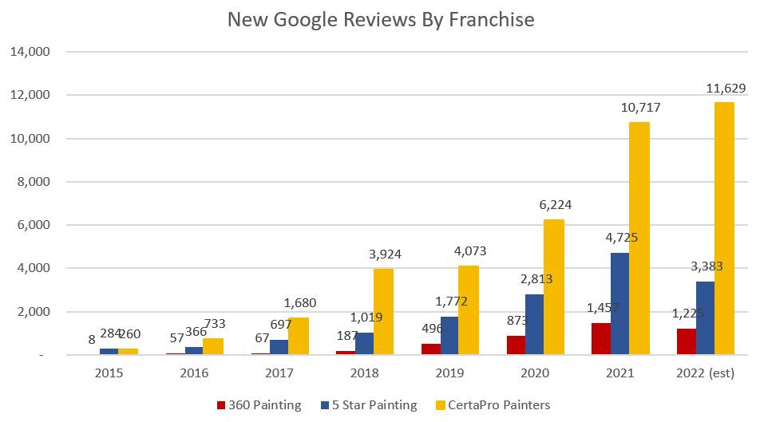
CertaPro is the only national painting brand on pace to increase Google reviews YoY

Slide 32
So what about Meineke?

Slide 33
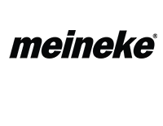
450 Google reviews / location
20% of reviews are negative
INDIANA
22 Meineke Locations
64% have 10 Google reviews or less in the last 30 days
7 positive Google reviews in the last 30 day per location
1.6 average positive Google reviews per week
33

Slide 34
725% YoY increase in Google reviews for CertaPro franchises working with us.

Slide 35
4x increase in brand dominance gap vs. national competitors since 2019.
24k
6k

Slide 36
We Are The Trusted Partner of Leading Brands
36

Slide 37
Pricing: MEINEKE GETS DISCOUNTED RATE!
 | Standard Pricing | Special Offer
Setup Fee & First Campaign | $500 | FREE
Monthly License (per location) | $300/mo | $200/mo
Management & Support | Included | Included
*No long term commitment required.

Slide 38
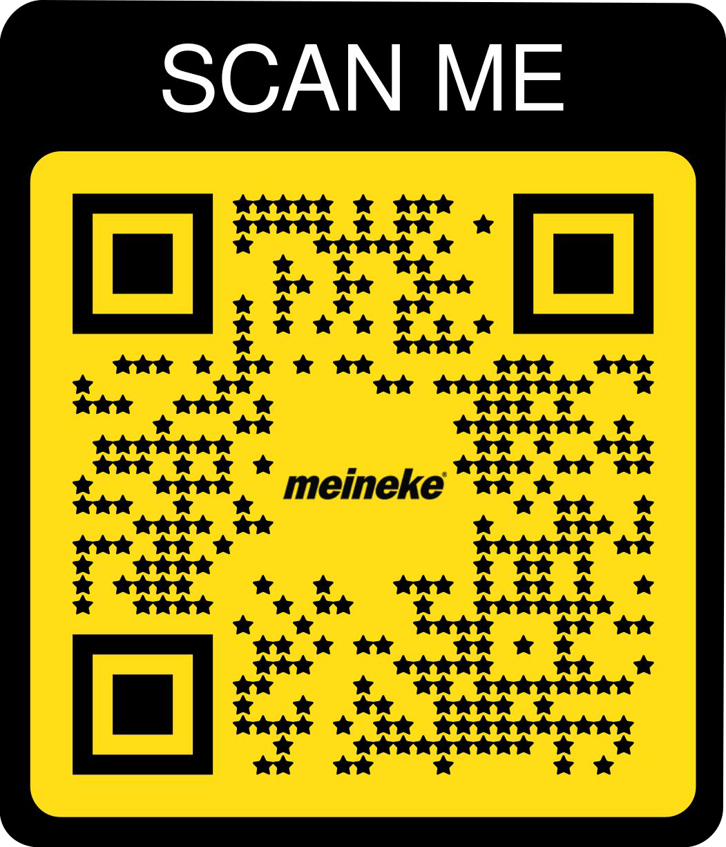
Next Steps
Scan the QR code and let us know if you are interested in doing a demo with me to learn more and give our solution a try.
Zach Garrett
zach@liftify.com
(463) 209-9961
38

Slide 39
Rise Above The Competition

Slide 40
Our Customer Solution For Franchise Brands
40

Slide 41
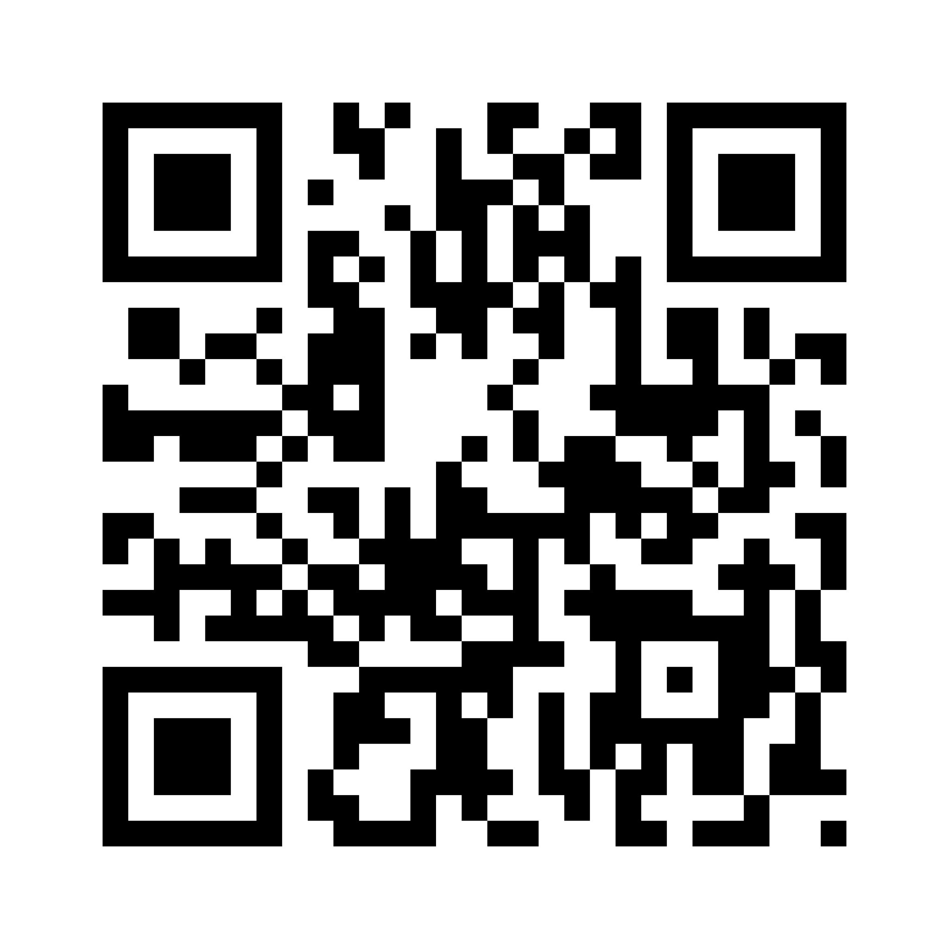
Holistic Review Generation Approach
ONLINE
OFFLINE
Email
Voicemails
Texting
Direct Mail
QR Codes
Brand Kits
Branded URL Links
Direct Calls
Retargeting Ads
Training

Slide 42
Review Generation
Custom QR Codes
Company branded QR codes can be used at office locations or by team members.
They make it easy for someone to leave you
a review
Unique for each location
Can be used digitally or in print
Make it 1 click for customer

Slide 43
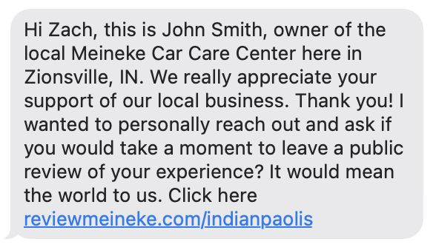
Review Generation
Custom Request URL’s
Company branded URL’s look great and make the customer trust the URL vs. some website they don’t know.
Unique for each location
Can be used anywhere
Make easy 1 click for the customer

Slide 44
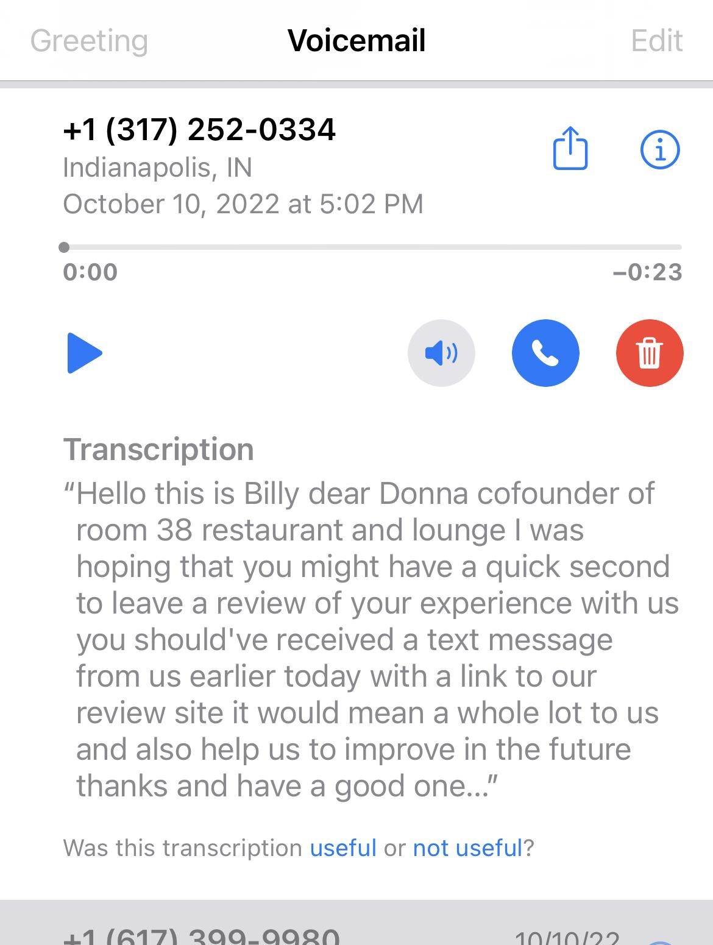
Review Generation
Voicemail Drops
Automatically send customers pre-recorded voicemail thanking them for working with you and asking them for a review.
Recorded by local business owner
Local area phone
Call back directly goes to business

Slide 45
Marketing
Social Sharing+
Automatically share reviews to Facebook, Instagram, Linkedin, Twitter and more with beautiful custom branded imagery.
Auto share 5 star reviews
Provide set of images
We will share across channels
Get more brand exposure
Save time of local team

