Slide 1
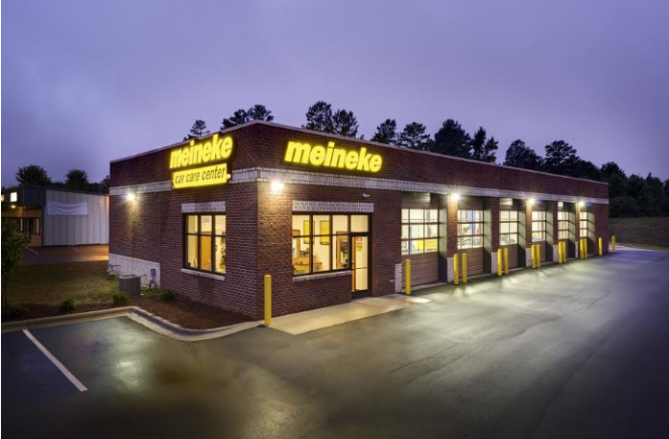
Meineke MDA Vendor Appreciation Orlando, FL 2022

Slide 2
Meineke Agenda
Pricing Update - Legacy
Price Decrease – Effective 1-1-23 Transact and Legacy
North America EV movement/update

Slide 3
2023 New Pricing Structure
Since 2019 Chevron has offered two pricing structures
Legacy and Transact
Legacy has a higher price and is direct billed by chevron
Transact had a lower price and is billed by Corcentric
Transact accounts also received additional rebates
Chevron is lowering Legacy pricing to match our Transact price effective 1-1-23
This will impact approximately 120 locations
This will lower costs between $.79/gal and $3.11/gallon on our most popular products.
Currently determining if Legacy pricing will include additional rebates

Slide 4
2023 Price Decrease
For the first time in 2 years, the index declined in the review period ( Sept. – Nov. )
Price will decrease on Lubricants -$0.29/gallon effective 1-1-23

Slide 5
North America EV update

Slide 6
EV Movement
Over the past few years there has been much hype regarding the growth of Battery Electric Vehicle in the global market. Most notably by the worlds largest Consumer OEMs; Volkswagen, General Motors, Stellantis, Renault-Nissan, Hyundai / Kia as well as Toyota. Although Toyota has held steadfast to their faith in strong market Hybrid vehicle adoption
These early estimates claim that Battery-electric vehicles (BEV) will account for 20% of new light-vehicle sales worldwide by 2025, and 59% by 2035 as government mandates begin and automakers roll out new models. Estimates also claim that Hybrid vehicles (PHEV, HEV) will to about 19% of new car sales by 2025 then flattening out
Government regulation around emissions and Green initiatives including consumer rebates for BEVs continue to remain in place as a carrot in western markets, but markets such as China and India have shifted to a “stick” approach. Implementing RDE (real driving emissions) monitoring systems on vehicle and establishing Zero emission zones, typically with-in large metropolitan, congested city centers. These regulations as well as OEM manufacturing restraints have forced compliance by OEMs to increase production of full BEV units
Specific to the United States; the Biden administration has raised climate targets and set a goal of having half of all new-vehicle sales in the country be zero-emission by 2030
© 2022 Chevron Corporation Confidential

Slide 7
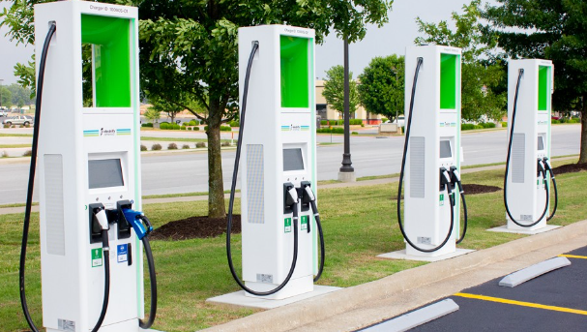
EV Movement
Over the past 12 months this picture has changed somewhat due to the reality of government implementation of draconian demands on a market which continues to struggle with Power generation, including in the United States where the shift to “green” sources has proven to be a problematic
Serious and Significant challenges include Power generation issues which have caused local government entities to advise consumers to lower thermostats in the winter, raise them in the warmer months, and charge BEVs only during off peak hours, and only to 50% of their charge. Major supply-chain constraints, geopolitical uncertainty and increased demand have pushed prices for lithium, nickel and other raw materials needed for battery production up significantly over the last two years, leading to higher battery costs
An even larger issue is lack of infrastructure charging networks. It’s estimated that the United States will need a minimum of 1.1 million public charging sites by 2025 and 2.3 million by 2030, compared with 100,000 available today, of which 30% are non-functioning due to maintenance problems at any one time. The Biden administration plans to spend $5 billion over the next five years on EV charging, targeting 500,000 public charging stations nationwide by 2025, this is well short of the estimated need
© 2022 Chevron Corporation Confidential

Slide 8
EV Movement
BEV – Battery Electric vehicle: These vehicles operate 100% on a battery charge and electric motor and have no ICE backup. These units have no internal power generation and must be plugged in for battery charge
HEV – Hybrid electric vehicle: These are full hybrid vehicles equipped with both a gasoline engine and an electric motor. The electric moor is fully capable of handling the work load of regular driving and can typically operate for great distances solely on the electric power. This typically occurs at lower speeds, stop and go conditions. The battery is charged via internal components, generator / regenerative braking. The ICE is triggered when the computer requires better efficiencies which can be achieved at higher speeds and longer distances
PHEV – Plug in Hybrid vehicle: PHEV’s are similar to HEV’s, but with one major difference; the battery charging for the electric motor is both internal (generator / regenerative braking) and external via a plug. Plug-in hybrids typically have greater electric-only ranges than full hybrids, and serve as a half point model between full BEN and HEV
© 2022 Chevron Corporation Confidential

Slide 9
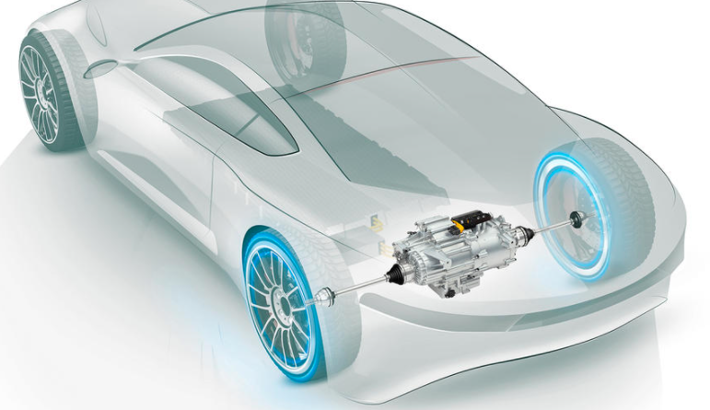
EV Movement
Because of the noted issues with fast conversion to full BEV Consumer OEMs are now ramping down their estimates and adopting a Hybrid approach similar to Toyota. General Motors has been the last holdout on ramping down the BEV shift estimates, but just recently is willing to discuss a Hybrids strategy. Although their advertising and direction of technology development budgets would suggest a stern BEV only position
All of this said, traditional engine oils and drive-line fluids will remain an important part of consumer vehicle builds and maintenance for the next few decades. The new opportunity will be with Hybrid engine oils, Renewable engine oils, E-Drive, Renewable E-Drive fluids as well as E-Coolants
Currently the world-wide car parc of EV’s is less than 1% and is less than 1.5% in California
The next few slides will address Consumer automotive trends and the opportunity's Chevron is prepared to tackle
© 2022 Chevron Corporation Confidential

Slide 10
EV Movement
Adoption of battery electric vehicles is widely believed to accelerate by 2025 to mass-scale, full battery electric vehicles (BEVs). This is somewhat dependent on cost parity with ICE vehicles available in the market, or if legislation expands it’s imposed bans on the sale and use of ICE vehicles in specific regions and municipalities. Efficiencies gained from long-life batteries, quick charging and more efficient electricity generation are also major factors in this projected growth
According to Kline Research by 2040 Electric vehicles will comprise approximately 22% of the world’s vehicle population. The great majority will consist of Start/Stop Technology, Hybrid, and a handful of Hydrogen units. But 16% of this group will be full battery electric vehicles. Half of these BEVs will operate on Chinese roads
Electrification of vehicles will eliminate the need for engine oil, but will open opportunities for oil marketers to develop specific EV products such as Coolants, specialty greases, and drive-line lubricants
Electric vehicles will become more efficient over the next decade. Includes battery manufacturing, electricity production and maintenance
© 2022 Chevron Corporation Confidential

Slide 11
EV Movement
Kline data 2022
© 2022 Chevron Corporation Confidential

Slide 12
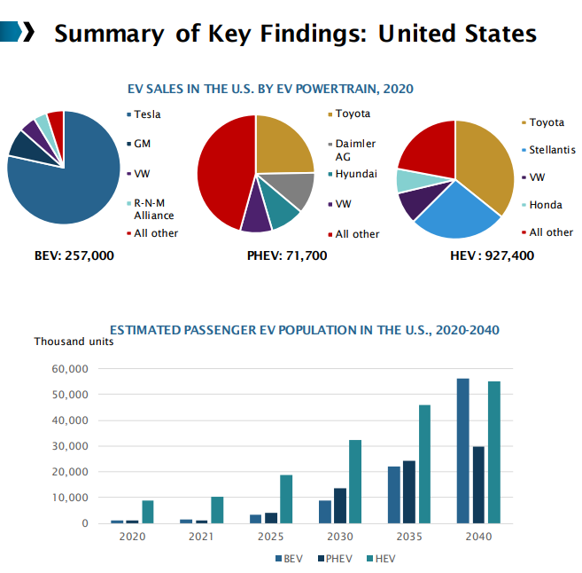
EV Movement
Governmental Support ⚫ Current U.S. administration is committed to support the EV industry. EVs sales are expected to boost within the next four years. A fund of USD 174 billion proposed in March 2021 is under review and subjected for the U.S. Congress approval. ⚫ Build Back Better" infrastructure bill ⚫ The California Air Resources Board (CARB): OEMs should comply to a quota of ZEV and PHEV
© 2022 Chevron Corporation Confidential

Slide 13
EV Movement
Thermal Runaway is the biggest challenge to EV charging, specifically fast-charge systems and fast depletion of the battery at high speeds
Thermal Runaway is the process of uncontrollable, self heating state where CO2 builds up in battery cells causing extremely high-temperature gases to escape in an explosive manner. Although critical mass of EV’s in the market-place bares only a few incidents of consumers burning down their homes these events will multiple with EV growth, and industry demands for faster charging
To address Thermal Management challenges, it’s imperative for the industry to adopt specific designed coolants with unique characteristics
© 2022 Chevron Corporation Confidential

Slide 14
Future Havoline EV™ Products
EV
Performance Attribute | HavolineEV™ e-drive Fluid | HavolineEV™ Renewable e-drive Fluid
Low Traction Coefficient | ✓ | ✓✓
Wear Protection | ✓✓ | ✓✓
Thermal Performance | ✓ | ✓✓
Corrosion Resistance | ✓ | ✓✓
e-Drive Efficiency | ✓ | ✓✓
Lower Carbon/Renewable | --- | ✓
TM
e-Drive Fluid
R E N E W A B L E
A 4.5 cSt premium offering using a proprietary base stock mix containing mostly renewable SynNova 4 and top-tier additives to maximize performance
the first renewable fluid of its kind in the world
EV
TM
e-Drive Fluid
A 4.5 cSt market general offering using a cost-competitive blend of Synthetic Group III base stocks and top-tier additives to deliver a
cost-effective, high-performing product
Efficiency evaluation was performed using a real, commercially available e-drive and hub-dyno vehicle testing
This evaluated a wide range of torque and speed combinations
Chevron has worked with Consumer OEMs to develop products to address OEM concerns
*Logos are not final and do not represent a commitment from Chevron Lubricants

Slide 15
EV Movement
Future Havoline EV Thermal Fluid 100 to address EV cooling challenges
Analysis | Havoline EV Thermal Fluid 100 | Test Method
Kinematic Viscosity, mm²/s (60ºC) | 3.7 | ASTM D455
Electrical Conductivity, µS/cm (25ºC) | 96 | ASTM D1125
pH | 8.2 | ASTM D1287
Density, kg/L (20ºC) | 1.066 | ASTM D1122
Reverse Alkalinity, mL 0.1M HCl (to pH 5.5) | 2.8 | ASTM D1121
Boiling Point, ºC | 110.9 | ASTM D1120
Hard Water Stability, mL Deposit | <0.1 | CEC C-06-T-95
Foaming Tendency, mL//s | 50//2 | ASTM D1881
Performance Attribute | HavolineEV™ Thermal Fluid 100
Low Electrical Conductivity | ✓✓
Corrosion Resistance | ✓
Electrical Conductivity Durability | ✓✓
Temperature Control | ✓
Materials Compatibility | ✓✓
Coolant Compatibility | ✓
© 2022 Chevron Corporation Confidential

Slide 16
Thanks for your partnership!

