Slide 1
REVOLUTIONIZING ENERGY MANAGEMENT

Slide 2
BUDDERFLY: ZERO INVESTMENT ENERGY SAVINGS AND CONTROL
Innovative energy management program
Saves energy and expense for the Franchisee
Does the work for Meineke owners
Provides equipment throughout with 10-year parts and labor warranty
Monitors key operational equipment
Budderfly invests in your Meineke to achieve energy savings
ZERO Capex required from the Franchisee or Brand
Effortless for both as well
All costs paid from energy waste elimination

Slide 3
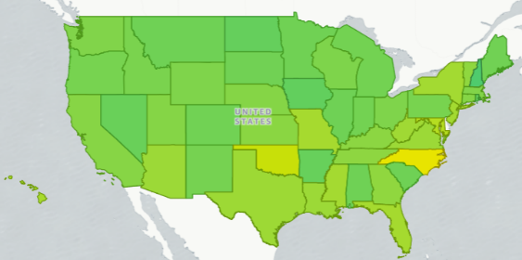
BUDDERFLY: PROVEN AND TESTED
OVER 3,000 LOCATIONS INSTALLED in 49 STATES ACROSS US AND CANADA
Newest Franchisees

Slide 4
MAJOR INDUSTRY CHALLENGES
COST OF OPERATIONS
CAPITAL EQUIPMENT INVESTMENT
Rising Energy Expense
adds to overall cost of running the business
Significant Cash Outlays
to fix or replace aging equipment instead of investing in the business or yourself
FRANCHISEE
NO TIME FOR ENERGY
PROCUREMENT
Business is a Fulltime Job
leaving little to no bandwidth for non-core, complicated energy decisions
Each project as a one off
Budderfly can leverage buying power and provide Project Management for hassle free install
INCREASING PRESSURE TO GO GREEN
BUDDERFLY: is the only holistic energy management solution at no out-of-pocket cost

Slide 5
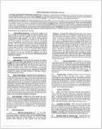
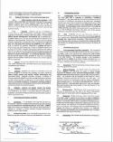
BUDDERFLY SOLUTION: HOW IT WORKS
FRANCHISEE registers and
executes simple EMO agreement
BUDDERFLY does the rest
Franchisee can focus on their business
FRANCHISEE
01
Assume Franchisee energy billing
Establish billing baseline from site kWh consumption history
Install efficiency upgrades at no cost to Franchisee
Provide Franchisee a 5% consumption savings on monthly bill
Maintain upgrades via warranty at no cost to Franchisee
Ongoing upgrades and monitoring at no cost to Franchisee
02
03
04
05
06
Budderfly continually adds new savings solutions throughout the term

Slide 6
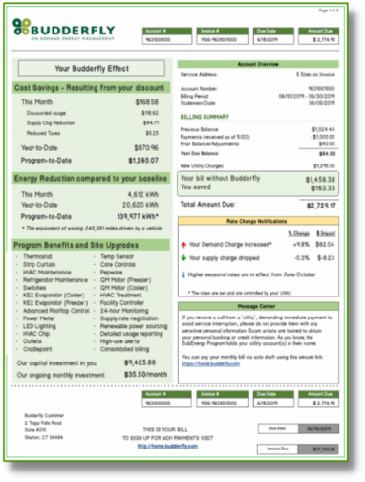
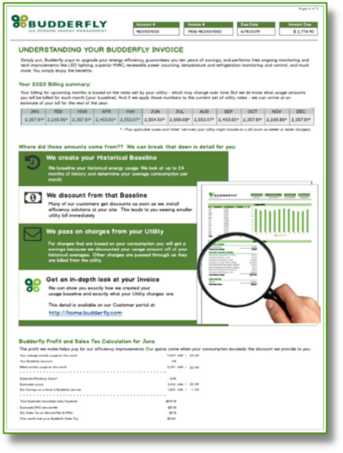
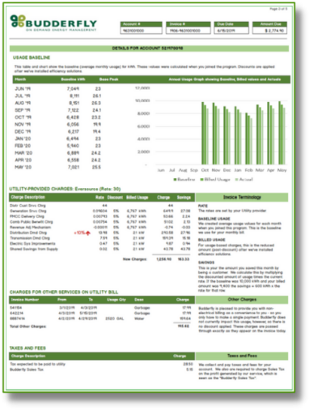
PATENTED ENERGY BILLING SYSTEM MANAGES THE SOLUTION
EASE OF MANAGEMENT
Budderfly’s patented billing system makes sense.
One bill, one system, to streamline multiple utility bills into one understandable, easy to use format.

Slide 7
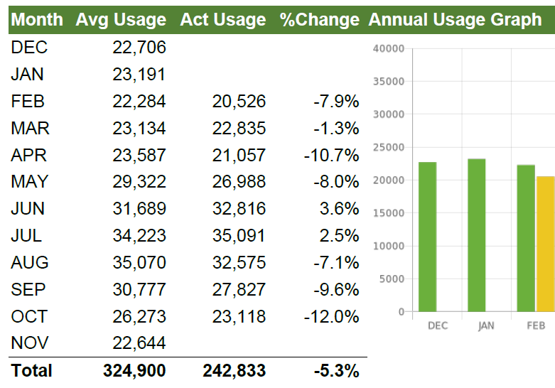
BUDDERFLY SOLUTION: HISTORIC USAGE
YOUR HISTORIC USAGE IS THE AMU (Average Monthly Usage)
Budderfly continually adds new savings solutions throughout the term

Slide 8
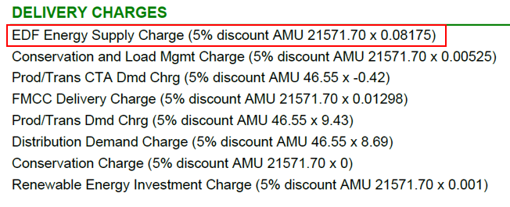
BUDDERFLY SOLUTION: GUARANTEED DISCOUNT
GUARANTEED COMMITTED CONSUMPTION SAVING DISCOUNT (CCSD reduces usage by 5%)
Budderfly continually adds new savings solutions throughout the term

Slide 9
BUDDERFLY MODEL IS SELF FUNDING
BUDDERFLY Converts Energy Waste into Franchisee Savings, Significant Upgrades and Services
Franchisee’s Original Energy Expense
Energy Savings Funds Franchisee Benefits
Committed Franchisee Discount: 5.0%
Energy Savings Pays for Upgrades: 20.0%
Shared Savings 50/50 split: 5.0%
(Immediate upon first upgrade install)
Usage
Savings
30%
(Waste convert into Franchisee value)
(50% Share starts after year 4)
Franchisee Benefit = 22.5% of Savings
5% committed upfront + no cost upgrades + 50% shared savings
Budderfly addresses remaining 70% with Renewables
Wasted energy is converted into savings by Budderfly to covers upgrade components, installation, monitoring, maintenance costs
Typical example above showing 30% savings with Shared Savings threshold contractually set at 25% after year 4.

Slide 10
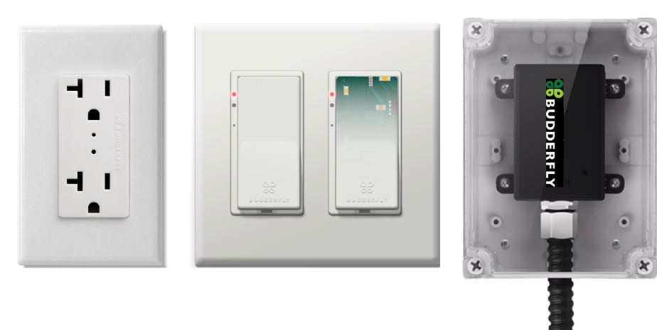
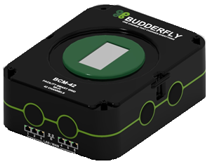
BUDDERFLY MAKES YOUR EQUIPMENT ENERGY INTELLIGENT

Slide 11
COMPREHENSIVE PORTFOLIO WITH 25+ SAVINGS COMPONENTS
BUDDERFLY TECHNOLOGIES
EMS
PLATFORM
FACILITY
SMART GRID
SMART IOT
DEVICES
LED LIGHTING
& CONTROLS
EQUIPMENT
MAINTENANCE
HVAC
REPLACE
HVAC
TREATMENT
HVAC
ECONOMIZER
ADV ROOFTOP
CONTROL SYS
MOTOR
REPLACE
REFRIGERATION
CONTROLS
WATER
HEATING
TEMP
MONITORING
TEMP
CONTROLS
INTELLIGENT
PROFILES
PEAK DEMAND
MGMT
DEMAND
RESPONSE
CAPACITY TAG
MGMT
BUDDERFLY TECHNOLOGIES
RENEWABLE
ENERGY
STORAGE
SOLUTIONS
GEOTHERMAL
HEAT/COOL
RADIANT
INSULATION
PHASE CHANGE
INSULATION
VENTILATION
EQUIPMENT
POWER FACTOR
CORRECTION
NORMALIZED
BILLING

Slide 12
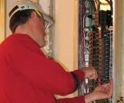
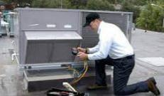
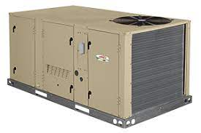
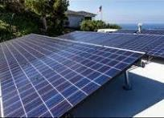
TYPICAL UPGRADES INSTALLED – NO OUT-OF-POCKET
ALL AT NO OUT-OF-POCKET COST
LED LIGHTING – if not completed
THERMOSTATS
CONSUMPTION METERING AND MONITORING
SIMPLE COMPRESSOR MAINTENANCE
HVAC UPGRADES:
Economizers
Treatments
Advanced Rooftop Controls
HVAC REPLACEMENT
HOT WATER HEATER REPLACEMENT– where applicable
FULL PARTS AND LABOR WARRANTY FOR TERM
ONSITE SOLAR AND STORAGE – where applicable
HVAC PREVENTATIVE MAINTENANCE PROGRAM*
(*For Fee Service… generally much more economical than local providers)

Slide 13
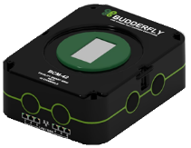
BUDDERFLY METERING AND MONITORING
Improves Equipment Life
Equipment usage can be identified by its energy consumption signatures
Budderfly creates baseline metrics - tracks individual energy signatures & operational variations
Enables visibility into what is happening by
Level: systemwide equipment performance, geography, territory, MUO, location type, etc.
Period: real-time or historical, minute, hour, day, week, month, year

Slide 14
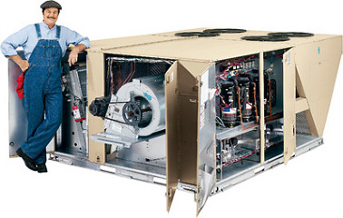
BUDDERFLY MAKES HVAC JUST ANOTHER COMPONENT
HVAC OPTIMIZATION –
We offer multiple Solutions for HVAC units not replaced by Budderfly
New motors installed – warrantied (parts & labor) for agreement
Performance additive
Intelligent thermostats
Intelligent integrated board chips
Franchisee only pays for PM administered by Budderfly
Quarterly PM (Preventative Maintenance) includes all materials a cost of $800 per year/unit for all HVAC
Full HVAC Replacement for qualifying locations*
Replaced HVAC Units are covered 100% parts and labor
Never worry about unplanned HVAC expense again
(*For qualified location based on spend and Engineer Survey)

Slide 15
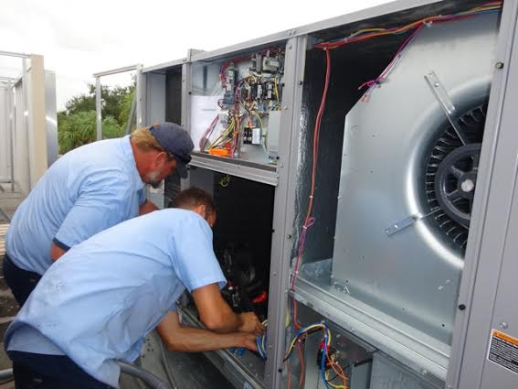
BUDDERFLY MAKES HVAC REPAIR AND SERVICE EASY
Our Commitment to you:
24/7 Support – We understand your HVAC equipment has no predictable timetable. That is why we have teams of experts standing by to assist.
Response* – Budderfly will endeavor to provide four (4) hour emergency response times to critical issues (HVAC is not functional)
Eight (8) hour response times to non-critical issues.
Certified Technicians – Our technicians are certified Specialists or Masters.
Systems Expertise – At Budderfly, we do not just change belts and filters - we provide a comprehensive range of services to ensure your unit continues to run efficiently. Including scheduled maintenance, emergency repairs, remote diagnostics and analytics, are just a few of the services we provide.

Slide 16
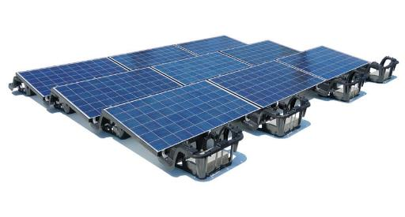
BUDDERFLY MAKES SOLAR JUST ANOTHER COMPONENT
On-Site Solar Made Simple For Meineke
BUDDERFLY has created the most unique and approach to Solar Energy
No upfront capital required by Franchisee
Short duration Term Commitment Period – 10 years vs. 15-20
Additional Savings of 10% off current supply rate
Additional Sign-On Bonus may be applicable
Maintain Any Existing Roof-Warranties
System Easily Removed at End of Lease Agreement
End of Term Flexibility (walk-away, renew, solar PPA only, buy out at FMV)
Ballasted Array Example

Slide 17
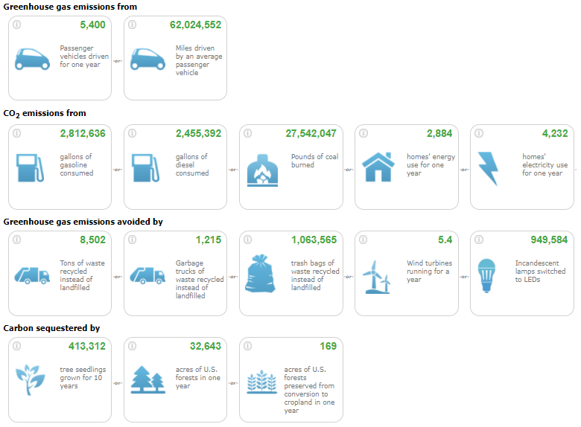
BUDDERFLY DELIVERS SUSTAINABILITY PR
Significant Sustainable Story for Popeyes at NO COST

Slide 18
CONTACT INFORMATION
Mike.Leatherwood@Budderfly.com
CELL: (786) 442-5065
THANK YOU

