Slide 1
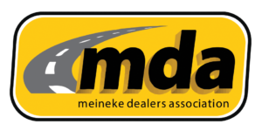

Slide 2
AUTOZONE - Meineke
Performance in Partnership

Slide 3
Sales have grown every month, year over year, for the last 3 years.
AutoZone has the right program in place, the right parts at the right price where you need them.

Slide 4
Advantages to the AutoZone Program

Slide 5
The Autozone advantage
All AutoZone stores are company owned! 7000 stores strong with over 100,000 employees.
Warranty Claims are handled seamlessly throughout the Meineke Network.
There are only 7 Meineke stores that are farther than 10 miles from an AutoZone commercial store. We are in your town, ready to deliver.
We have integrations into all shop Management systems you use, Mkey, VAST, TechMetric, and all others. You’ll see the servicing store, Network, and DC inventories, you can also see VDP parts that will come directly from the manufacturer, most times overnight.
Technical training is available in person for employee growth and development. These classes are hosted by our vendors and are ASE-quality classes.
We offer shop referrals to our DIY in-store and online customers, so get your shop set up today.

Slide 6
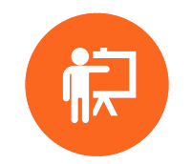
PROFESSIONAL BUSINESS & TECHNICIAN TRAINING
Train Today for Tomorrow’s Success
Our Training Partners:
Notes:
Updae

Slide 7
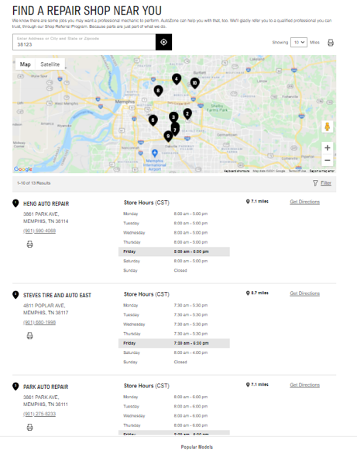
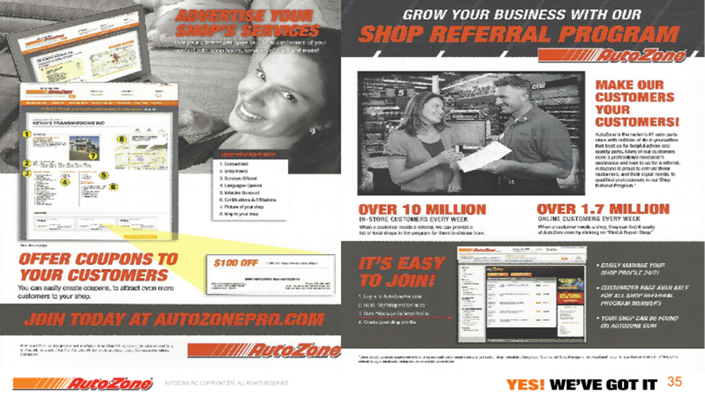
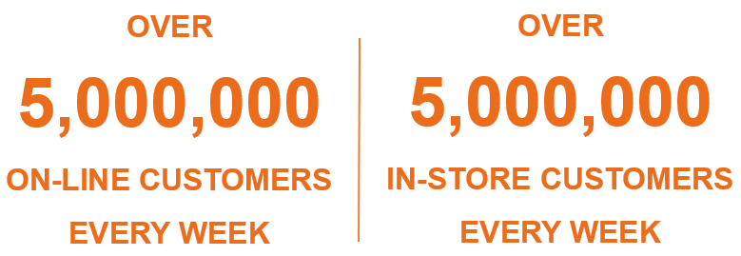
SHOP REFERRAL
Connect DIY customers to your shop
Promote your shops
Create custom coupons
Quick and easy signup process
Create custom coupons to be displayed in your referral profile
Updated search functionality in AutoZone.com to make it easier for customers to find your shop
Notes:
Priority Assignment
Shop search results will appear in the following priority order:
1. The closest Firestone or Tires Plus location appears at the top of the list.
2. AWS of $3,000 and above, sorted with National Accounts appearing first, UDS next and within each of those groups
sorted by sales (highest first)
3. AWS between $2,000 and $2,999, sorted with National Accounts appearing first, UDS next and within each of those
groups sorted by sales (highest first)
4. AWS between $1,000 and $1,999, with National Accounts appearing first, UDS next and within each of those groups
sorted by sales (highest first)
5. AWS between $300 and $999, with National Accounts appearing first, UDS next and within each of those groups
sorted by sales (highest first)
If no shops within the consumer’s set distance range meet the requirements above, then the following criteria is applied (all,
not in order of listing below):
6. Greater than or equal to $50 AWS in the prior month
7. Enrolled in the program
8. Customer Type is National Account
9. Number of Techs greater than or equal to 2
10. Primary Shop Type is General Repair

Slide 8
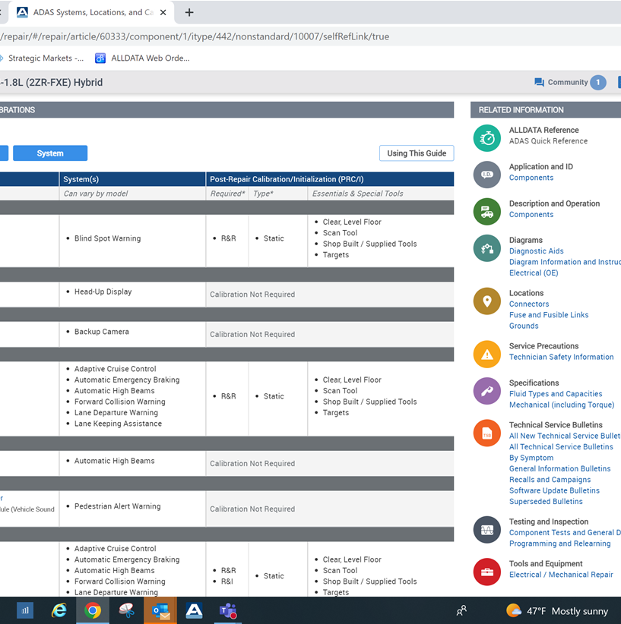
Meineke convention
What to plan for, we will offer training for break out sessions on hot topics:
Technical training to highlight new business opportunities :EV and Hybrid repair and maintenance…Scan Tool updates…
ADAS training – why its important to know – invest or outsource?
ALLDATA ADAS hot link :

Slide 9
DISCUSSION

