Slide 1
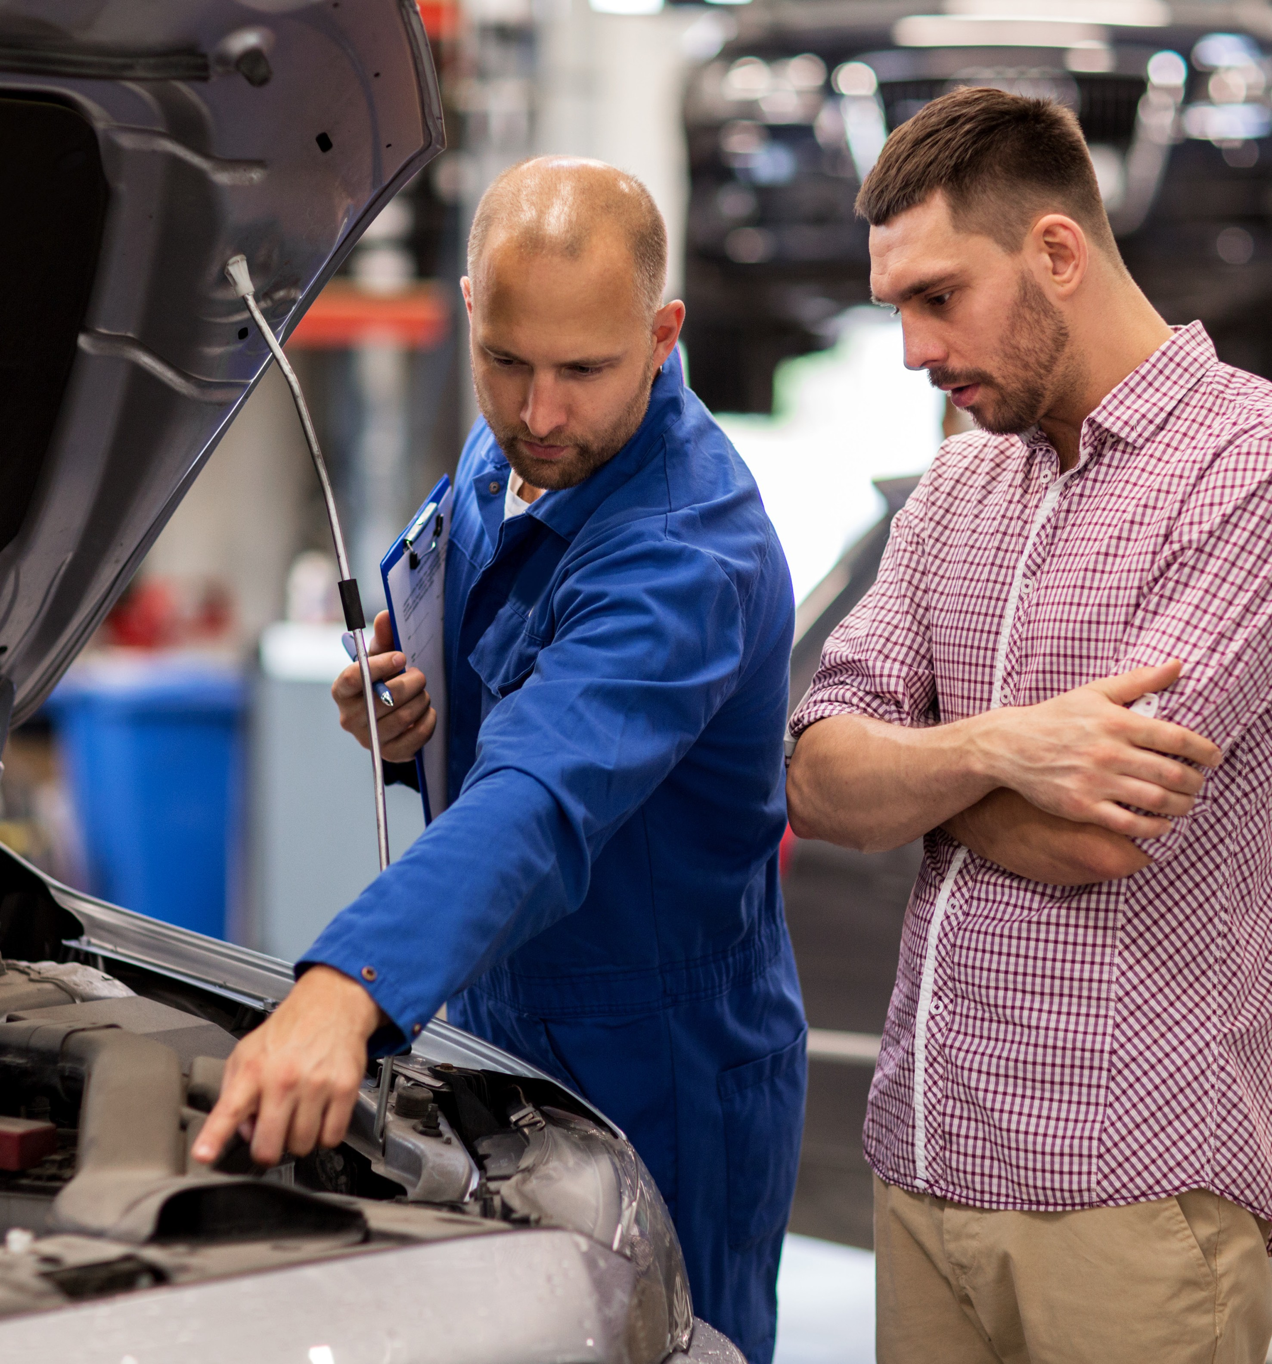
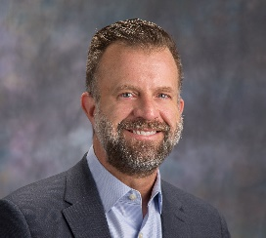
4 Easy Steps to Increasing Profits and Revenue
Chris Evans
Director, Partnerships
AutoVitals

Slide 2
Customer Engagements = Profitable Growth
What should your ARO goal be?
5x Your Labor Rate!!

Slide 3
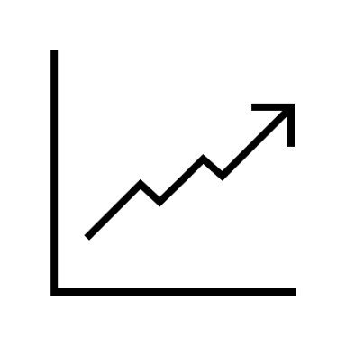
Customer Engagements = Profitable Growth
Don’t become a box checker when it comes to DVI!
By-products:
Customer Satisfaction
Profitability
New Customers
Retention
Employee Satisfaction
Customer Engagement
ARO $$

Slide 4
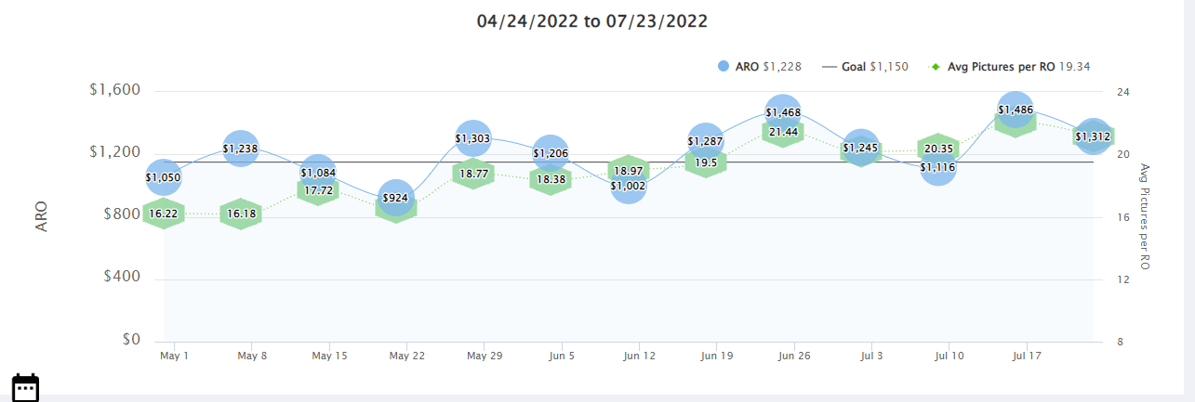
Customer Engagements = Profitable Growth
1. Number of Pictures
ARO $$
Average Pics per RO

Slide 5
Customer Engagements = Profitable Growth
Are just any pictures ok to use?

Slide 6
Customer Engagements = Profitable Growth
2. Explain your Pictures
ARO $$
Average Edited Pics

Slide 7
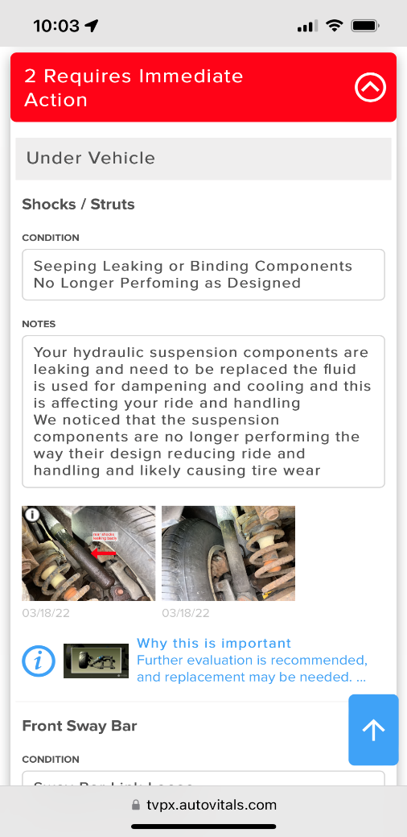
Customer Engagements = Profitable Growth
2. Explain your Pictures (con’t)
More content = increased trust and higher ARO!
Transparency with DVI builds trust
Educational content supports your recommendations
Canned condition notes
Canned notes explaining the issue
Explaining the pictures/videos
“Why this is important” videos

Slide 8
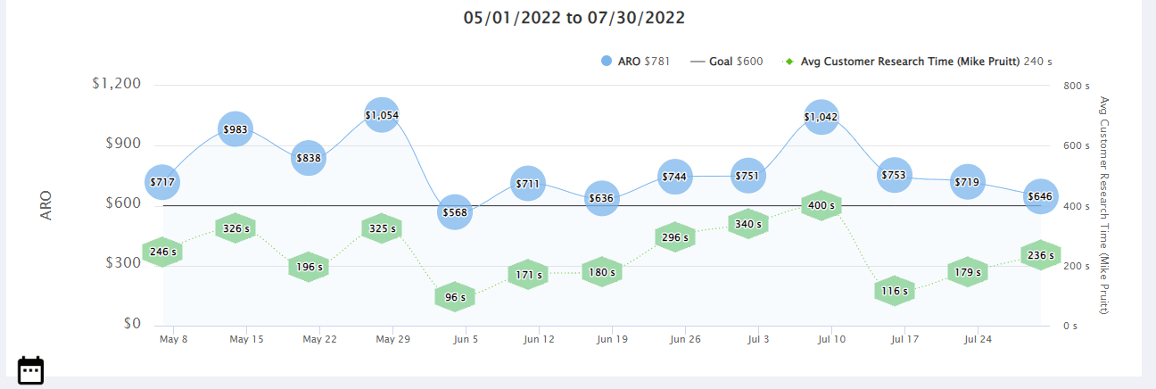
Customer Engagements = Profitable Growth
3. Give your Customers Time to Review the Inspection
ARO $$
Average CRT
Customer Research Time (CRT)

Slide 9
Customer Engagements = Profitable Growth
After sending the DVI, when should I contact my customer?
When they’ve had at least 240 seconds to review the inspection!

Slide 10
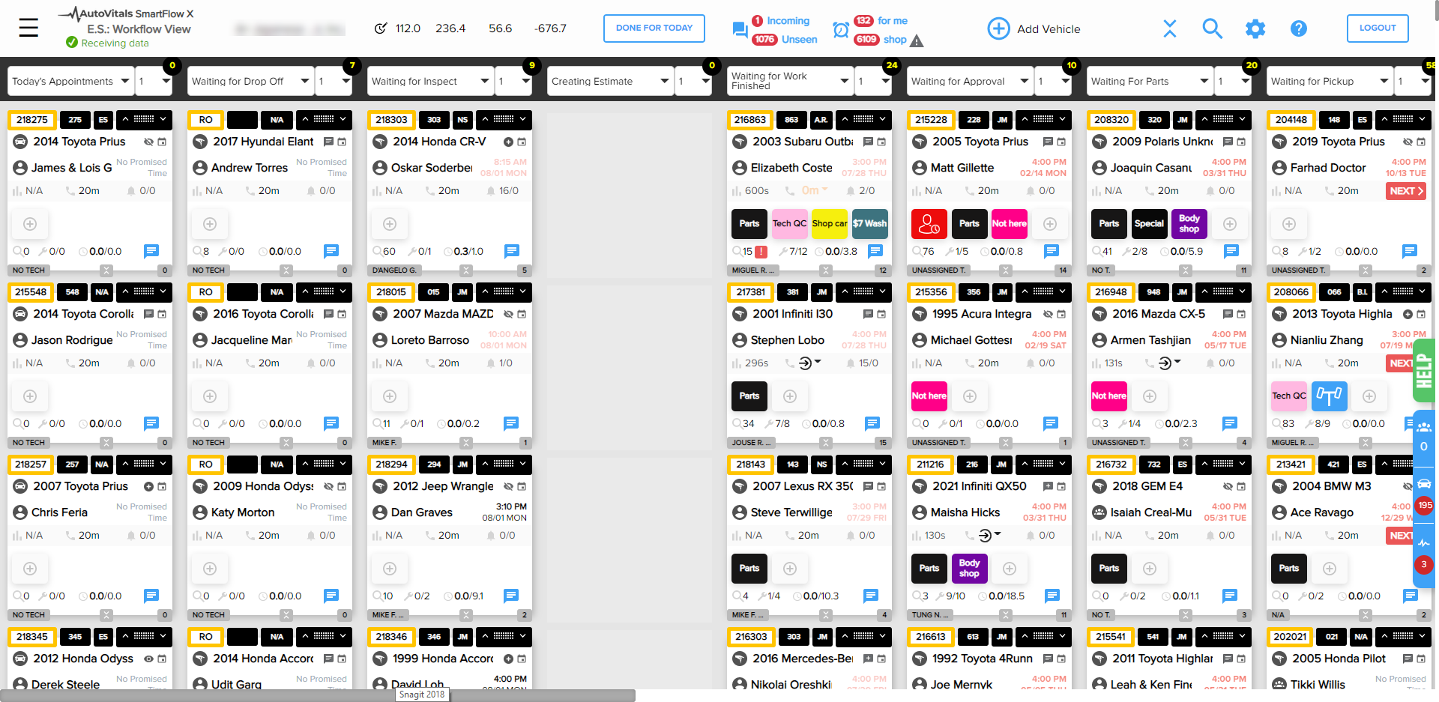
Customer Engagements = Profitable Growth

Slide 11
Customer Engagements = Profitable Growth

Slide 12
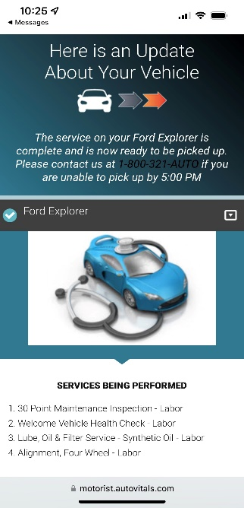
Customer Engagements = Profitable Growth
3. Utilize Automated Status Updates
Waiting for inspection
Creating estimate
Waiting for approval
Parts ordered/on hold
Waiting for work finished
Waiting for pickup
Also increases loyalty!
Reduces incoming calls by 67%!
*
*Service Desk Institute

Slide 13
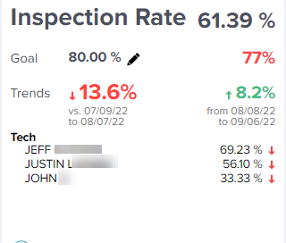
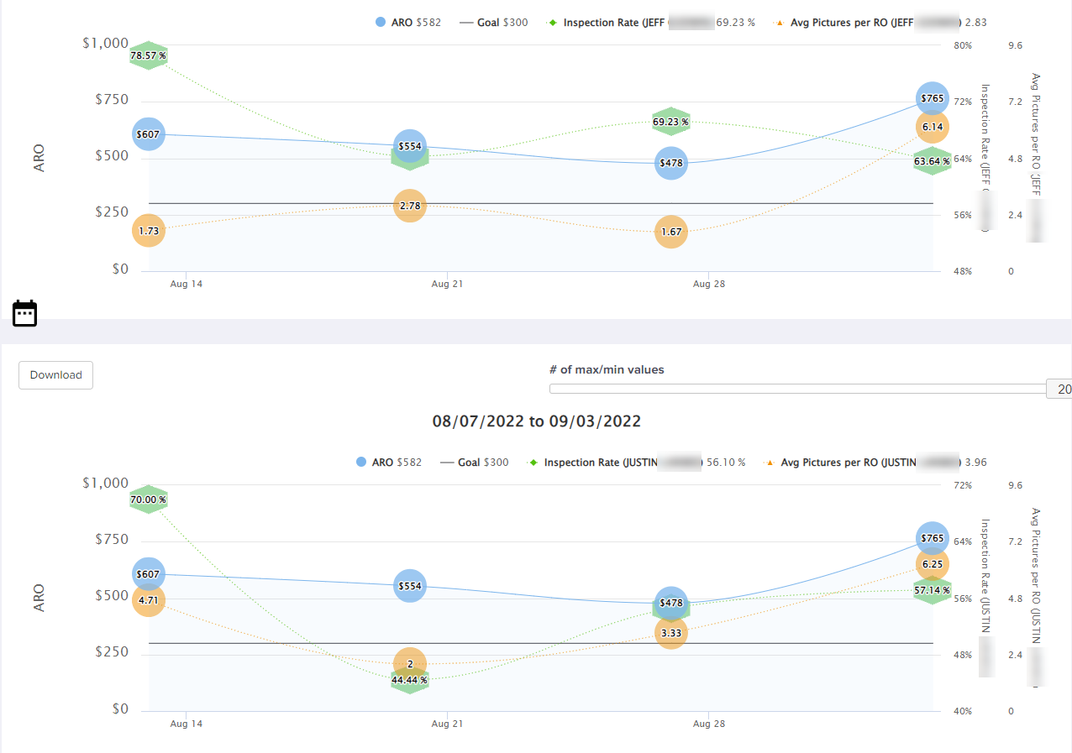
Customer Engagements = Profitable Growth
4. Leverage KPIs
Identify best practices
Guide struggling techs with proven success from their peers
Inspection rate
Ave pictures per RO
ARO $$
Goals
*klara.com

Slide 14
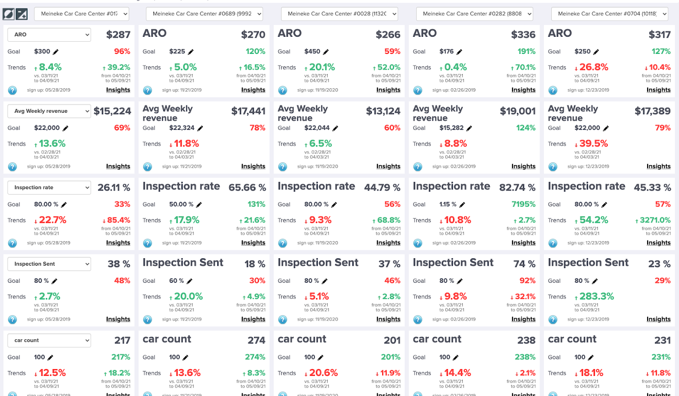
Customer Engagements = Profitable Growth
#100
#1001
#2002
#2801
#2501
Multi-shop KPIs
ARO
Inspection rate
Inspection sent rate
Car count
% of pictures edited/explained
And more…

Slide 15
Customer Engagements = Profitable Growth
5. Request Customer Reviews
Should be automated
Receive higher ratings.
Review requests generates 4.34 out of 5 stars
Unprompted reviews receive 3.89 out of 5 stars
Businesses with a 4.0 to 4.5-star rating earn an additional 28 percent in annual revenue, while 5-star businesses have below-average sales, sometimes earning less in revenue than 1 to 1.5-star businesses.*
Responding to negative reviews makes it more likely for 44.6 percent of consumers to visit a business.*
*reviewtrackers.com

Slide 16
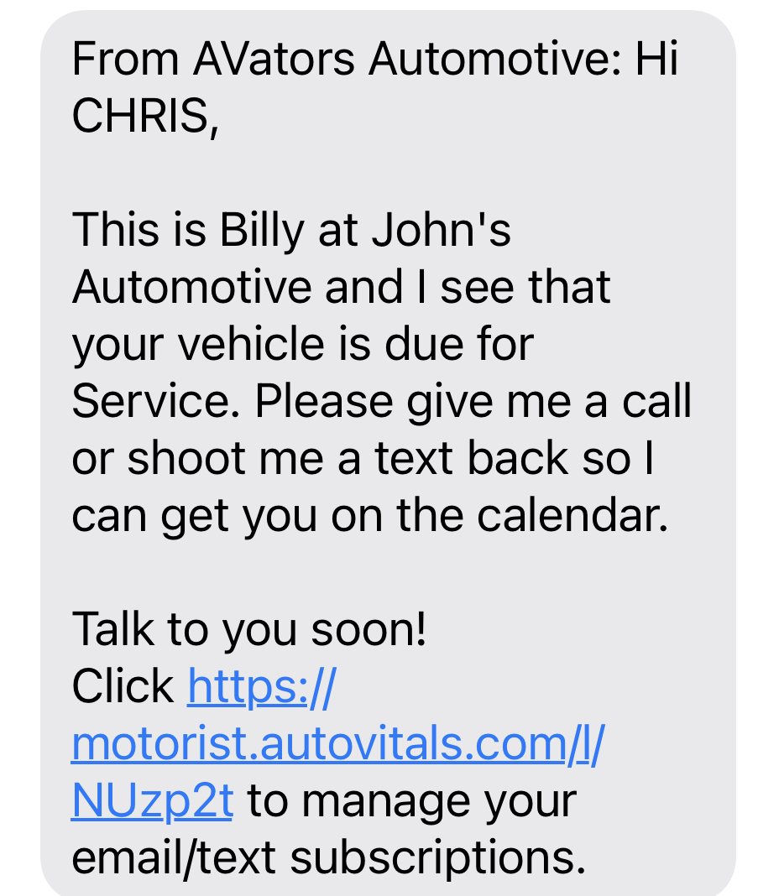
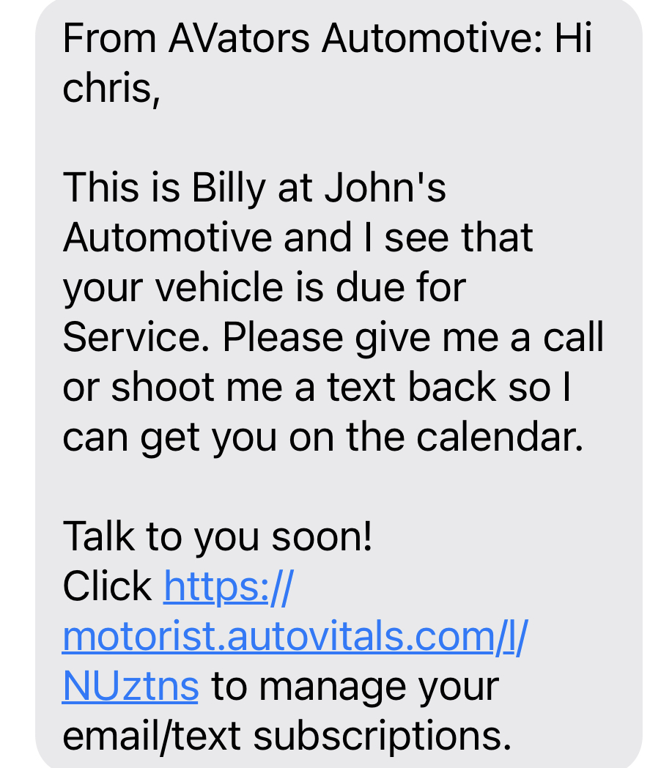
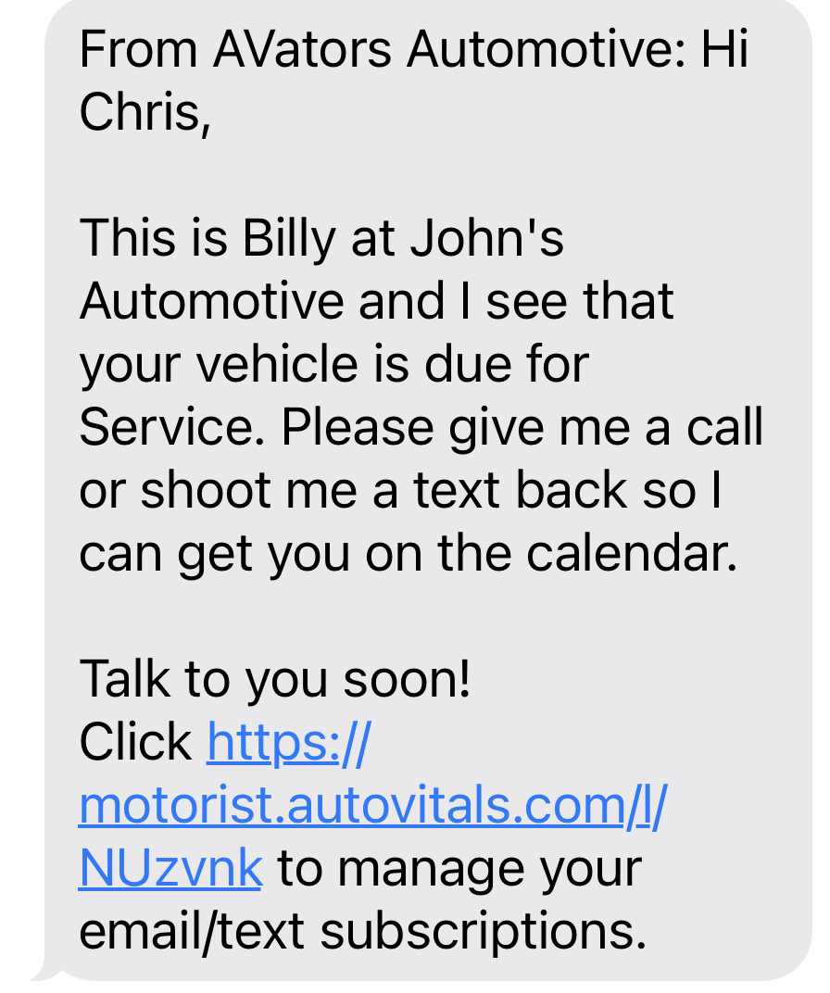
Customer Engagements = Profitable Growth
Which looks more personable?
(A)
(B)
(C)

Slide 17
Customer Engagements = Profitable Growth
What should be your ARO goal?
5x Your Labor Rate!
If your labor rate is $150/hr, then your goal should be $750…
Automotive Averages:
National average - $374
AutoVitals shop average - $503
Top 200 AutoVitals shop average - $962

Slide 18
Customer Engagements = Profitable Growth
How do you get there – shop goals?
Advise your customers that they’ll receive an inspection.
Inspection rate
Inspection sent rate
Average pictures per inspection
% of pictures edited
Average # of recommendations
CRT (customer research time)
80% minimum
80% minimum
15 or more
30-60%
8-10
240 sec minimum

Slide 19
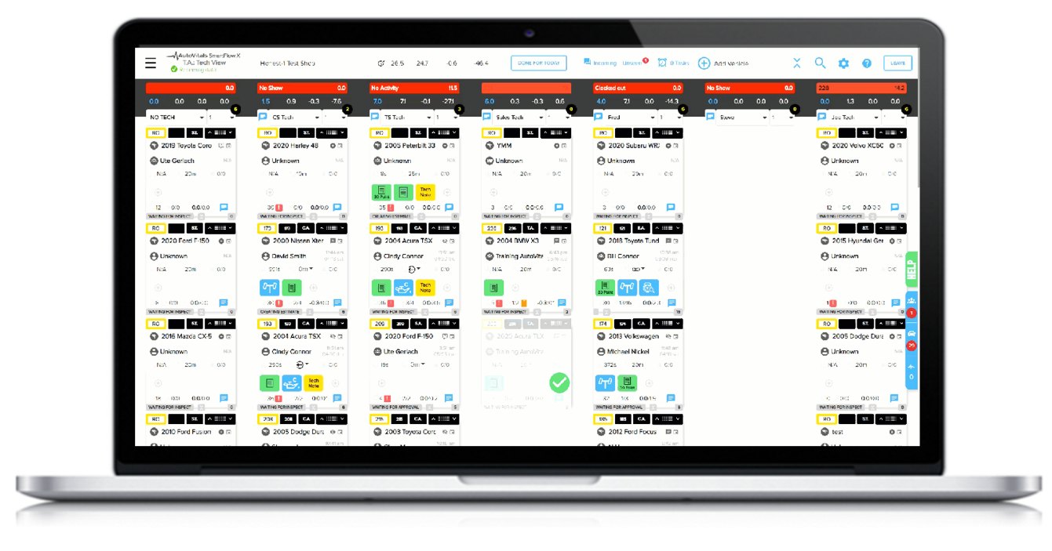
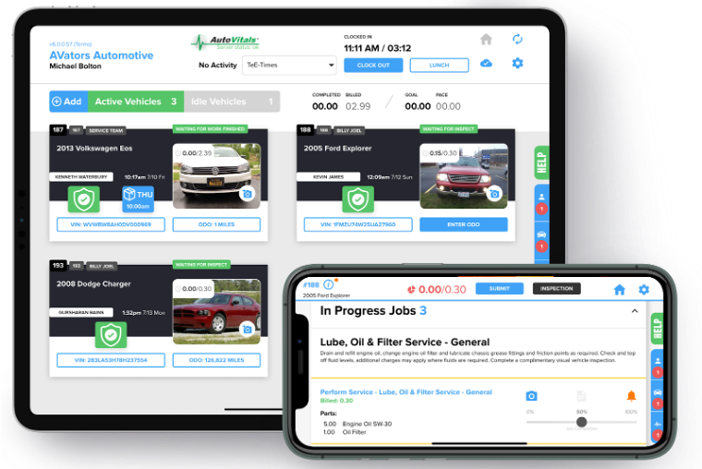
Customer Engagements = Profitable Growth
Major Notables
Pre-populated notes from the tech to the customer
Educational videos – the “why”
Internal chat
Smart markers
Recommendations automatically populate
Task manager
Guided mode for easy tech training
In-app notifications
Shop eyes only notes
Dedicated coach

Slide 20
Customer Engagements = Profitable Growth
Bottom line… A truly effective DVI will provide the following:
What you find during the inspection AND the “why”
The customer’s inspection interaction
+60 KPIs – You can’t manage what you can’t measure!
Technician comparisons
Multi-shop comparisons
Repair status updates
Keeps employees at their stations
Keeps your customers engaged

Slide 21
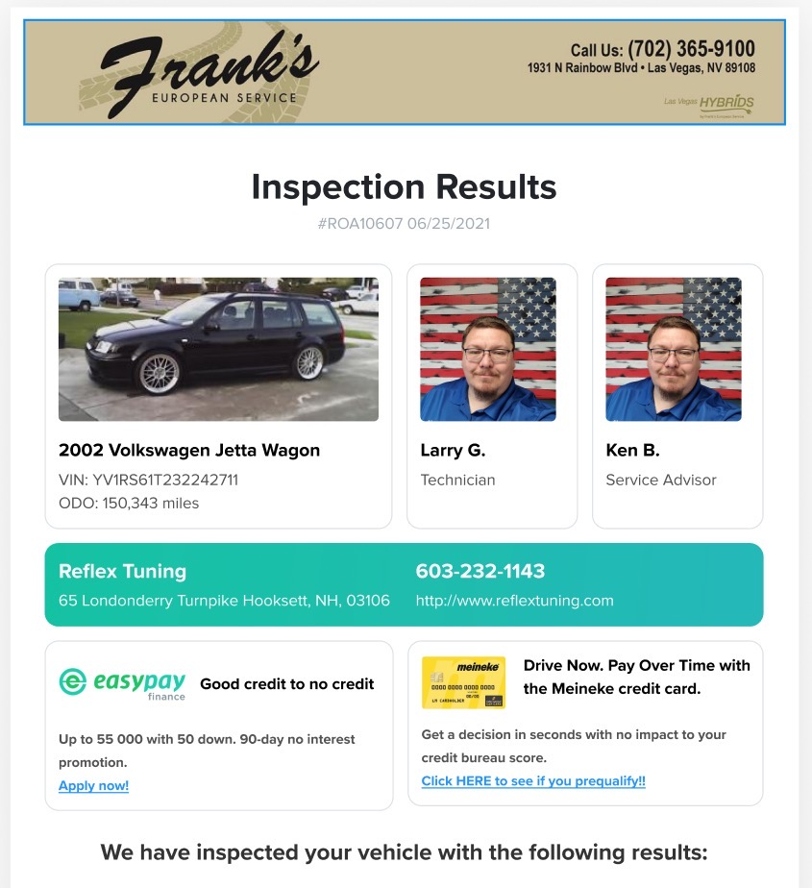
Customer Engagements = Profitable Growth
Integrations coming soon…
Consumer Financing
Synchrony
EasyPay Finance
American First
Sunbit
360 Payments waterfall

Slide 22
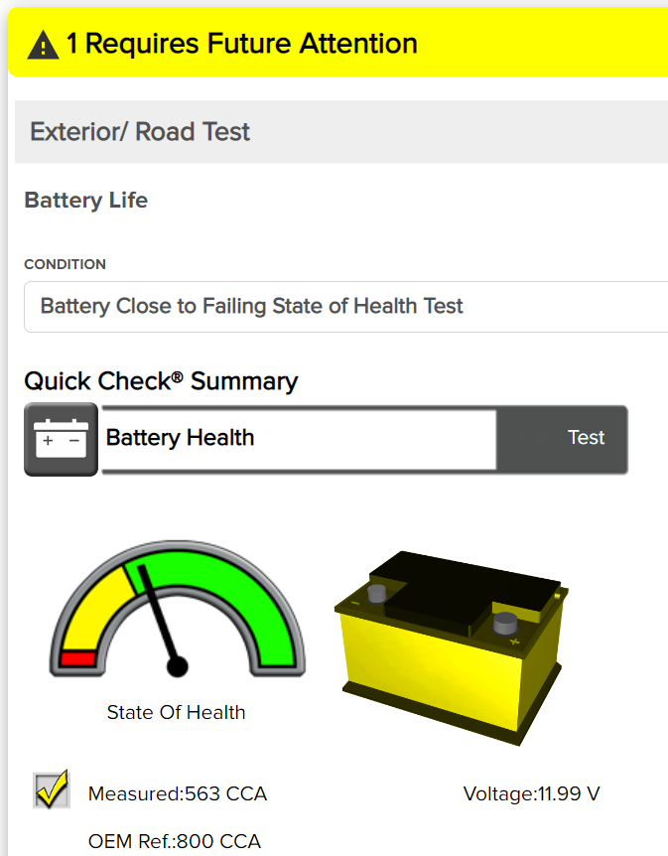
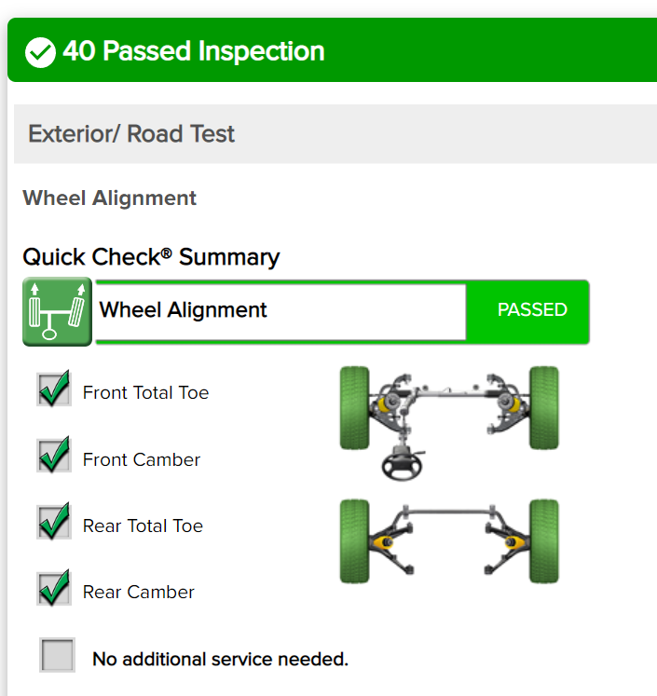
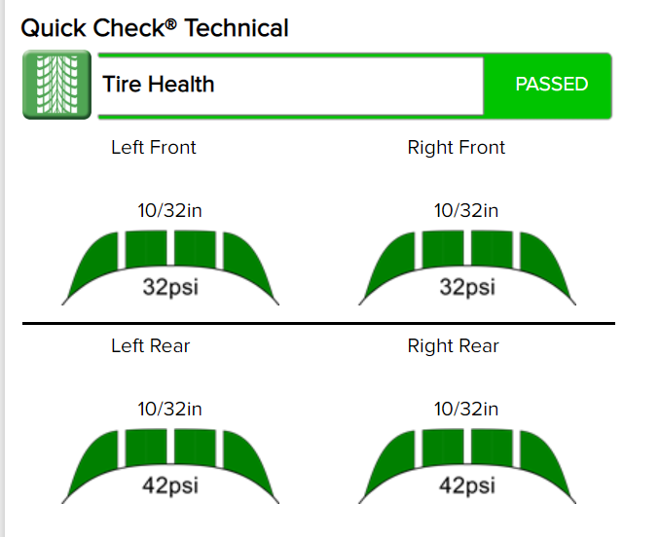
Customer Engagements = Profitable Growth
Integrations coming soon…
Technology
Repairify
Hunter
Grove Glove
Autel
And more

Slide 23
Customer Engagements = Profitable Growth

