Slide 1

MDA
2022 VAE

Slide 2
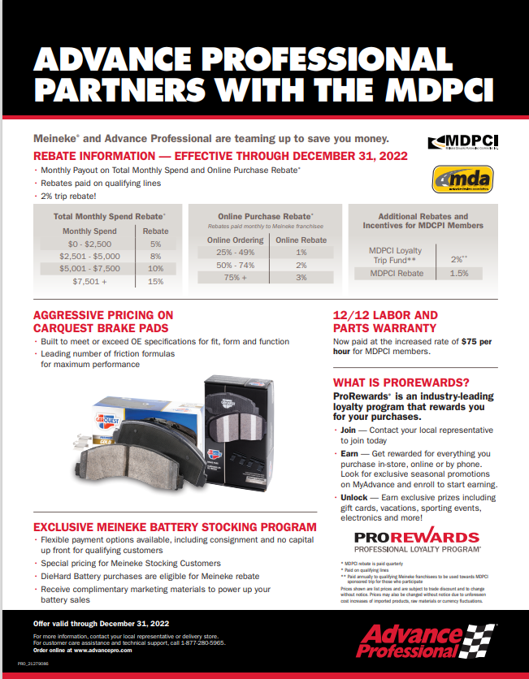

Slide 3
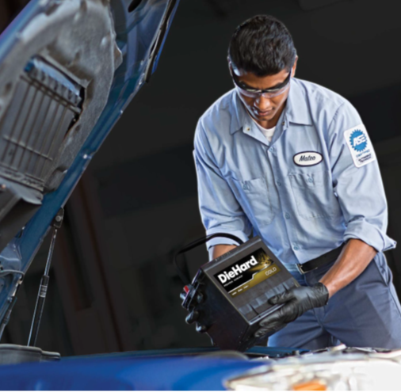
Winning Strategy
Best in Class Product – DieHard
Consignment Stocking Options
Special MDPCI Battery Stocking Pricing
Marketing Support
DieHard Assurance
Battery Tester Program

Slide 4
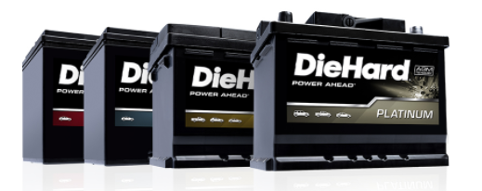
Stocking Pricing
Most Silver Batteries* | $89.99
With MDPCI Max Rebates | $72.44
* 2-year free replacement
Most Gold Batteries* | $109.19
With MDPCI Max Rebates | $87.90
* 3-year free replacement
Most Platinum Robust Batteries* | $124.79
With MDPCI Max Rebates | $100.46
* 4-year free replacement
Most Platinum AGM Batteries* | $155.99
With MDPCI Max Rebates | $125.57
* 3-year free replacement

Slide 5
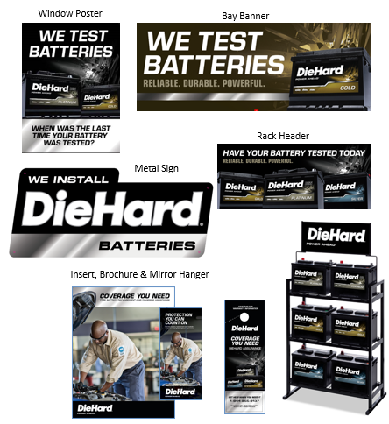
Complimentary Marketing Support
We’ve got you covered!!

Slide 6
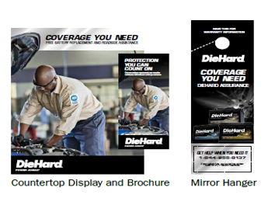

DieHard Assurance
Protect your customers with industry-leading battery coverage
Included Marketing Materials
FREE Battery Replacement, and the following coverage up to $125:
24 months or 24,000 mile coverage
24-hour jump starts and towing
Travel coverage up to $250
No cost to you or your customer
Flat tire changes
Fluid delivery
Lock out assistance
Get FREE marketing materials to help increase your battery sales
Bi-Fold
Mirror Hanger
Counter Top Display
Counter Top Insert
Special resources for you and your customers
Learn more about DieHard Assurance

Slide 7
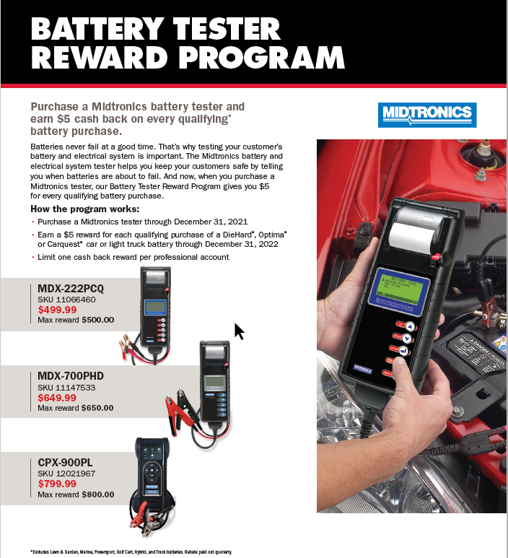
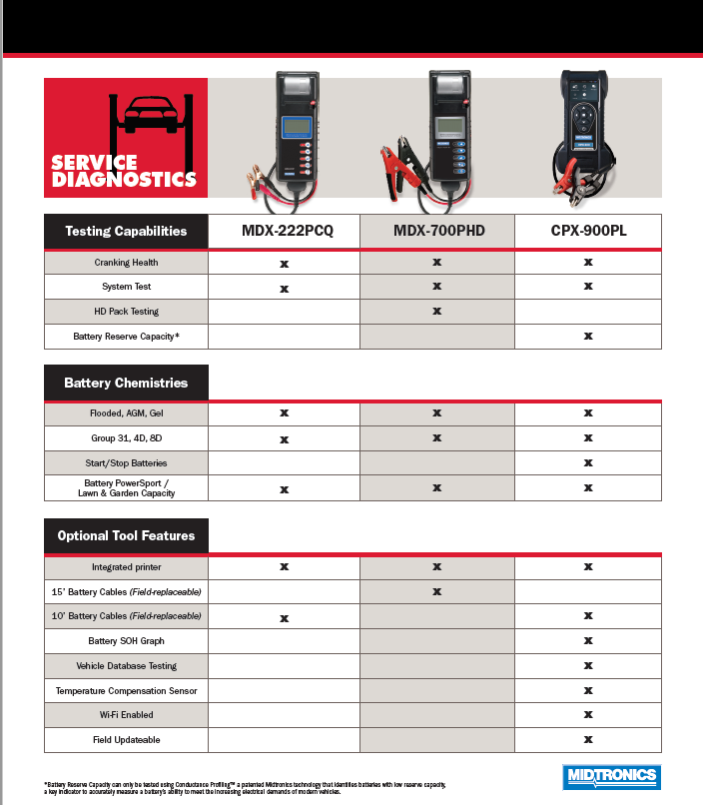
Battery Tester Program

Slide 8
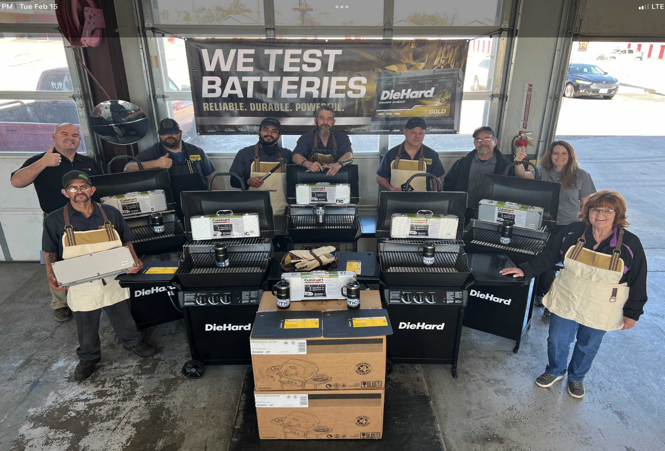

Slide 9



Meineke Exclusive Promo - October/November!

Slide 10

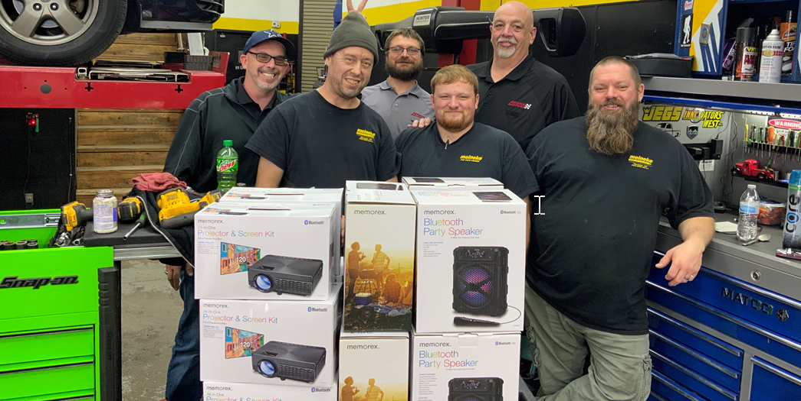
July/August Steering and Suspension Meineke Exclusive Promotion Winners!!
Utku Alp 1675 – Milwaukee, WI Jeff Richardson 1888 – Holyoke, MA
Philip Scheidler 2919 – Muncie, IN Jim Sloan 2005 – Broken Arrow, OK
Brendan Sullivan 1377 – Overland Park, KS Paul Hammond 342 – Charlottesville, VA
Paul Hammond 584 – Hampton, VA Castor Cooper 730 – Gastonia, NC
Mark Nelson 2602 – Bluefield, WV Matthew Gates 1114 – Portsmouth, NH

Slide 11
Investing in Our Partnership
Targeted Categories that received price reductions in 2022
Bearings, Seals, Hub Assemblies
Brakes - Calipers
Brakes - Hydraulics
Chassis Parts (including CQ Blue)
Climate Control - Heating & Air Conditioning
Cooling System - Parts & Components
Cooling System - Water Pumps and Hardware
DORMAN-branded products
Exhaust
Ignition/Emission - Air Injection & O2 Sensors
Ignition/Emission - Fuel Injection Components
Ignition/Emission -Spark Plugs
Oil Filters
Brake Hardware
Ignition/Emission – Ignition Components
Performance Parts
Power Steering & Components
CV Axles
Belts
Radiators
AC Compressors
Fuel Pumps
Wiresets
Timing Belt Kits
TPMS Sensors
Thermostats
Radiator Fan Assemblies
Hoses
Radiator Caps

Slide 12

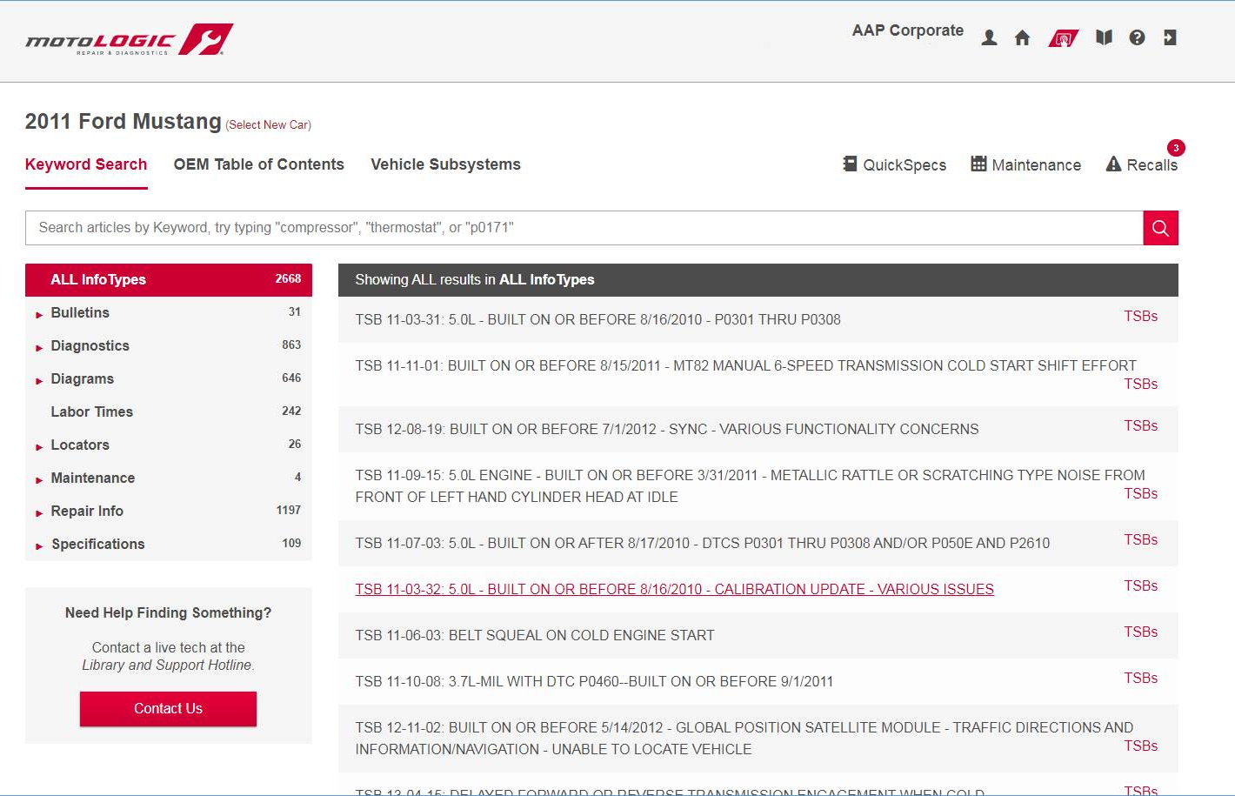
100 Unedited OE Information
Smarter Search Leading Coverage
Revolutionary Platform
More Features Shops Need

Slide 13

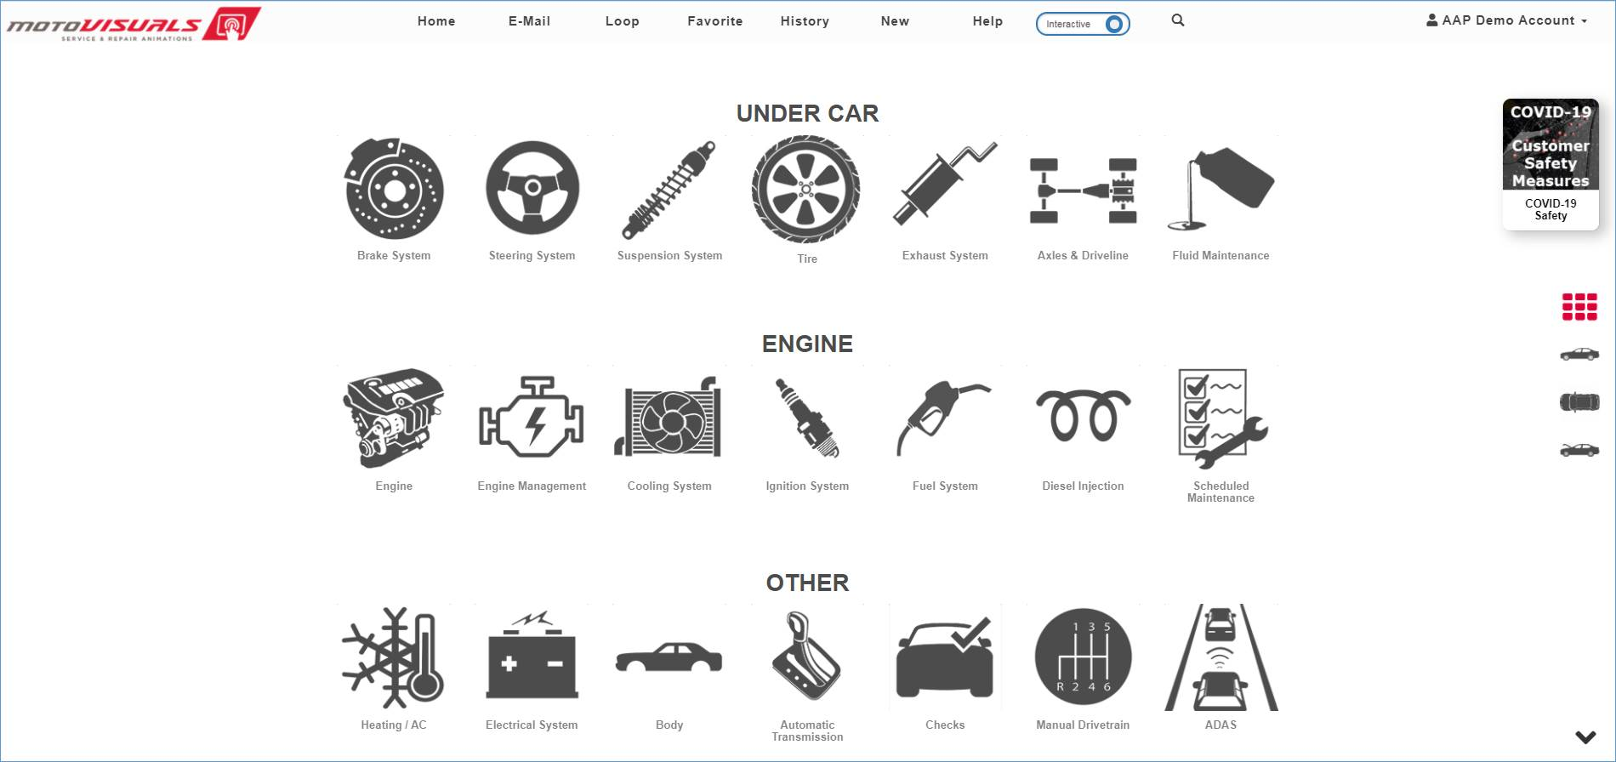
Explain Service and Repairs – Bring Service Recommendations to Life
Increase Customer Confidence –Many Ways to Share
Help Increase Your Close Rate

Slide 14
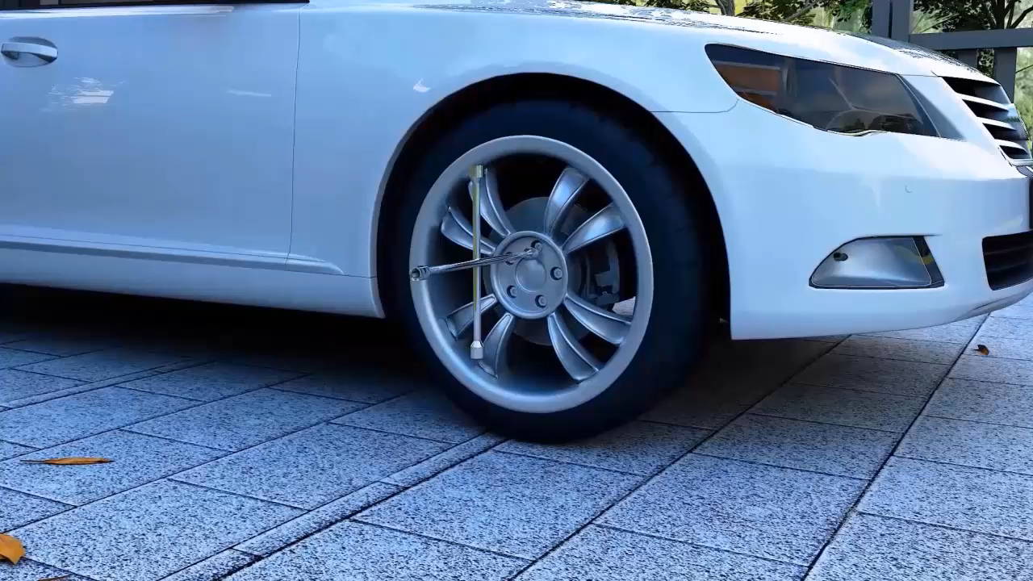

Slide 15
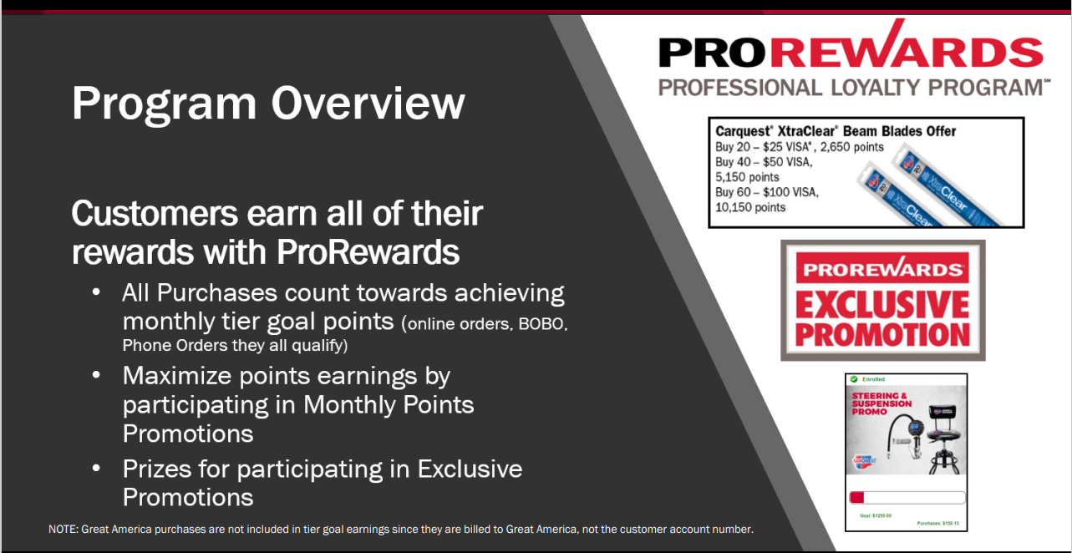

Slide 16
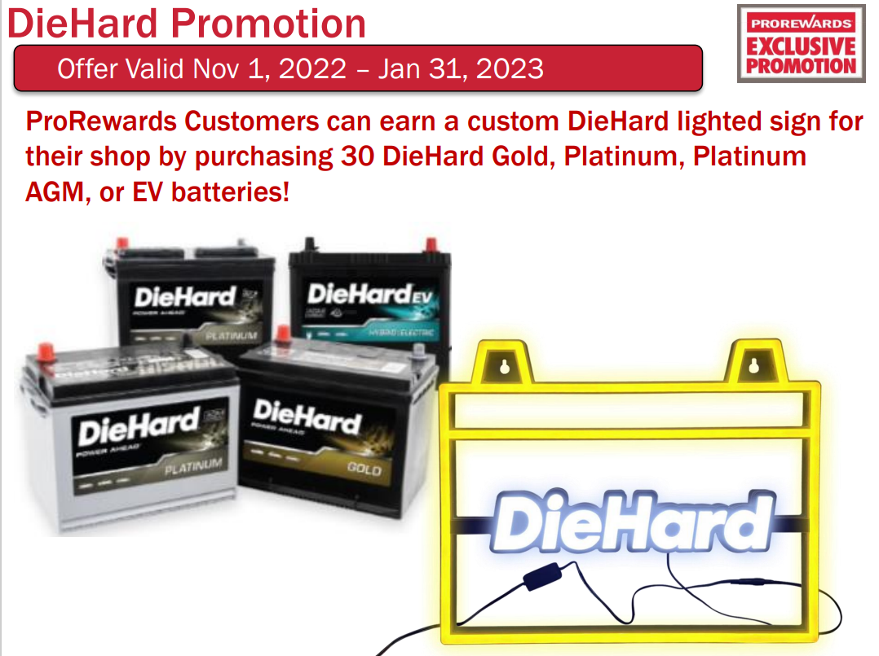
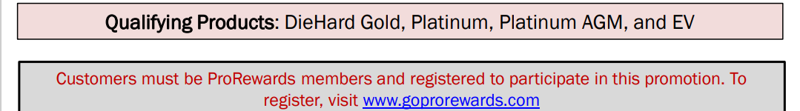

Slide 17


Slide 18
