Slide 1
2022 / 2023 MDA
ATD program
12/14/2022

Slide 2
Agenda
About ATD
Digital capabilities
Data & Analytics
2022/2023 tire program
1

Slide 3
About ATD
Who we are and our capabilities

Slide 4
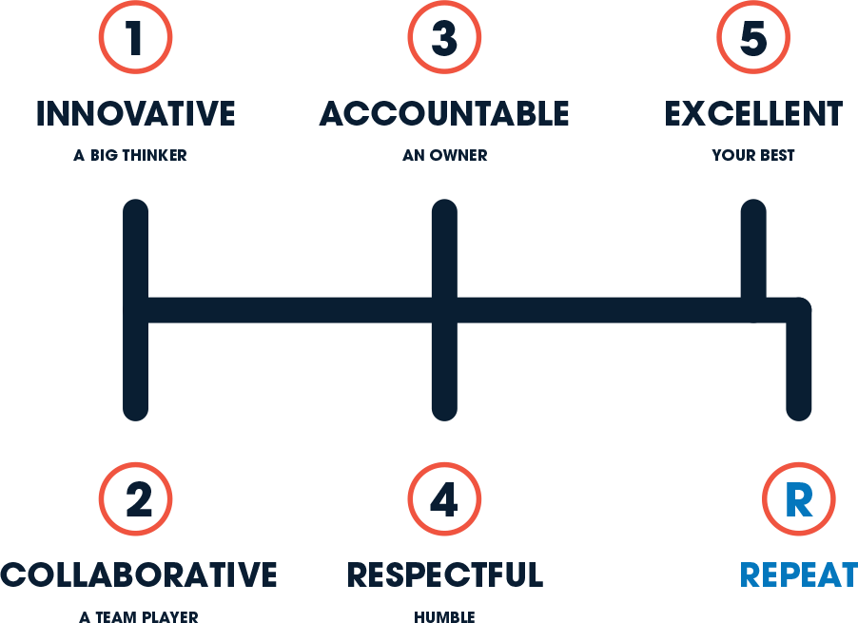
Our Purpose, Vision and Values form the bedrock of our company
Purpose
To help our customers thrive
and drive to the future
Vision
To be the most connected and insightful automotive solutions provider
Values
We share the responsibility for the wellbeing of our company, our associates, and our customers.
Everyday we strive to BE…
3

Slide 5
Our refreshed strategy is founded in our vision to be the most connected and insightful automotive solutions provider
Market-
Leading Data and Insights
WIN
Trusted Connector of the Automotive
Aftermarket Ecosystem
Tools and Capabilities to Build Our Customers’ Business
Innovative and Aligned Partner
DIFFERENTIATE
Seamless Fulfillment to Efficiently Solve
Customer Needs
Best-in-Class Logistics
Broadest Product Selection
Easy and Convenient
Ways to Interact
COMPETE
Right Price, Always Available
Transparent, Competitive Pricing and Promotions
Always in Stock
Continuous Improvement Capabilities Reliable and Secure Technology Connected Culture & Agile Talent Industry-Leading ESG
FOUNDATION
Future-Focused Fundamentals
4

Slide 6
ATD is a premier automotive solutions provider, harnessing data- driven solutions and innovative technology to connect world-class manufacturers with customers throughout North America
Network
139 Distribution
Centers
30+ Hub & Spoke networks
4 Mixing Warehouses
7 Adjustment Centers
Transportation
Inventory
$1B Product on
Hand
22M SqFt. Warehouse
600k Stocking Locations
15k Active Products
Customers
80k Total
customers
130k Delivery Points
8M+
Deliveries/year
45M Units Delivered/year
Employees
5k Associates
across
North America
825 Sales Associates
1 Unique Culture
80M Miles/year
17k Int’l
Containers/year
1.4k Private Fleet
5

Slide 7
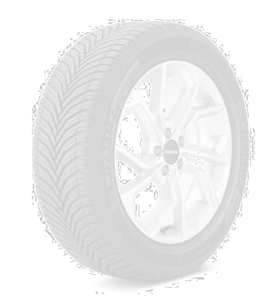
In 2021, ATD
distributed
We serve 80,000 total customers across channels…
33 Million tires to customers across all major channels
Core
Independent
Auto Dealer
Large Independent & Corporate
eCommerce
Retailers
And more…
With our strategically aligned portfolio of brand partners
6

Slide 8
Digital capabilities

Slide 9
Our digital capabilities enable our retail customers to seamlessly reach consumers and manage their businesses
Ordering platform
Fully customizable
Fully customized, branded websites and mobile applications
Personalized mobile app
Full product catalog
Full search, location, quote
and purchase features
Microlearning tool
Behavioral science,
artificial intelligence
Performance and knowledge growth
APEX
Incentive program
management solution
Direct retailer visibility
Seamless Ordering and Fulfilment
Enabling Sales
Self-service order visibility
Fully-digital, mobile-first
Modernizing delivery of products and services
Routing and telematics software
Optimizes our fleet to ensure quick, consistent delivery
Value added services
Helps retailers manage
their business
8

Slide 10
Data & Analytics
Data and Analytic driven decision making

Slide 11
Torqata tools, powered by data, enable users to make informed decisions
that will optimize operations
Productivity + Profitability
Marketing + Sales Vendor Automation
Market Price Explorer
Gain full access to market data & analysis on local, national, and e-commerce tire prices
AUTO
Auto Replenish
Automatically maintain your SKU-level inventory and take the worry out of balancing supply and demand
Profit Expert
Maximize profit by leveraging backend rebates and benefits
REPLINISH
Category Compass
Optimize SKU mix for each
location based on local demand
Demand Navigator
Increase store traffic and sales through a lead generation tool leveraging customer data
Tire Eye
Improve customer satisfaction by locating the right tire at the closest location.
TIRE
EYE
MARKET
Market Intel Planner
Program Planner
Future product roadmap
INTEL PLANNER
Enhance sales strategies based on market signals and actionable insights provided in an easy to use dashboard
Increase performance of rebates, promotions, and campaigns with actionable insights
Product Equivalence
Identify product alternatives
Sales
Voyager
Purchase Order Forecasting
Increase fill rates from manufactures and manage contractual obligations
Multi Echelon Stocker
Anticipate & plan for
changing market trends
Dispute Resolution Transparent, seamless data stream between OE, distributors, and
retailers to immediately resolve discrepancies and promote action
Sales Voyager
Set and adjust sales plan and use to push good, better, best tire recommendations to the front office sales team
Mobile Tire Installer Application or service for connecting tire installations at
the point of customer need
© 2021 Torqata Data and Analytics, LLC. All rights reserved
1
0

Slide 12
ATD/MDA Meineke program
Driving value to you everyday

Slide 13
ATD / MDA 2022 program elements
ATD custom program:
Strong brands with coverage for all segments of the business.
Two custom programs to help enhance profitability.
Ability to roll up multiple locations to maximize savings.
ATD Retail Rewards and Partner Program.
ATD Xpress:
On demand delivery for franchisees when they sign on an ATD tire program (Currently available to 70%+ of the Meineke franchise locations.
ATD Tire Protection Plan:
Nation-wide tire protection plan with full road hazard coverage on program tires.
National preferred pricing program:
Consistent and competitive pricing matrix for all locations.

Slide 14
2022 program elements

Slide 16
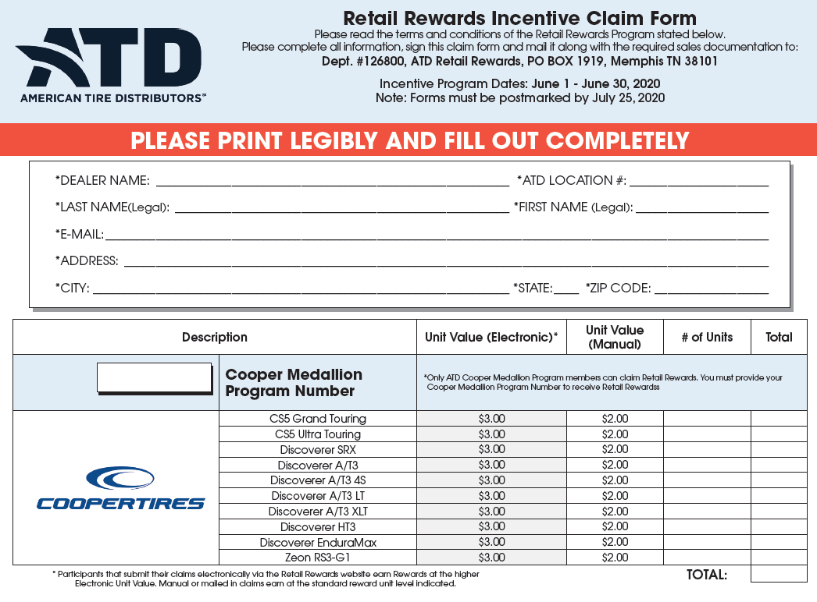
ATD – Cooper Retail Rewards
Program Details
All ATD Cooper Extra Dealers are eligible for ATD’s Retail Rewards Program
Eligible dealers can enroll employees to earn additional income for selling Cooper Tires
Submit monthly sales and ATD will issue Retail Rewards to a reloadable Visa Debit Card
ATD will issue 1099s to employees who earn more than $600.00 annual

Slide 17
ATD – Meineke Toyo Plus Program
Program Details
Program earnings start at 50 qualifying units per quarter
All products earn – simple and
easy
Quarterly Volume Bonus schedule for additional earning opportunities
Multi-location owners can combine units to maximize earnings
YE Reconciliation Program
Participation in ATD Retail
Rewards program
Must sign up through ATD Marketing department
Units per Quarter | Light Truck | Passenger
50 | $ 3.00 | $ 2.00
Quarterly Volume Bonus
100 | $ 3.00
250 | $ 4.00
400 | $ 5.00

Slide 18
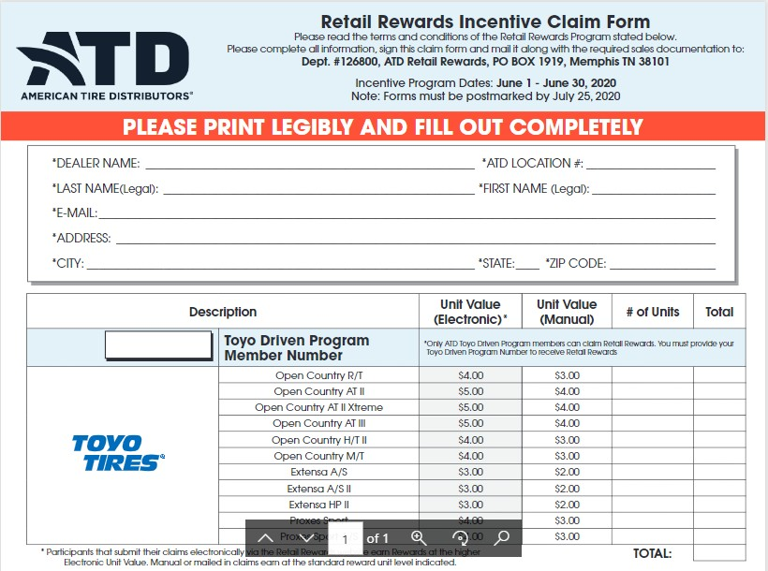
ATD – Toyo Plus Retail Rewards
Program Details
All ATD Toyo Plus Dealers are eligible for ATD’s Retail Rewards Program
Eligible dealers can enroll any sales associates to earn additional income for selling Toyo Tires
Associates submit monthly sales and ATD will issue Retail Rewards to a reloadable Visa Debit Card
ATD will issue 1099s to employees who earn more than $600.00 annual

Slide 19
Tiered brands to support your business needs
Paid out to each location quarterly based on that locations purchases on the below brands.
Tier One
$3.00 per tire
Tier 2
$2.00 per tire
Tier 3 / 4
$1.00 per tire

Slide 20
NET DOWN
Cooper 235/70R16 DISCOVERER AT3 4S | ATD Invoice | Cooper Meineke ExTRA | ATD Retail Rewards | ATD Meineke Program | Max Backside | Max Net Price
 | $144.51 | $8.50 (max) | $3.00 | $2.00 | $13.50 | $131.01
Toyo | ATD Invoice | Toyo Driven | Toyo Driven QVB | ATD Retail Rewards | ATD Meineke Max Program Backside |  | Max Net Price
245/65R17 Open Country AT III | $149.14 | $3.00 | $5.00 | $5.00 | $2.00 | $15.00 | $134.14

Slide 21
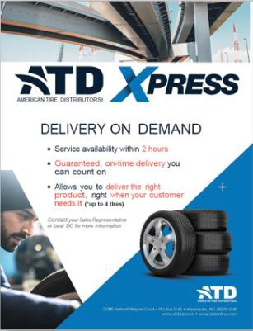
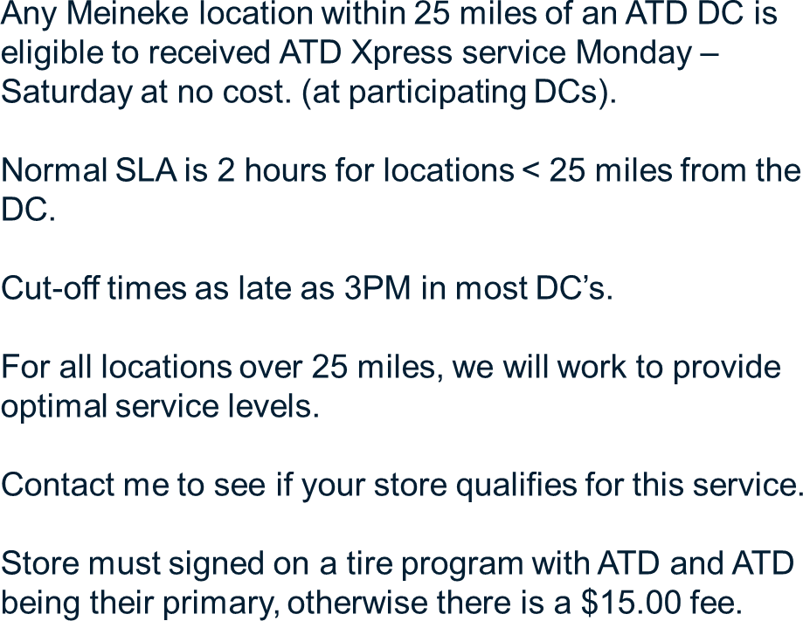
ATD Xpress

Slide 22
ATD Tire Protection Plan
Road Hazard Replacement Warranty
Free replacement for 12 months/12,000 miles,
whichever comes first.
After that period prorated down to a tread depth of 2/32” or a maximum of four years.
Flat Tire Changing Assistance
Available for 24 months from the date of purchase. Customer is eligible for claims in the period of up to
$75 each.
Free Flat Repairs, Inspections, and Air Checks within
Meineke network.
The Tire Protection Plan is supported by Automotive Business Solutions (ABS) with over 50,000 nationwide network members.
$25.00 per month per locations
If a warranty issue arises within 25 miles of the original servicing location, they return to that dealer for warranty repairs and the dealer is responsible for that claim. Should the consumer be outside of the 25 miles radius they call ABS to find the nearest servicing location.

Slide 23
ATD Tire Protection Plan
Description | Price on Site
TIRE PROTECTION PLAN (1 PACK of 250 / PK) | $14.95
SERVICE PROTECTION PLAN SERVICE PROS (1 PACK of 250/PK) | $14.95
TIRE PROTECTION PLAN POSTER 1EA | $4.95
SERVICE PROTECTION PLAN POSTER 1EA | $4.95
DRIVE W/CONFIDENCE COUNTER CARD 1EA | $7.95
DRIVE WITH CONFIDENCE TIRE INSERT 1EA | $8.95
PROTECTION PLUS SERVICE PROTECTION PLAN FOLDERS | $13.95
PROTECTION PLUS TIRE PROTECTION PLAN FOLDERS | $13.95

Slide 24
National preferred pricing program
The MDA and ATD have built a national pricing program that we offer as part of the program, so that no
matter where you are in the US, you will get this national price when you enroll through MDA.
ATD honors this pricing for 30 days so that it is a consistent program.

Slide 25
Thank you!

